Slide 1
Executive Committee
January 27, 2023

Slide 2
agenda

Slide 3
AGENDA
1. Call to Order
2. VOTE: Approval of Agenda
3. Minutes
4. REPORT & VOTE: Invoices
5. MIPA Update
6.Other Business
7. Adjournment

Slide 4
MINUTES

Slide 5
MPO Invoice

Slide 6
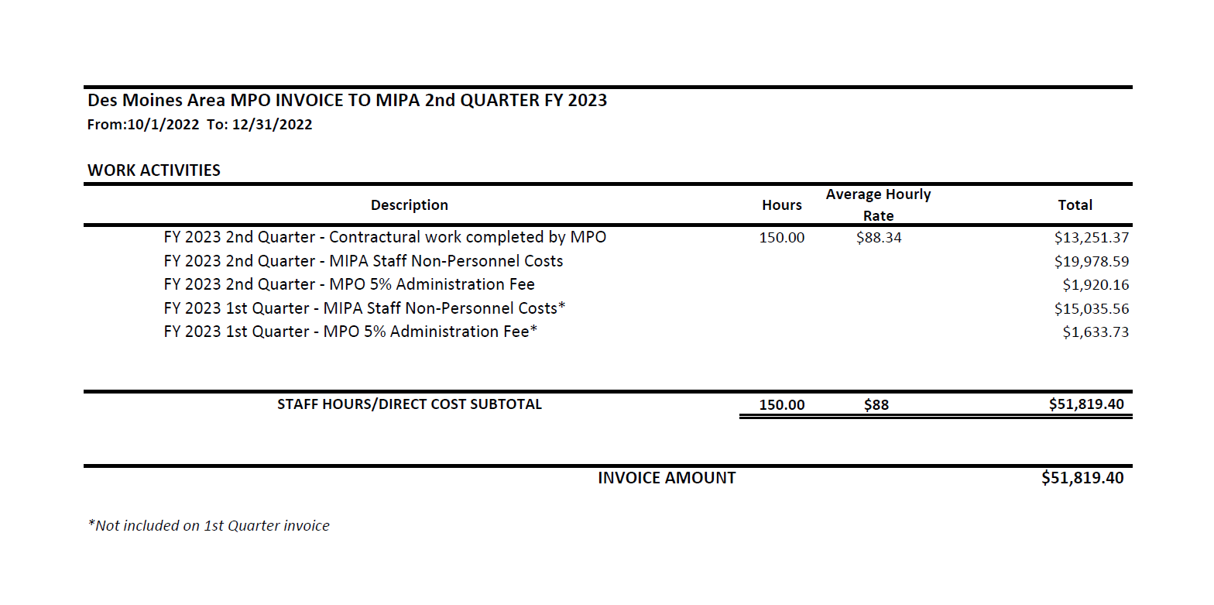

Slide 7
ISSUE: Invoices from MPO
REPORT: Staff will provide an overview of the invoice from MPO.
BACKGROUND:
The Des Moines Area MPO invoiced MIPA for 2nd quarter fiscal year 2023 $51,819.40 for staff hours.
RECOMMENDATION:
Consider vote to approve invoice.

Slide 8
MIPA Update

Slide 9
Contracts

Slide 10
Des Moines Area MPO Contracts
Des Moines Area MPO holds ongoing contracts with several central Iowa organizations for administrative and planning support, including:
  MIPA
  Central Iowa Regional Transportation Planning Alliance (CIRTPA)
  Central Iowa Housing Trust Fund
  Story County Housing Trust Fund
MPO also contracts with local governments for more on-time projects, including:
  Hartford Comprehensive Plan
  Marion County Zoning Code Update
  Melcher/Dallas grant assistance

Slide 11
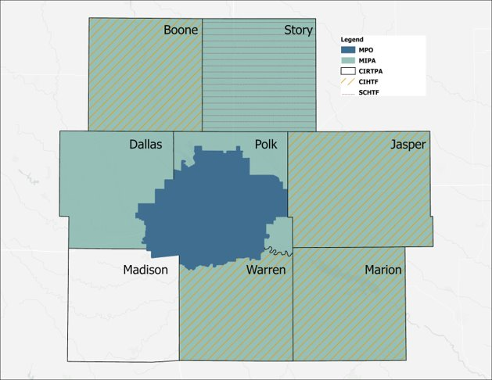
Des Moines Area MPO Contracts
CIRTPA (1994-present)
Polk County WMAs (2017-present)
  Polk Soil & Water (2017-2020)
  Polk County (2020-present)
Central Iowa Housing Trust Fund (2019-present)
Story County Housing Trust Fund (2022-present)
MIPA (2022-present)

Slide 12
Des Moines Area MPO Contracts
Contracts MPO holds were before creation of MIPA; staff’s intent was many of these contracts would move to MIPA eventually
Timeline to move may be accelerating - MPO board in ongoing discussions about future of its contracts
  Precipitated by potential Story County Housing Assistance contract in fall 2022
  Special meeting on strategic direction on contracts on January 12th
  Review of MPO strategic plan, 28E agreement, and other documents

Slide 13
Des Moines Area MPO Contracts
What is the Story County Housing Assistance Contract?
  An RFP was sent out by Story County to implement a housing action plan that was a result of the County’s Housing Needs Assessment. The only response was from the MPO and a contract was awarded for $191,000 over a 3-year period
  Discussion by the MPO board has centered around if the MPO or MIPA is the appropriate agency to fulfill this role
MIPA would appear to be the better fit because:
  Story County is a member government
  There are synergies with the Story County Housing Trust that may be staffed by MIPA
  Helps meet the requirements set forth by EDA, which will be discussed shortly

Slide 14
Review of MIPA Purpose
EDA-approved activities include:
  Coordinating and implementing economic development activities in the District;
  Carrying out economic development research, planning, implementation and advisory functions identified in the CEDS; and
  Coordinating the development and implementation of the CEDS with other local, State, Federal and private organizations

Slide 15
Review of MIPA Purpose
MIPA implementation of EDD-approved activities – what members get:
  Grant writing assistance and administration
  Technical assistance and consultation (~10 hours/member included)
  Opportunity to contract for more in-depth community development assistance
    Fee on top of membership dues to help ensure fairness in accessing limited MIPA staff resources

Slide 16
Impact of MPO’s Decision on MIPA – Things to Consider
Short-term:
  Is MIPA ready and able to take over contracts in FY 24 if MPO does not wish to continue?
    Particularly the housing trust funds and contracts with local governments for general planning assistance
    What fits MIPA’s mission and what does not?
  If taking on additional contracts, could/should MIPA expand staff and/or contract with MPO for staff assistance?
Long-term:
  Should MIPA one day not rely on the MPO for services?
  If so, how can MIPA grow to the point it is independent of the MPO?

Slide 17
Impact of MPO’s Decision on MIPA – Things to Consider
MIPA/MPO Relationship: MIPA contracts with MPO for administrative assistance, office space/overhead, and supplemental planning assistance
  MIPA Benefits:
    MIPA staff can focus on assisting MIPA members and let MPO staff deal with federal contracts
    MIPA staff can bounce ideas off of MPO planners
    Cost-savings for office space, benefits, etc.
  MPO Benefits:
    Revenue to help offset costs; keeps MPO dues down
    Additional experience for staff

Slide 18
Budget Development

Slide 19
FY 2024 Budget Development
Anticipated Costs (TBD, was $175,000 in FY 23)
  Salary and Benefits for MIPA staff
  Indirect costs for MIPA staff (part of MPO contract)
  Additional admin and planning staff support from MPO
Anticipated Revenue
  EDD Partnership Program grant: $70,000
  Membership Dues: $70,000
    Note any overage collected beyond $70,000 would be placed in reserve funds
  Contracts/grants (TBD, was $35,000 in FY 23)

Slide 20
FY 2024 Budget Development
Items for discussion
  Assessment rate - $0.15/capita yields ~$121,300 assuming membership stays the same as today
  MPO contract situation
    What, if any, contracts currently with MPO come to MIPA?
    Does MIPA contract with MPO grow accordingly to staff these?
  Does MIPA add staff outside MPO contract?
  Any other budget needs?

Slide 21
Upcoming meeting

Slide 22
Upcoming Meeting Dates
February 24th 10:00 AM
City of Adel
Dallas County

Slide 23
Other business

Slide 24
adjournment

