Slide 1
Executive Committee Meeting
October 27, 2023

Slide 2
October 27, 2023 AGENDA
Call to Order
VOTE: Approval of Agenda
VOTE: Approval of Meeting Minutes
REPORT and VOTE: Des Moines Area MPO Invoice to MIPA for the 1st Quarter of Fiscal Year 2024
REPORT and VOTE: CDBG Administration Contracts
REPORT and OPTIONAL VOTE: MIPA Transition Update
REPORT: Central Iowa Regional Transportation Planning Alliance Administration
Other Non-Action Items of Interest to the Committee
Next Meeting Date – 10:00 a.m., Friday, November 17, 2023, hybrid meeting
Adjournment

Slide 3
MPO 1st Quarter Invoice to MIPA
The MPO bills MIPA for work conducted on MIPA’s behalf on a quarterly basis
The 1st quarter invoice is available in the agenda packet

Slide 4
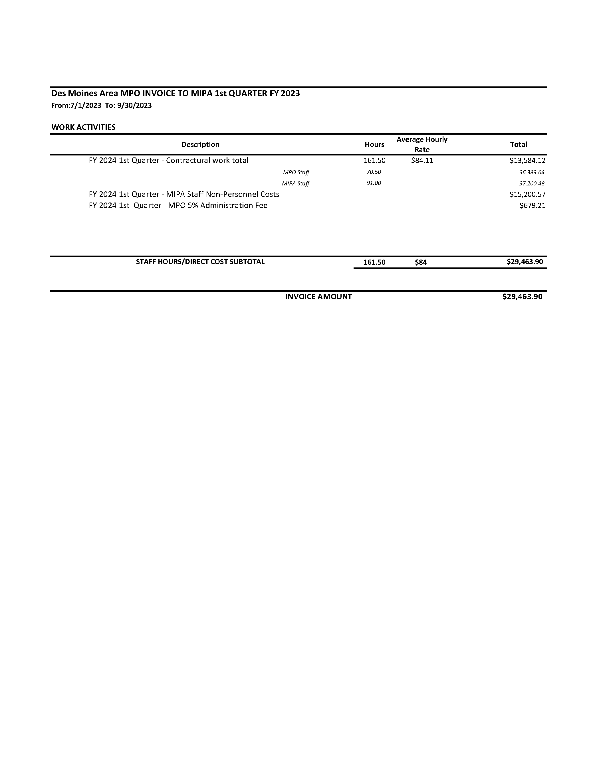
MPO 1st Quarter Invoice to MIPA
4

Slide 5
CDBG Administration Contracts
The City Knoxville and City of Nevada intend to apply for CDBG funding to improve the facades of their downtown businesses
As part of this process, IEDA requires certified administrators for the project to ensure compliance with CDBG federal regulations
The City of Knoxville and City of Nevada wish to hire MIPA to fill this role as all staff are CDBG certified
Each contract is for $30,000 to be paid for out of the CDBG grant from IEDA
The contracts would only become fully executed if the project is awarded CDBG funding

Slide 6
MIPA Transition
The MPO Board has indicated that MIPA must transition away from the MPO as the MPO Board intends to end all contracts with MIPA by the end of FY 2024 (June 30, 2024). Although not explicitly stated, the sooner that MIPA transitions away the better
With that understanding, MIPA staff released a Request for Information (RFI) to member communities and other interested regional partners (ISU, DMACC, Grand View University, etc.) in June to determine opportunities available for organizational operations

Slide 7
MIPA Transition
The RFI requested respondents to list the available services that they would be willing to provide, including:
      General Office Support
          Office Space
          Accounting, budgeting, and reporting
          Payroll and benefits administration
          Other general administrative support
        Planning Support
          GIS/data analysis
          Public involvement
          Advice and collaboration with MIPA staff

Slide 8
MIPA Transition
There were two responses, one for Planning Support and another for Office Space and Payroll and Benefits Administration (Story County). In either scenario, MIPA would still need to secure additional accounting and budgeting support in addition to other employee benefits (deferred comp, etc.), legal services, and other software (Microsoft office, GIS, etc.)
Current Scenario – MIPA contracts with the MPO for most services. Current services include:
  Rent, printing, and other office necessities
  Budgeting, accounting, and payroll
  Staffing support for projects

Slide 9
MIPA Transition
Scenario #1 – MIPA finds another organization to mimic the current arrangement
The MPO and MIPA are closely aligned due to the overlapping nature of the two organizations’ planning work and membership. There are very few organizations in the Mid-Iowa region that have a similar footprint and have the same interactions with state and federal programming

Slide 10
MIPA Transition
Scenario #1a – MIPA Negotiates with Story County
Since Story County was the only respondent to the RFI for multiple services, MIPA could negotiate for the items that the County included in its response. Mainly office space and payroll and benefits administration
With this scenario, MIPA would still need to secure budgeting and accounting services and employee benefits such as deferred compensation. While MIPA could potentially secure health, vision, and dental insurance through the County, it would be at COBRA prices which would be above the cost of the plan
Given some of the staffing changes that have occurred with Story County, the planning support that was included in the RFI response may not be available at this time
Summary - This scenario would have MIPA renting space from Story County and paying for benefits administration and payroll. However, MIPA would still need to secure a number of other resources that it currently receives from the MPO

Slide 11
MIPA Transition
Scenario #2 – MIPA is a separate organization
In this scenario, MIPA would not look to others for support staff or shared benefits. Each of the following scenarios are variations of MIPA securing needed services and equipment. Each will require additional staff or contracted services (e.g. accounting).

Slide 12
MIPA Transition
Scenario #2a – MIPA utilizes a shared workspace
There are a variety of shared workspaces that are available to companies or other non-profit organizations. These types of arrangements typically include many office amenities such as internet, printing and copying, and meeting & conference room access
MIPA would need to secure everything that is being provided by the MPO except for office space and general printing. This would most likely include hiring a firm or staff person for payroll, benefits, and accounting
Summary - This option may not be ideal for document storage or meeting the various requirements for public interaction that MIPA and the agencies administered by MIPA are required to follow.

Slide 13
MIPA Transition
Scenario #2b – MIPA rents office space from an organization/city/county
This scenario is similar to Scenario #2a whereby MIPA would still need secure everything necessary to function as an organization but would rent space from an agency rather than a shared workspace
Summary - Based on the responses received from the RFI, it does not appear that many communities or organizations are interested in this arrangement

Slide 14
MIPA Transition
Scenario #2c – MIPA is a virtual organization
This scenario represents MIPA on its own by securing all needed services, excluding rent. Rather, employees work from home or through an individual shared workspace
Summary - This scenario raises the same issues from a public accountability aspect as Scenario #2a. It also limits the ability for staff to work collaboratively on projects as employees would have to schedule meeting face to face ahead of time.

Slide 15
MIPA Transition
Scenario #2d – MIPA rents its own space
This scenario represents MIPA on its own by securing all needed services itself, including rent
Summary – This arrangement would allow the organization the greatest control of costs and flexibility in providing services to member communities. It also requires the most work to ensure all the organizational needs are met

Slide 16
MIPA Transition
Given the available scenarios, it is important for the MIPA Board to review and compare available goods and services. To facilitate that review, staff has grouped needed items into three categories.
Category #1 – Immediate need
Category #2 – Necessary items in a reasonable time frame
Category #3 – Potential items of need that are not immediate

Slide 17
MIPA Transition
Category #1 – Immediate need
  Payroll
  Employee insurance and other benefits
  Organizational insurance
  Accounting, banking, budgeting, and project management
  Computers and necessary software (Microsoft Office and ArcGIS)
  File storage and sharing
  Basic office supplies and filing
  Website and other technology access
  Policies and procedures manual
  Employee handbook

Slide 18
MIPA Transition
Category #2 – Necessary items in a reasonable time frame
  Office space – Including internet access and phone services
  Office furniture
  General office printing, copying, postage, etc.
  Meeting space
  OSHA and other required materials
Category #3 – Potential items of need that are not immediate
  Plotter for map printing
  Office Signs
To illustrate cost comparisons, staff has provided the following potential office space leases that are currently or will soon be available. Although office space is listed in Category #2, it is easier to find cost comparisons for illustrative purposes when compared to other Category #1 items

Slide 19
MIPA Transition
MIPA Office Cost Comparisons
Location | Cost | Size | What is included | Total Cost
MPO – Current | $26,329 (Budgeted) | ~400 sq feet | Rent, utilities, building costs | $26,329
7900 Hickman Road, Windsor Heights | $10.00 per SF | 1,858 SF | Includes utilities, building services, property expenses, other | $18,580
7506 Hickman Road, Windsor Heights | $11.00 per SF | 1,006 SF | May not include certain utilities, building services, and property expenses | $11,066 plus other costs
2600 Grand Avenue, Des Moines | $10.95 per SF | 1,000 SF | Does not include utilities, property expenses, or building services | $10,950 plus other costs
913 9th Street, West Des Moines | $18.23 per SF | 988 SF | May not include certain utilities, building services, and property expenses | $18,011.24 plus other costs
3821 71st Street, Urbandale | $9.50 per SF | 1,200 SF | May not include certain utilities, building services, and property expenses | $11,400 plus other costs

Slide 20
MIPA Transition
As staff continues to review potential services and costs, Category #1 items will be prioritized first. Staffing benefits, including insurance and differed compensation, will most likely be the items that will take the longest to secure
Because insurance is only needed for two employees, it was advised that each potential vendor will have the same general costs. Therefore, it would be best to select an insurance vendor to work with for health, vision, and dental. Assured Partners was recommended and currently works with other EDDs and COGs in Iowa
Staff is requesting permission to begin working with Assured Partners to get quotes for employee insurance and other potential service vendors

Slide 21
CIRTPA Administration
Last month staff presented updates on CIRTPA activities, and the discussions being held to review administrative options available to CIRTPA
A CIRTPA Administration Subcommittee meeting was held on October 25 where the committee voted 4 – 0 to recommend to the full CIRTPA Technical and Policy Committees to hire MIPA to become the new organization administrators
Should CIRTPA and MIPA agree on administration terms, MIPA would be able to hire an additional staff person (Andrew Collings) and associated costs that would have a net positive gain to the overall MIPA budget

Slide 22
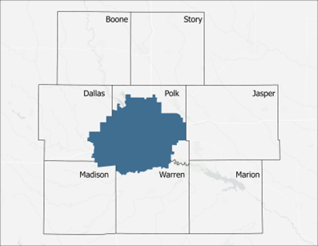
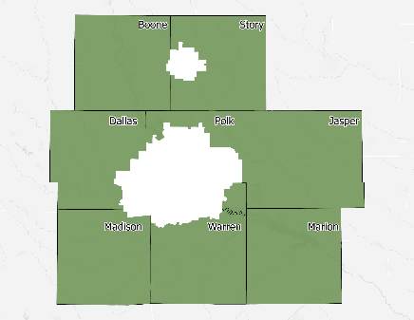
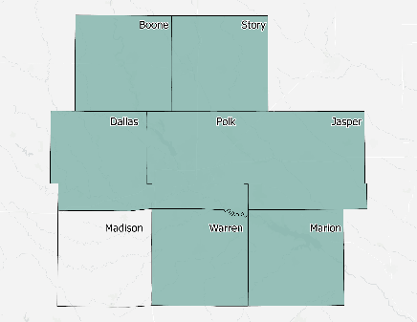
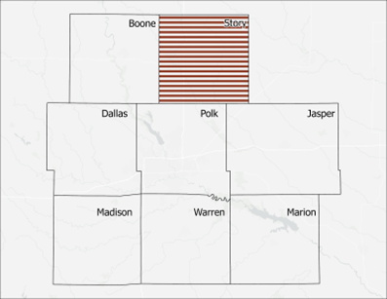
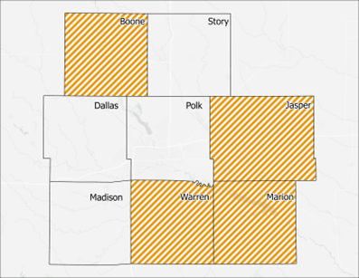
Des Moines Area Metropolitan Planning Organization
Chair: Bob Andeweg, Urbandale Mayor
Central Iowa Regional Transportation Alliance (CIRTPA)
Chair: Anthony Brown, Adel City Administrator
Mid Iowa Planning Alliance for Community Development (MIPA)
Chair: Brenda Dryer, Ames Chamber of Commerce
Story County Housing Trust Fund
Chair: Amber Corrieri, Ames City Council
Central IA Housing Trust Fund
Chair: Deven Markley, Carlisle City Administrator
Activities
Facilitate federal transportation funding; multimodal transportation planning
Activities
Facilitate federal transportation funding; multimodal transportation planning
Activities
Grant writing and administration; general planning assistance; infrastructure planning for economic development
Activities
Funds programs that support and advance affordable housing
Activities
Funds programs that support and advance affordable housing
Organizational Structure
28E organization
Policy Committee, Executive Committee, & Technical Committee
Organizational Structure
28E organization
Policy Committee & Tech. Committee
Organizational Structure
501c4 non-profit
Board of Directors & Exec Committee
Organizational Structure
501c3 non-profit
Board of Directors
Organizational Structure
501c3 non-profit
Board of Directors
Budget Revenue Sources
US Department of Transportation
(~$1.2 million in FY 23)
MPO Member Dues
($1/capita, ~$575,000 in FY 23)
Contracts with partner organizations
(TBD annually, ~$300,000 in FY 23)
Budget Revenue Sources
IA Department of Transportation
(~$82,000 in FY 23)
Member Dues
($0.13/capita, ~$28,000 in FY 23)
Budget Revenue Sources
US Economic Development Admin.
($70,000)
Member Dues
($0.15/capita, $70,000)
Contracts with members
(TBD annually, ~$35,000 in FY 23)
Budget Revenue Sources
IA Finance Authority
(10% of housing program dollars provided to the area by formula, ~$30,900 in FY 23)
Budget Revenue Sources
IA Finance Authority
(10% of housing program dollars provided to the area by formula, ~$46,000 in FY 23)
Regional Investment
$305 million in STBG/TAP since 1995
Regional Investment
$79 million in STBG/TAP since 2010
Regional Investment
$5 million in grant awards since 2019
*Note – some funds received for MIPA communities prior to MIPA’s official formation in 2022
Regional Investment
$1.2 million in housing assistance since 2018
*Note – organization formed in 2018
Regional Investment
$1.5 million in housing assistance since 2020
*Note – organization formed in 2020

Slide 23
CIRTPA Administration
Likely timeline
October 25: CIRTPA Administration Subcommittee recommendation vote
November 16: CIRTPA Technical and Policy Committee vote to enter into negotiations with MIPA for administrative services
November 17: MIPA Executive Committee vote to enter into negotiations with CIRTPA for administrative services
December through January 2024: Iowa DOT reviews and provides comments on a potential agreement between CIRTPA and MIPA. There is not a required timeline for review, therefore this is time for DOT staff to review necessary materials. This step may take longer given Iowa DOT staff turnover at key positions, however existing DOT staff is aware of this transition

Slide 24
CIRTPA Administration
Likely timeline
January 18: CIRTPA Board approves the administrative contract
January 26: MIPA Board approves the administrative contract
February TBD: CIRTPA gives the MPO 30 days notice to terminate the existing administrative contract
April 1: Effective date of the administrative contract with MIPA

Slide 25
October 27, 2023 AGENDA
Call to Order
VOTE: Approval of Agenda
VOTE: Approval of Meeting Minutes
REPORT and VOTE: Des Moines Area MPO Invoice to MIPA for the 1st Quarter of Fiscal Year 2024
REPORT and VOTE: CDBG Administration Contracts
REPORT and OPTIONAL VOTE: MIPA Transition Update
REPORT: Central Iowa Regional Transportation Planning Alliance Administration
Other Non-Action Items of Interest to the Committee
Next Meeting Date – 10:00 a.m., Friday, November 17, 2023, hybrid meeting
Adjournment

