Slide 1
Executive Committee Meeting
February 23, 2024

Slide 2
February 23, 2024 AGENDA
Call to Order
VOTE: Approval of Agenda
VOTE: Approval of Meeting Minutes
REPORT and VOTE: Planning Services Agreement with CIRTPA
REPORT and VOTE: MIPA FY 2024 Budget Amendment
REPORT and VOTE: Office Space and General Transition Update
REPORT and VOTE: Hiring Committee Update
REPORT: MIPA FY 2025 Work Program and Budget Draft
REPORT: MIPA Handbook and Policies and Procedures Manual Drafts
Other Non-Action Items of Interest to the Committee
Next Meeting Date – March 29, 2024
Adjournment

Slide 3
CIRTPA Planning Services Agreement
Staff continues to work with Iowa DOT regarding MIPA provided planning services to CIRTPA
Most notably, a draft FY 2024 Unified Program and Work Plan (UPWP) that incorporates MIPA’s budget, income, and cost structure has been submitted to the DOT for review
A planning services agreement between MIPA and CIRTPA has been prepared that is based on the existing agreement between the MPO and CIRTPA

Slide 4
CIRTPA Planning Services Agreement
Timeline
February 23: MIPA Executive Committee approves the planning services contract
February 26: CIRTPA Board approves the planning services contract and CIRTPA gives the MPO 30 days notice to terminate the existing planning services contract
April 1: Effective date of the planning services contract with MIPA

Slide 5
FY 2024 Budget Amendment
A budget amendment for FY 2024 is needed to incorporate additional income and expenditures
  Additional Staff (Senior Planner and Bookkeeper)
  CIRTPA contract
  Expenses related to MIPA’s transition

Slide 6
FY 2024 Budget Amendment
Cost Breakdown - FY 2024 (Draft)
 | Original Amount | 1-3 Quarters | 4th Quarter | Total New | % Change
( a ) Salaries and Wages | $108,495 | $81,371 | $62,188 | $143,559 | 32%
( a1 ) Salaries (minus paid leave) | $98,895 | $74,171 | $59,628 | $133,799 | 35%
( a2 ) Wages | $9,600 | $7,200 | $2,560 | $9,760 | 2%
( b ) Fringe Benefits | $77,418 | $58,063 | $25,871 | $83,934 | 8%
( b1 ) Paid Leave | $16,409 | $12,306 | $7,501 | $19,808 | 21%
( b2 ) Other | $61,009 | $45,757 | $18,370 | $64,126 | 5%
( c ) Salaries and Wages + Fringe Benefits | $185,912 | $139,434 | $88,059 | $227,494 | 22%
( d ) Non-Personnel Costs | $64,324 | $48,243 | $35,151 | $83,394 | 30%

Slide 7
FY 2024 Budget Amendment
 | Original Amount | 1-3 Quarters | 4th Quarter | Total New | % Change
( d ) Non-Personnel Costs | $64,324 | $48,243 | $35,151 | $83,394 | 30%
Facilities | $20,724 | $15,543 | $6,000 | $21,543 | 4%
Insurance (office) | $3,278 | $2,458 | $787 | $3,246 | -1%
Professional Services (Legal & Audit) | $8,964 | $6,723 | $2,306 | $9,029 | 1%
Payroll and Bank Fees | $0 | $0 | $750 | $750
Computers & Software | $7,872 | $5,904 | $8,875 | $14,779 | 88%
Telecommunications | $5,832 | $4,374 | $2,436 | $6,810 | 17%
Printing & Postage | $1,639 | $1,229 | $646 | $1,875 | 14%
Travel & Training | $5,000 | $3,750 | $2,375 | $6,125 | 23%
Mileage | $1,500 | $1,125 | $1,125 | $2,250 | 50%
Dues & Memberships | $5,000 | $3,750 | $0 | $3,750 | -25%
Equipment & Supplies | $3,213 | $2,410 | $3,375 | $5,785 | 80%
Publications & Subscriptions | $803 | $602 | $375 | $977 | 22%
Food & Beverage | $500 | $375 | $400 | $775 | 55%
CIHTF Audit and Support | $0 | $0 | $950 | $950
CIRTPA dTIMS | $0 | $0 | $3,500 | $3,500
CIRTPA Annual Audit | $0 | $0 | $1,250 | $1,250

Slide 8
FY 2024 Budget Amendment
 | Original Amount | 1-3 Quarters | 4th Quarter | Total New | % Change
( e ) Contract Costs | $88,258 | $66,193 | $0 | $66,193 | -25%
MPO Staff Support | $83,598 | $62,698 | $0 | $62,698 | -25%
Admin fee to MPO (5% of personnel costs, where allowed) | $4,660 | $3,495 | $0 | $3,495 | -25%
( f ) Total Costs | $338,494 | $253,871 | $123,210 | $377,081 | 11%

Slide 9
FY 2024 Budget Amendment
REVENUES |  | 1-3 Quarters | 4th Quarter | Total New | % Change
Membership Dues | $84,466 | $63,349 | $21,116 | $84,466 | 0%
EDD PP Match | $70,000 | $52,500 | $17,500 | $70,000 | 0%
Overage beyong match (for reserves) | $14,466 | $10,849 | $3,616 | $14,466 | 0%
US Economic Development Administration Partnership Program (EDD PP) | $70,000 | $52,500 | $17,500 | $70,000 | 0%
Contracts/Grants | $208,600 | $156,450 | $85,609 | $242,059 | 16%
Central Iowa Housing Trust Fund | $51,300 | $38,475 | $12,825 | $51,300 | 0%
Story Co. Housing Trust | $34,800 | $26,100 | $8,700 | $34,800 | 0%
Story Co. Housing Trust - ARPA | $20,000 | $15,000 | $5,000 | $20,000 | 0%
Story Co. Housing Plan Implementation | $73,000 | $54,750 | $18,250 | $73,000 | 0%
Marion Co. Subdivision Regulations | $20,000 | $15,000 | $0 | $15,000 | -25%
Marion Co. Comp Plan | $0 | $0 | $0 | $0
CIRTPA | $0 | $0 | $38,459 | $38,459
Norwalk Housing Assistance | $9,500 | $7,125 | $2,375 | $9,500 | 0%
TBD Contracts | $0 | $0 | $0 | $0
TOTAL REVENUES | $363,066 | $272,299 | $124,226 | $396,525 | 9%

Slide 10
FY 2024 Budget Amendment
 | 1-3 Quarters | 4th Quarter | Total New | % Change | 1-3 Quarters
TOTAL REVENUES | $363,066 | $272,299 | $124,226 | $396,525 | 9%
COSTS
Salaries, Wages, Benefits, and Indirect Costs | $250,236 | $187,677 | $123,210 | $310,888 | 24%
Salaries (minus PTO) | $98,895 | $74,171 | $59,628 | $133,799 | 35%
Benefits | $77,418 | $58,063 | $25,871 | $83,934 | 8%
Wages | $9,600 | $7,200 | $2,560 | $9,760 | 2%
Non-Personnel | $64,324 | $48,243 | $35,151 | $83,394 | 30%
Contract Costs | $88,258 | $66,193 | $0 | $66,193 | -25%
TOTAL COSTS | $338,494 | $253,871 | $123,210 | $377,081 | 11%
BALANCE | $24,572 | $18,429 | $1,016 | $19,444 | -21%

Slide 11
Office Space and General Transition Update
Transition Item | Status
Payroll | A payroll firm has been identified and funds set aside in the budget for services.
Employee Insurance (Health, Dental, Vision) | Paperwork is being prepared to establish employee insurance plans.
Deferred Compensation | The SIMPLE IRA plan company has been identified and funds incorporated into the budget.
Accounting | Hiring of a bookkeeper will move forward once an Executive Director has been identified.
Computer Equipment and IT | MMIT has provided cost estimates for needed services and equipment.
Office Space | A commercial realty agent was used to analyze available office space in the Des Moines Metro including Ankeny, Clive, Johnston, Urbandale, West Des Moines, and Windsor Heights. Several spaces were toured, and a preferred alternative was identified.

Slide 12
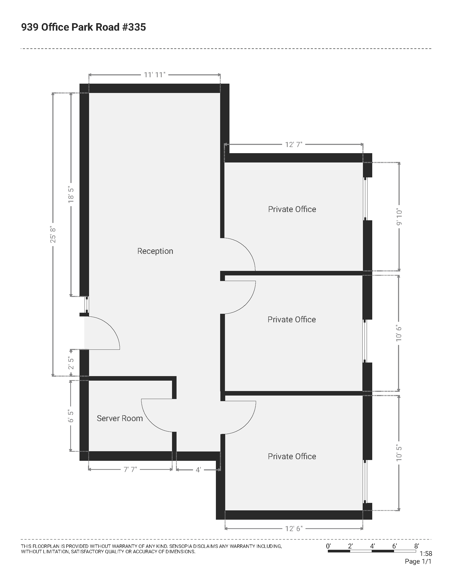
Office Space and General Transition Update
939 Office Park Road - #335, 1,090 SF

Slide 13
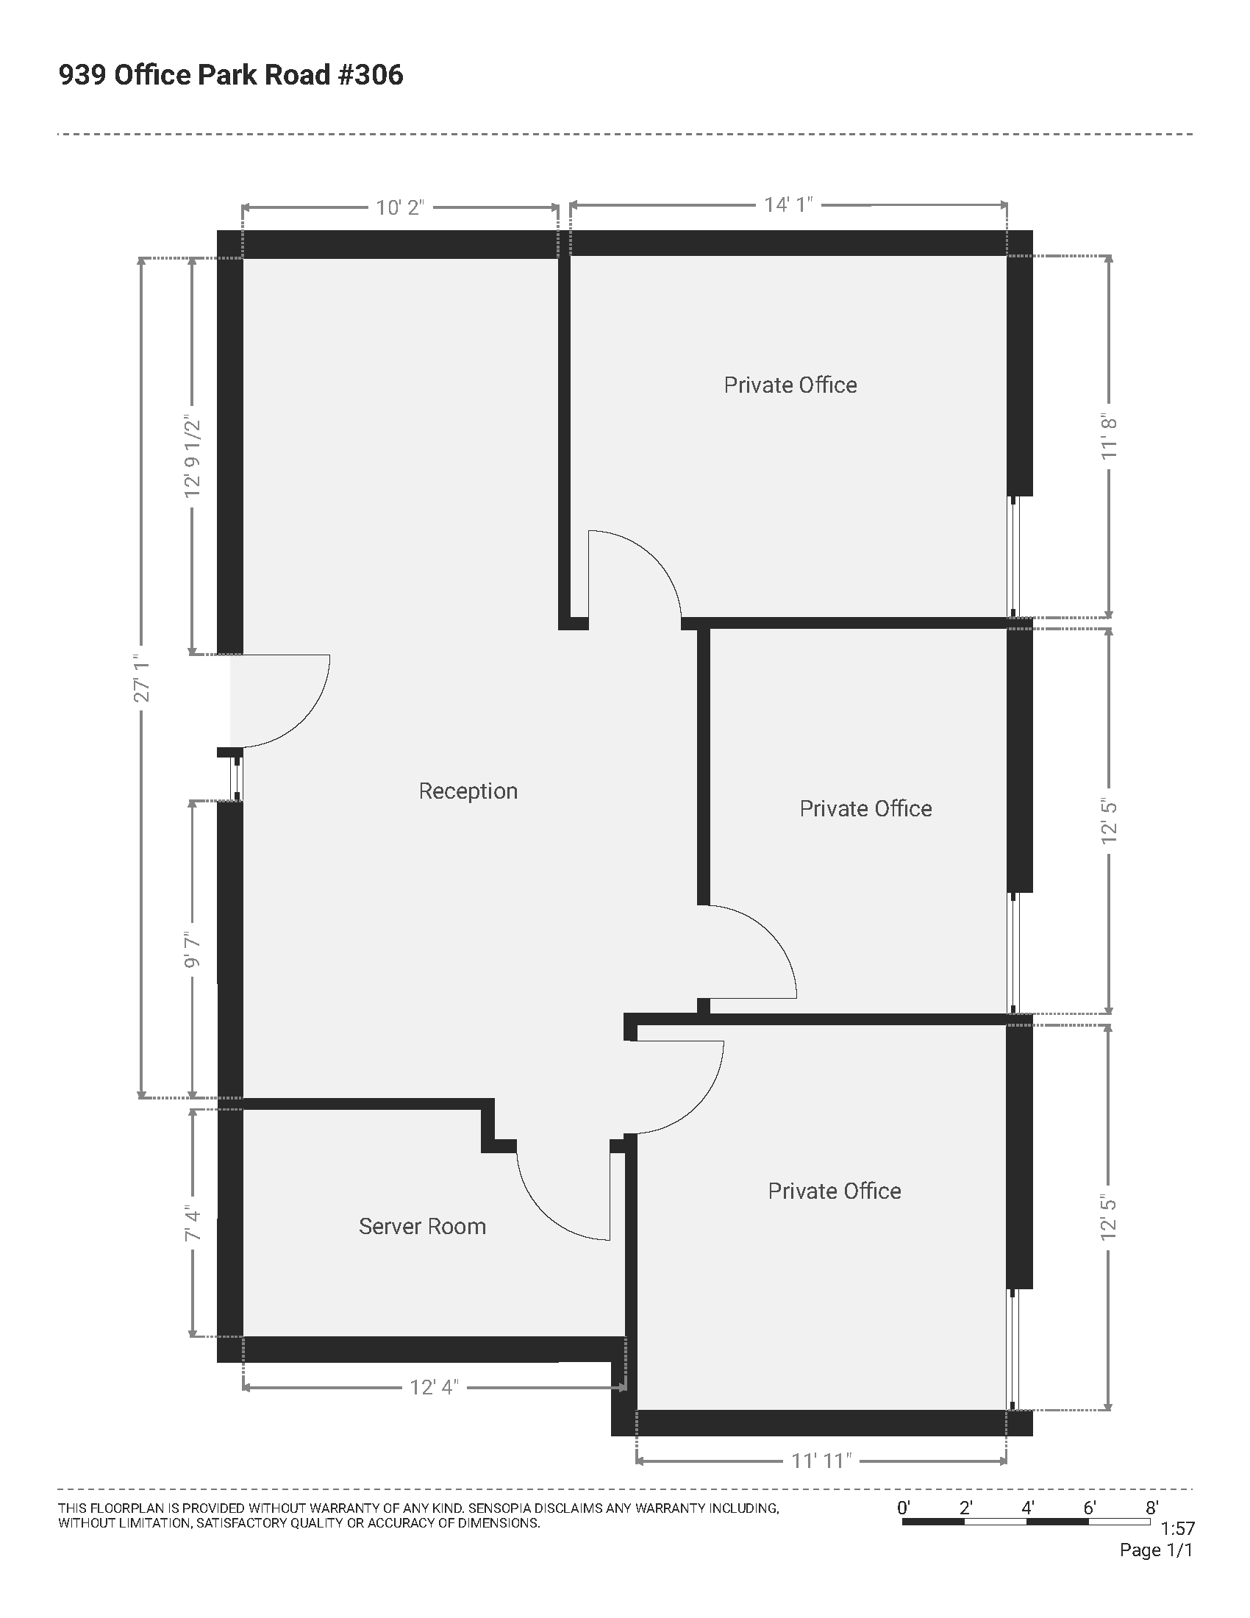
Office Space and General Transition Update
939 Office Park Road - #306, 1,200 SF

Slide 14
Office Space and General Transition Update
The following terms have been offered with an all-inclusive rent:
3 year: $15.75 PSF with 3% annual increases
5 year: $15.25 PSF with 2.5% annual increases
Includes one (1) wall, new carpet and paint.
The total cost per year is within the funding set aside in the budget for rent. The next step is to negotiate a lease.

Slide 15
Hiring Committee Update
The Hiring Committee consists of:
  Supervisor Linda Murken – Story County
  Glenn Lyons – City of Knoxville
  Luke Parris – City of Norwalk
The Hiring Committee will serve as an Interview Committee and make a recommendation to the Executive Committee
  Job postings to all MIPA staff – March 1
  Employee interest of position notification – March 11
  Interviews – March 18
  Recommendation to MIPA Executive Committee – March 29

Slide 16
FY 2025 Work Program and Budget Draft
Cost Breakdown - FY 2025 (Draft)
( a ) Salaries and Wages | $273,979
( a1 ) Salaries (minus paid leave) | $264,379
( a2 ) Wages | $9,600
( b ) Fringe Benefits | $114,768
( b1 ) Paid Leave | $39,197
( b2 ) Other | $75,571
( c ) Salaries and Wages + Fringe Benefits | $388,747
( d ) Non-Personnel Costs | $128,882
( d ) Non-Personnel Costs | $128,882
Facilities | $26,329
Insurance (office) | $5,149
Professional Services (Legal & Audit) | $9,225
Payroll and Bank Fees | $3,500
Computers & Software | $10,200
Telecommunications | $9,744
Printing & Postage | $2,585
Travel & Training | $9,500
MIPA Mileage | $5,000
Dues & Memberships | $8,250
Equipment & Supplies | $4,500
Publications & Subscriptions | $2,000
Food and Beverage and Meeting Rooms | $1,600
CIHTF Audit and Support | $5,800
CIRTPA dTIMS | $14,000
CIRTPA Annual Audit | $5,000
CIRTPA Data Bike Support | $5,000
CIRTPA Mileage | $1,000
CIRTPA Food and Beverage | $500
( e ) Contract Costs | $0
Accounting/Back End Support
Admin fee to MPO (5% of personnel costs, where allowed) | $0
( f ) Total Costs | $517,629

Slide 17
FY 2025 Work Program and Budget Draft
REVENUES
Membership Dues | $85,986
EDD PP Match and Overage | $85,986
US Economic Development Administration Partnership Program (EDD PP) | $70,000
Contracts/Grants | $385,242
Central Iowa Housing Trust Fund | $51,660
Story Co. Housing Trust | $34,989
Story Co. Housing Trust - Housing Development | $10,000
Story County HP Implementation | $51,500
Norwalk Housing | $5,500
Marion County Comprehensive Plan | $45,000
Knoxville Comprehensive Plan | $10,000
Indianola CDBG Admin | $0
Knoxville CDBG Admin | $0
Martensdale CDBG Admin | $0
CIRTPA | $176,593
TBD Contracts | $0
TOTAL REVENUES | $541,228
COSTS
Salaries, Wages, Benefits, and Indirect Costs | $517,629
Salaries (minus PTO) | $264,379
Benefits | $114,768
Wages | $9,600
Non-Personnel | $128,882
Contract Costs | $0
TOTAL COSTS | $517,629
BALANCE | $23,599

Slide 18
MIPA Handbook and Policies and Procedures Manual Drafts
Staff has prepared a draft MIPA Handbook and draft MIPA Policies and Procedures Manual that are based on the recent work of the Des Moines Area MPO
Notable changes include:
  Loss of IPERS eligibility and other changes to differed compensation
  Changes to health insurance coverage, including the addition of a Health Savings Account (HSA)
  Changes to the vacation and sick time policies

Slide 19
Other Non-Action Items – Services Through CIRTPA
Due to CIRTPAs status as a 28E organization, it can access subscriptions and equipment purchases (including the standard state contract) at a cheaper cost compared to MIPA
As the transition continues staff will determine which items would benefit being purchased through CIRTPA and work to secure those purchases. MIPA would reimburse CIRTPA for purchased equipment and services and pay an additional fee (5%)

Slide 20
Other Non-Action Items – Services Through CIRTPA
Due to CIRTPAs status as a 28E organization, it can access subscriptions and equipment purchases (including the standard state contract) at a cheaper cost compared to MIPA
As the transition continues staff will determine which items would benefit being purchased through CIRTPA and work to secure those purchases. MIPA would reimburse CIRTPA for purchased equipment and services and pay an additional fee (5%)

Slide 21
February 23, 2024 AGENDA
Call to Order
VOTE: Approval of Agenda
VOTE: Approval of Meeting Minutes
REPORT and VOTE: Planning Services Agreement with CIRTPA
REPORT and VOTE: MIPA FY 2024 Budget Amendment
REPORT and VOTE: Office Space and General Transition Update
REPORT and VOTE: Hiring Committee Update
REPORT: MIPA FY 2025 Work Program and Budget Draft
REPORT: MIPA Handbook and Policies and Procedures Manual Drafts
Other Non-Action Items of Interest to the Committee
Next Meeting Date – March 29, 2024
Adjournment

