Slide 1
Executive Committee Meeting
January 26, 2024

Slide 2
January 26, 2024 AGENDA
Call to Order
VOTE: Approval of Agenda
VOTE: Approval of Meeting Minutes
CONSENT and VOTE: Contracts and Expenses
REPORT: Planning Services and Administration Agreement with CIRTPA
REPORT and VOTE: Transition Plan
REPORT and VOTE: Job Descriptions and Hiring of Staff
REPORT: FY 2025 Work Program and Budget Development
REPORT: Update on Board Representatives and Officers Selection
REPORT: Update from MIPA Staff
Other Non-Action Items of Interest to the Committee
Next Meeting Date – February 23, 2024
Adjournment

Slide 3
Contracts and Expenses
Contracts
VENDOR | PURPOSE | NOTES/INFORMATION | AMOUNT REQUESTED
City of Norwalk | Implementation of the City of Norwalk’s Owner-Occupied Repair Program | Continuation of services currently being provided to the City. | Up to $10,000.00
Expenses
VENDOR | PURPOSE | NOTES/INFORMATION | AMOUNT REQUESTED
Denman & Company LLC | Progress billing for the FY 2023 audit | Cost included in annual budget. | $3,000.00

Slide 4
CIRTPA Planning and Administration
In November, MIPA and CIRTPA voted to enter into negotiations for MIPA to provide planning and administration services
MIPA staff sent an email to Iowa DOT Systems Planning staff on December 1st to update them of the potential change with CIRTPA. Due to the holidays a meeting with Systems Planning staff was held on January 3rd.
Systems Planning and District 1 staff were present to continue discussion of what action steps are needed to transition administrative duties to MIPA by April 1st

Slide 5
CIRTPA Planning and Administration
Beyond Systems Planning and District 1 staff, other departments were identified that needed to be brought into the discussion. Those include:
  Program Management – To ensure project funding will continue to be programmed
  External Audits – To ensure that CIRTPA’s UPWP and cost structure are DOT compliant
  Finance – To ensure MIPA is setup correctly in the DOT’s system
Additional items from the DOT side will need to be reviewed, such as the funding agreement between CIRTPA and the DOT
CIRTPA staff identified April 1 as the transition date
At another meeting on January 23rd with the DOT and all identified departments it was determined that the April 1 transition deadline is attainable. The two items that were requested are a transition plan that Systems Planning staff will review and certification from EDA on indirect costs

Slide 6
CIRTPA Planning and Administration
Timeline
October 25: CIRTPA Administration Subcommittee recommendation vote
November 16: CIRTPA Technical and Policy Committee vote to enter into negotiations with MIPA for administrative services
November 17: MIPA Executive Committee vote to enter into negotiations with CIRTPA for administrative services
December through February 2024: Iowa DOT reviews and provides comments on a potential agreement between CIRTPA and MIPA. There is not a required timeline for review, therefore this is time for DOT staff to review necessary materials. This step may take longer given Iowa DOT staff turnover at key positions, however existing DOT staff is aware of this transition
Complete
Complete
Complete
Mostly Complete

Slide 7
CIRTPA Planning and Administration
Timeline
February 22: CIRTPA Board approves the administrative contract
February 23 MIPA Board approves the administrative contract
February 26: CIRTPA gives the MPO 30 days notice to terminate the existing administrative contract
April 1: Effective date of the administrative contract with MIPA

Slide 8
Transition Plan
The MPO Board has indicated that MIPA must transition away from the MPO as the MPO Board intends to end all contracts with MIPA by the end of FY 2024 (June 30, 2024).
Current Scenario – MIPA contracts with the MPO for most services. Current services include:
  Rent, printing, and other office necessities
  Budgeting, accounting, and payroll
  Staffing support for projects

Slide 9
Transition Plan
This situation will end at the end of FY 2024, if not earlier. There is no option to continue contracting with the MPO in any capacity
In conjunction with the ongoing negotiations with CIRTPA to provide planning and administrative services, the transition date away from the MPO has been identified as April 1
At the October MIPA Executive Committee Meeting staff presented on the various transition scenarios available to MIPA. To provide additional information for the Board, staff has prepared a transition report that takes the previously identified scenarios and adds additional context and information

Slide 10
Transition Plan - Scenario #1a – MIPA Negotiates with Story County
Identified Advantages
Story County has extensive experience with many organizational matters including accounting, HR, and project management, just to name a few. Working with such a qualified community would be beneficial in being able to access the accumulated institutional knowledge
MIPA has several ongoing contracts in Story County and organizational proximity would reduce the amount of ancillary costs (mileage) for those projects
Identified Obstacles
Being administered by Story County would not be to the same extent as the MPO and costs would be incurred in securing additional support (e.g. bookkeeping)
There are 8 counties that MIPA staff will need to serve (including CIRTPA communities) so an office location outside of a central location would put an increased cost and time burden on current, or future, employees
MIPA would be somewhat beholden to any cost increases (or decreases) from Story County. Currently as costs increase for the MPO, they increase proportionally for MIPA. Being a smaller organization MIPA has the ability to adjust services rendered or utilize cheaper alternatives to reduce costs as needed

Slide 11
Transition Plan - Scenario #2a – MIPA Utilizes a Shared Workspace
Identified Advantages
Renting space would be all inclusive for internet, furniture, printing, meeting space, etc. Making transitioning to a different office space easier than other alternatives
Identified Obstacles
MIPA and the organizations it administers utilize various state and federal funding which have document retention requirements. A shared workspace is not ideally situated for document storage
MIPA needs to be publicly accessible for meeting Iowa’s open meeting law and posting agendas. Shared work environments are not conducive to meet those requirements
Finding space for additional staff would increase costs more quickly than in other scenarios due to space being at a premium within a shared workspace environment. For example, there would be a $7,800 additional increase in office space costs for Collaboratedsm should another position be hired

Slide 12
Transition Plan - Scenario #2b – MIPA Rents Office Space from an Organization/City/County
Identified Advantages
Similar benefits as Scenario #1a and Scenario #2a, depending on the organization/city/county
Identified Obstacles
Similar obstacles to Scenario #1a and Scenario #2a, depending on the organization/city/county

Slide 13
Transition Plan - Scenario #2c – MIPA is a Virtual Organization
Identified Advantages
MIPA would save on certain non-personnel costs. These would include:
  Rent and Internet - $29,929
  Telephone - $1,688
  Furniture/Office Equipment - $4,500
  Total - $36,117
Would be the easiest environment to transition to, although printing and other similar office needs would need to be identified

Slide 14
Transition Plan - Scenario #2c – MIPA is a Virtual Organization
Identified Obstacles
Other costs would increase due to the decentralized nature of the organization.
  Additional Mileage - $10,000
  Internet for employees - $3,600
  Telephone for employees - $3,600
  Additional printing and hardware costs - $3,000
  Rent for document storage - $3,600
  Total - $23,800
Although MIPA would save approximately $12,000 a year, collaboration and communication would be conducted virtually amongst staff. There is a significant benefit for staff to have face to face communication, including for supervision
Document storage would still need to be centralized, so rent would be incurred. The public would also need contact information and a location to provide comments
For separation of duties, someone would need to prepare checks and invoices. Mailing checks for signature between multiple parties would slow down the ability to pay bills and conduct other financial matters. Driving checks around for signature would reduce the efficiency of support staff and increase costs

Slide 15
Transition Plan - Scenario #2d – MIPA rents its own space
Identified Advantages
MIPA would be established as its own identity and would be fully in control of the organization and costs
MIPA would not be tied to another organization or entity and have the potential to have to seek different accommodations years later (like with the MPO)
A centralized location would promote collaboration amongst staff and with member communities
As the organization grows there will be a solid foundation from which to incorporate new staff, ideas, and projects
Identified Obstacles
Requires the most amount of effort at the front end of the process to establish the MIPA organization
Is one of the more expensive options provided, however there is not a significant difference in costs between the various scenarios or when compared to the current MPO agreement

Slide 16
Category #1 – Immediate Need
Need/Scenario | Options | Recommendation
Payroll – Scenarios #2a, 2b, 2c, and 2d | Various payroll services exist in the central Iowa region. Examples include: Heartland Avail G&A Partners | Most payroll companies will cost generally about the same, $2,000/year. Heartland was previously utilized by the MPO so that is the recommendation due to familiarity, however all options are available.
Employee Insurance (Health) – All Scenarios | Staff is working with Assured Partners to provide a comparable insurance plan to the MPO. Several options are available: Wellmark (SimplyBlue, CompleteBlue, EnhancedBlue, HDHP) Unity Point POS United Health Care and other plans that are HMO, POS, and PPO The goal is to minimize impacts on employees as much as possible, while providing the greatest benefit to MIPA. | Utilize Wellmark’s HMO High Deductible Health Plan with a $5,500/$11,000 (single/family) deductible and maximum out of pocket. Pair that with a Health Savings Account (HSA) with $4,000 provided for single employees and $8,000 for family employees by MIPA. This would keep the same $1,500/$3,000 maximum out of pocket that employees currently have. Single employees would have a 90/10 split and 85/15 for family employees. Single employees would pay $430 per year ($36 a month) and family employees would pay $2,524 ($210 per month). Employees wishing to utilize a POS or PPO plan could do so and pay the difference in cost. This represents a savings of $3,310 per year for single employees and $4,365 for family employees, or a total of $7,675 per year to MIPA.
Employee Insurance (Vision and Dental) – All Scenarios | Wellmark currently provides vision and dental for employees through the MPO. Assured Partners utilizes Wellmark as well. | Continue using Wellmark for Vision and Dental Insurance with the same budgeted cost as FY 2024 of $2,297 per year.

Slide 17
Category #1 – Immediate Need
Need/Scenario | Options | Recommendation
Deferred Compensation – All Scenarios | MIPA currently has a 5% matching defined contribution plan (457(b)/401(a)) through the MPO and is administered through Principal. MIPA employees also receive IPERS through the portion of their salary that is paid through the MPO. MIPA is ineligible for IPERS and has several options available to establish a defined contribution plan. These include a 457(b)/401(a) or SIMPLE IRA, which can be established at various agencies like: Principal Vanguard T. Rowe Price | Due to the high cost of managing their plan, the MPO is leaving Principal for the Iowa Retirement Investors’ Club (RIC). MIPA is not eligible to utilize this opportunity. MIPA should establish a SIMPLE IRA at T. Rowe Price which will provide for a 3% matching defined contribution plan. SIMPLE IRAs don’t’ have a cost to the employer and employees who elect to receive notices electronically will have their fees waived as well. Because IPERS will no longer be eligible, and the match on investing is reduced, employee salaries should be increased to account for the reduction in benefits.
Other Employee Benefits – All Scenarios | This includes life insurance and short/long term disability. | Continue to provide these services at the budgeted rate of $7,336 per year.
Organizational Insurance – All Scenarios | The MPO and MIPA utilize Jester Insurance for Property, General Liability, Worker’s Compensation Coverage, and Umbrella Coverage. | Continue to provide these services at the budgeted rate of ~$3,000 a year.
Accounting – All Scenarios | MIPA utilizes the MPO for accounting services. MIPA can choose to hire an employee or hire an accounting firm to provide bookkeeping services. $45,000 is budgeted for either option. MIPA uses QuickBooks for income and expense tracking. | Hire a part-time 75% FTE bookkeeper. For separation of duties there will need to be someone to track income and expenses, get mail, as well as write checks (for the Director to sign). This position can also perform other administrative tasks as needed. Hiring an agency can also be completed, however services would most likely be limited to bookkeeping.

Slide 18
Category #1 – Immediate Need
Need/Scenario | Options | Recommendation
Computer Equipment (for employees), Necessary Software, and File Storage and Sharing –Scenarios #2a, 2b, 2c, and 2d | Each employee will have various computer equipment to use that has already been purchased while at the MPO. These include: Monitors Keyboard and mouse Computer (laptop/desktop) MMIT provides IT services for the MPO and has done so for several years. IT services are available through other companies such as ACCES, however each company provides roughly the same services. Microsoft products (word, excel, outlook, SharePoint, teams, etc.) would be secured through the IT vendor. Other software such as ESRI and QuickBooks will be purchased directly through the data vendor with funds that are currently budgeted. Currently, MIPA employees utilize a shared drive that is housed on a server located within the MPO. There are various software solutions available that would provide a similar setup for employees. These include: Dropbox - $1,000 a year Egnyte - $1,000 a year SharePoint – Included with Microsoft While consulting with MMIT they recommended the purchase of various hardware components to ensure a secure internal network. This includes a hardware firewall, ethernet switch, wireless access point, and a Packet Capture/Analysis device. This equipment is already utilized at the MPO for their internal network. The total cost for network equipment purchase would be $2,247. | Utilize the existing computer equipment that employees use and will be available during the transition. Continue to use MMIT for IT services for familiarity and continuity. Continue to purchase Microsoft products through MMIT and securing other software directly as needed. Utilize SharePoint as MIPA’s file storage and sharing software due to the cost being included with the Microsoft Office Suite. It can be mounted to each computer internally to mimic the exact file storage and sharing structure that is currently utilized. Once an office is selected, and as needed, purchase the required networking equipment.
Website and other technology access – All Scenarios | MIPA and associated organizational websites (CIRTPA, HTFs) all utilize wordpress.com. Each website was developed specifically within the wordpress.com environment. There is other software to use for website development however staff has access to each website and having each website within the same environment is beneficial to updating each website. | Continue to use wordpress.com for the website. In the future, investigate completing a website refresh for MIPA and associated organizations.
Policies and procedures booklet/manual, employee handbook, and job descriptions – All Scenarios | Draft policies and procedures manual, employee handbook, and job descriptions will be provided to the Board for review and approval. They will be based on the MPO’s documentation due to familiarity. The MPO recently updated all of their policies and associated materials so they are the most relevant documentation available. Other policies and procedures and employee handbook are available for review, however the MPO is the most relevant set of documents to meet federal requirements and which staff is most familiar. | Adopt a modified policies and procedures manual, employee handbook, and job descriptions.

Slide 19
Category #2 – Necessary items in a reasonable time frame
Need/Scenario | Options | Recommendation
Office Space – including internet access and phone services – Scenario #2d | As previously discussed, there are a variety of options available to MIPA for office space. In scenario #2d MIPA would rent office space in a traditional office environment. Options include: Renting space in the Des Moines metro area Renting space outside of the Des Moines metro in a larger community or county seat Renting/purchasing space in a smaller community MIPA has the budget to accommodate a variety of alternatives. During the October MIPA Executive Committee Meeting staff presented a variety of office space options across the Des Moines Metro Area that were all within the existing budgeted amount of $26,329. The Des Moines Metro was chosen due to the higher rent costs to illustrate the large number of potential options available. MIPA can also have a satellite office elsewhere in the region. Since both Des Moines and Ames are their own MSAs and MIPA does a significant amount of housing and other related work in Story County, it would make sense to have additional staff capacity in that area. MIPA also expects to continue to administer the SCHT and local presence has been requested at various times over the years. If office space cannot be secured by April 1 or if a preferred site is not ready in time, staff can work remotely until the office location is secured. Depending on office location, internet may or may not be provided. There is already funding in the budget to purchase internet if the office location does not have it available. MMIT has provided a cost for office phones and phone services for $1,688 a year. | Find an office somewhere within the Des Moines Metro area to fit four staff people due to the area’s central location within MIPA’s planning area and the residences of existing staff. Work with Story County to rent enough space for a desk to have a staff person present on a weekly basis. Utilize an Internet service provider at the location chosen for office space. Utilize MMIT to establish a phone system.
Office furniture and desks – Scenario #2d | Various new and used office furniture and desks area available from several retailers. Around $3,000 is available in the budget for purchasing basic items. | Purchase needed used items from a reputable office supply or furniture store.
General office printing, copying, and postage – Scenario #2d | Staff has received two quotes for the use of a copier and printer (combination machine) that can either be purchased outright or leased. Option 1 Option 2 Both options come with maintenance, service, and a printing allocation included. The MPO utilizes a postage machine with a yearly rent of $1,000 on top of the postage cost. MIPA could bulk purchase stamps without paying rent on a machine. | Lease Option 2 (the least expensive version) for printing and copying services. Bulk purchase postage stamps for office use.

Slide 20
Category #2 – Necessary items in a reasonable time frame
Need/Scenario | Options | Recommendation
Meeting Space – Scenario #2a, 2b, 2c, and 2d | There are many meeting spaces available for use. MIPA will most likely not be utilizing an office space which can accommodate large meetings, therefore MIPA may occasionally a need larger space when virtual is not appropriate. When a larger space is needed, meetings can be held throughout the MIPA region at member's available meeting space. The MPO has also offered to allow MIPA use its space for a nominal fee. | When a larger meeting space is needed, MIPA will make arrangements to find a suitable location specific to the meeting.
OSHA and other required HR posters –Scenario #2a, 2b, 2c, and 2d | There are HR firms that do provide these services. Staff can also research needed postings and request them from the prerequisite state or federal departments. | Utilize existing staff to collect and display OSHA and other HR related materials.

Slide 21
Category #3 – Potential items of need that are not immediate
Need/Scenario | Options | Recommendation
Plotter – Scenario #2a, 2b, 2c, and 2d | MIPA can purchase a plotter, however they can be expensive to the tune of $10k or more. MIPA can also purchase printing services from another vendor, such as FedEx Office. Used plotters can be purchased for $2k or more. | Pay for printing needs as they arise. Investigate possible purchase of a plotter in future years.
Office Signage – All Scenarios | MIPA will need to put signs up for the public to locate the office, either on a building, location signage, or office directory. Costs would be incurred one time and can be as little as needed. There is up to $1,000 in the budget for signage. | Determine signage needs based on office location.

Slide 22
Transition Timeline
Potential Transition Timeline to meet the April 1 deadline
Date/Time | Items to be addressed
January 26 MIPA Executive Committee Meeting | Decide office transition, presumably from the identified scenarios Adopt proposed job descriptions Post available jobs for staff applications Identify a committee to “hire” Staff begins identifying office space based on direction from the Board
Early to Mid February | Post bookkeeping position for hire or secure bookkeeping services based on direction from the Board Contract for Health, Vision, and Dental Insurance, deferred compensation, and other employee benefits subject to approval from the Board
February 22 CIRTPA Board Meeting | CIRTPA votes to terminate the contract with the MPO and contract with MIPA starting April 1
February 23 MIPA Executive Committee Meeting | Review draft policies and procedures manual and employee handbook Review applicants for positions and set up interviews Vote to provide planning and administrative services to CIRTPA starting April 1 Select office space
Early to Mid March | Work with various vendors to transition or secure needed software, equipment, furniture, insurance, and other items as identified in the needs above Hold interviews with candidates
March 29 MIPA Executive Committee Meeting | Hire staff person for CIRTPA position Hire staff for needed positions Execute a budget amendment to accommodate new funding and staff Hire Bookkeeping position (if applicable) Finalize anything needed for the transition
April 1 | Begin operations away from the MPO

Slide 23
Transition Budget
Current FY 2024 Budget
Total Costs | $341,774
Total Revenue | $395,422
Balance | $53,648
Potential Adjusted FY 2024 Budget (Annualized)
Total Costs | $735,197
Total Revenue | $766,903
Balance | $31,707
Potential FY 2025 Budget
Total Costs | $735,659
Total Revenue | $787,803
Balance | $50,144

Slide 24
Job Descriptions and Hiring of Staff
Since its inception, the MPO has been assisting MIPA in the hiring of employees. MIPA employees are currently split with the MPO 80/20 for the MPO to provide insurance and other employee benefits
To ensure consistency and equity in MIPA’s hiring process, MIPA should approve new job descriptions and either proceed with internal hires or post them to relevant hiring websites
By having existing staff reapply for available positions, it allows both the employee and MIPA the opportunity to affirm the upcoming employment arrangement. Existing employees were hired with certain expectations that are no longer relevant. It also allows for a more transparent hiring process

Slide 25
Job Descriptions and Hiring of Staff
Staff has prepared descriptions for the following positions:
  Executive Director
  Bookkeeper
  Senior Planner – Housing Focus
  Senior Planner – Community Development Focus
  Senior Planner – Transportation Focus
  Associate Planner
For the planner positions, both a senior and associate option will be made available for each position to account for entry level candidates that may apply
A hiring committee can be established to perform interviews and make recommendations to the Executive Committee. This is dependent on whether hiring is external

Slide 26
Job Descriptions and Hiring of Staff
Proposed Timeline
  January 26 MIPA Executive Committee Meeting – Approve of job descriptions and hiring process and establish a hiring committee
  Last week of January – Post jobs on relevant hiring websites or release to staff
  February 23 MIPA Executive Committee Meeting or Hiring Committee – Review candidate applications and schedule interviews
  Early to Mid-March - Hold candidate interviews
  March 29 MIPA Executive Committee Meeting – Approve the hiring of staff

Slide 27
FY 2025 Work Program and Budget
MIPA’s scope of work for next fiscal year
  Work elements and activities
  Committees
  Costs
Proposed work activities are tied to MIPA’s EDA requirements and CEDS
  Attract, retain, and expand business throughout Mid-Iowa Region
  Provide the necessary infrastructure to sustain and grow communities and businesses
  Attract, retain, and expand the workforce throughout Mid-Iowa
  Prepare the workforce to the evolving Mid-Iowa economy of today and into the future
  Bolster the economic resilience of Mid-Iowa by safeguarding our natural assets and through disaster avoidance and mitigation

Slide 28
FY 2025 Work Program and Budget
MIPA staff soliciting input on priorities for FY 2025
  Outward facing, planning-related efforts (i.e., plans, studies, research, technical assistance to communities)
  Internal facing, organizational efforts (i.e., strategic plan implementation, committee support, staff and board development, funding/resources)

Slide 29
Board Representatives and Officers Selection
MIPA staff will send member representative forms to communities who have not already submitted their board representative. Staff will also work with communities to select representatives for the Executive Committee and MIPA officers
The Executive Committee is selected from the members of the MIPA Board of Directors. Each county in the MIPA area selects three representatives, two public and one private, to serve on the Executive Committee
  January – Submit board representative
  February – Executive Committee members established, and officers selected
  March – New officers take effect

Slide 30
Staff Updates
MIPA staff will provide quarterly updates to the Executive Committee on recent work activities and upcoming work items

Slide 31
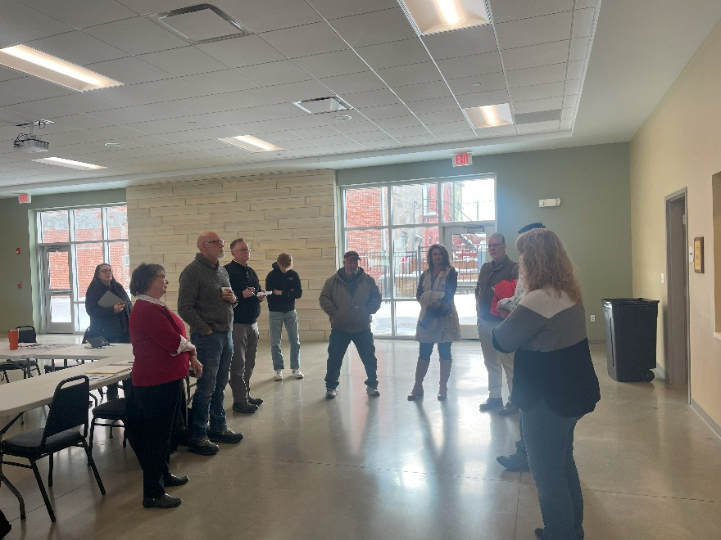
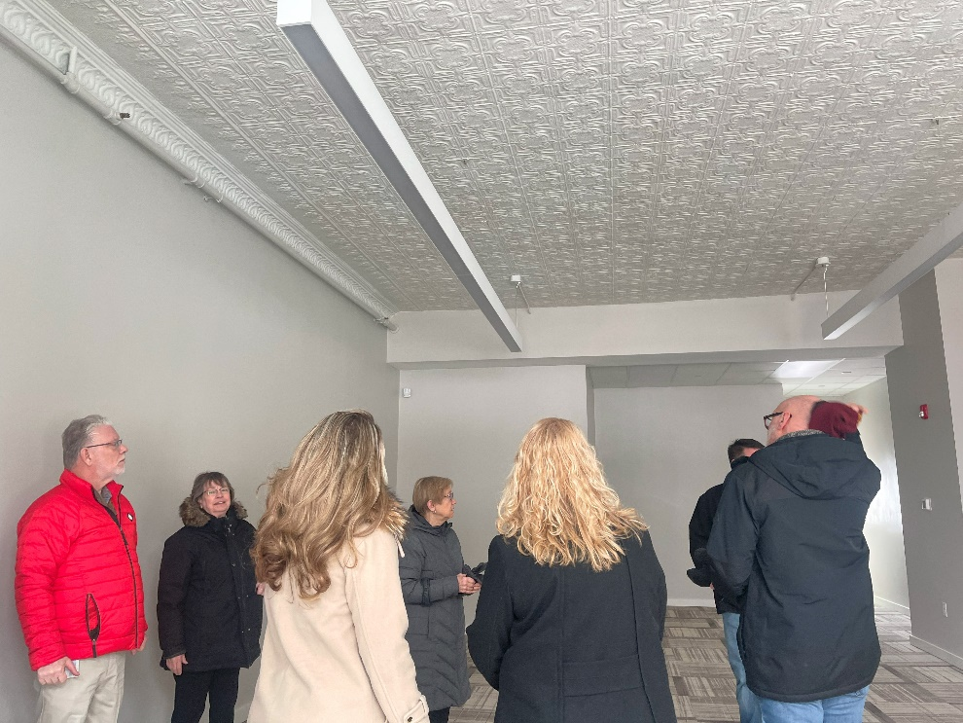
Cambridge Boost
One Cambridge's Steering Committee
Community visit & tour were great
Could’ve asked for a better Expert Boost team
Assisted with original application in 2022
Consulted with ERI Staff to improve second application
Consulted on second application that was awarded.

Slide 32
Broadband Equity, Access, & Deployment Program (BEAD)
Federal Broadband run through the State of Iowa
Reached out to Iowa Communication Alliance & Iowa Area Development Group to get a pulse on broadband post OCIO awards
MIPA submitted comments/responses to the initial BEAD proposal 12/15/23

Slide 33
Broadband Equity, Access, & Deployment Program (BEAD)
Applications will be in Iowa Grants
Applications must come from the broadband provider
Timeline still unknown
Process will be very similar to OCIO’s NOFO 8.
Equity arm of BEAD seems like a good fit for public librarys & public schools

Slide 34
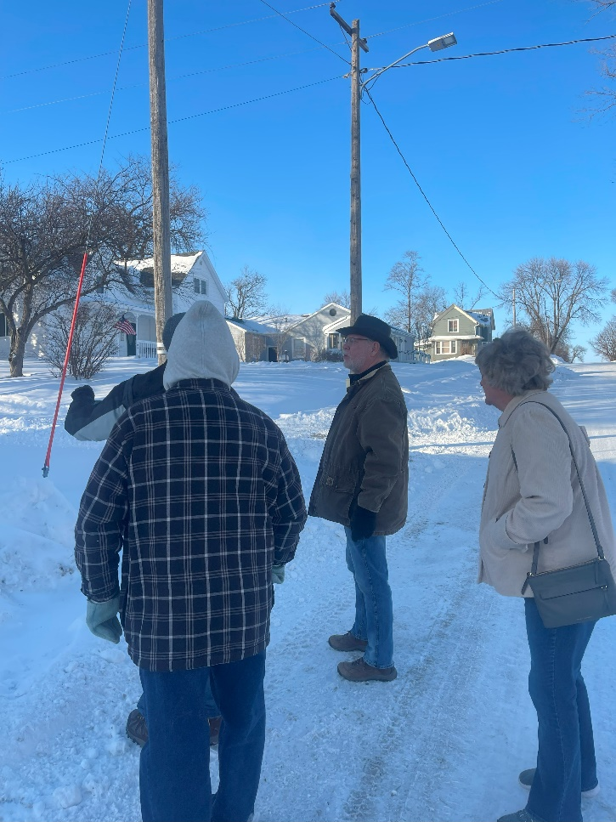
Zearing
Assisting with grant applications for 102 W Main St
Invited Jim Thompson from IEDA to see about Emergency Catalyst
  Moving forward with Emergency Catalyst & Derelict Building applications

Slide 35
Story County Housing Trust (SCHT)
Provide administration for the organization
  Execute monthly board meetings, process claims from grantees and work with the SCHT treasurer to make payments, submit drawdowns and required reporting to IFA
  Provide support to grantees to ensure projects are successful
  Participate in various Story County housing-focused work groups on behalf of the SCHT
Submitted 2024 application to IFA
  Awarded $349,890 including $34,989 in admin for MIPA
  Application window now open for Story County projects

Slide 36
Story County Housing Action Plan
    Implementation arm of the Story County Housing Study with action steps
    Meet regularly with Story County staff and Ames Economic Development Commission to execute the action steps
    Recent work on the action plan:
      Compilation of housing resources available to individuals
      Housing resource guide focused on community development
      Inventory of sites for potential development
      2 HFI houses underway
      Working with lenders on homebuyer assistance programs

Slide 37
SCHT - ARPA Funding
Awarded to the SCHT by the Story County Board of Supervisors
Funding for 2 Homes for Iowa (HFI) houses
  Nevada & McCallsburg
  Spring delivery
  Currently accepting bids for various phases of onsite construction
Funding for First-time Homebuyer Program
  $5,000 grants
  Recently submitted a request to the supervisors to modify the requirements to ensure the funds can be used

Slide 38
Central Iowa Housing Trust Fund (CIHTF)
Provide administration for the organization
  Execute periodic board meetings, process claims from and make payments to grantees, prepare and submit drawdowns and required reporting to IFA
  Provide support to grantees to ensure projects are successful
Submitted 2024 application to IFA
  Awarded $516,604 including $51,660 in admin for MIPA
  This week the CIHTF board approved 9 applications for projects throughout the CIHTF region

Slide 39
Norwalk LMI Housing Rehabilitation Program
Contract with the City of Norwalk
City is responsible for advertising the program/application
Determine if the household qualifies based on IFA income and asset guidelines
Work with the city to ensure the property is an appropriate candidate for the program
Perform any needed site inspections before and after work

Slide 40
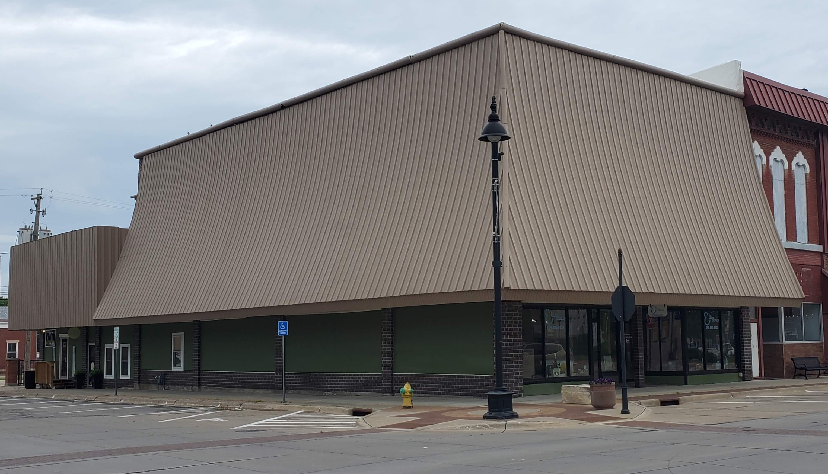
Knoxville CDBG Façade Project
IEDA officially closed out the Knoxville CDBG façade project at Elite Dance on December 19, 2023
This was the very first MIPA contract
MIPA staff living in Knoxville?

Slide 41
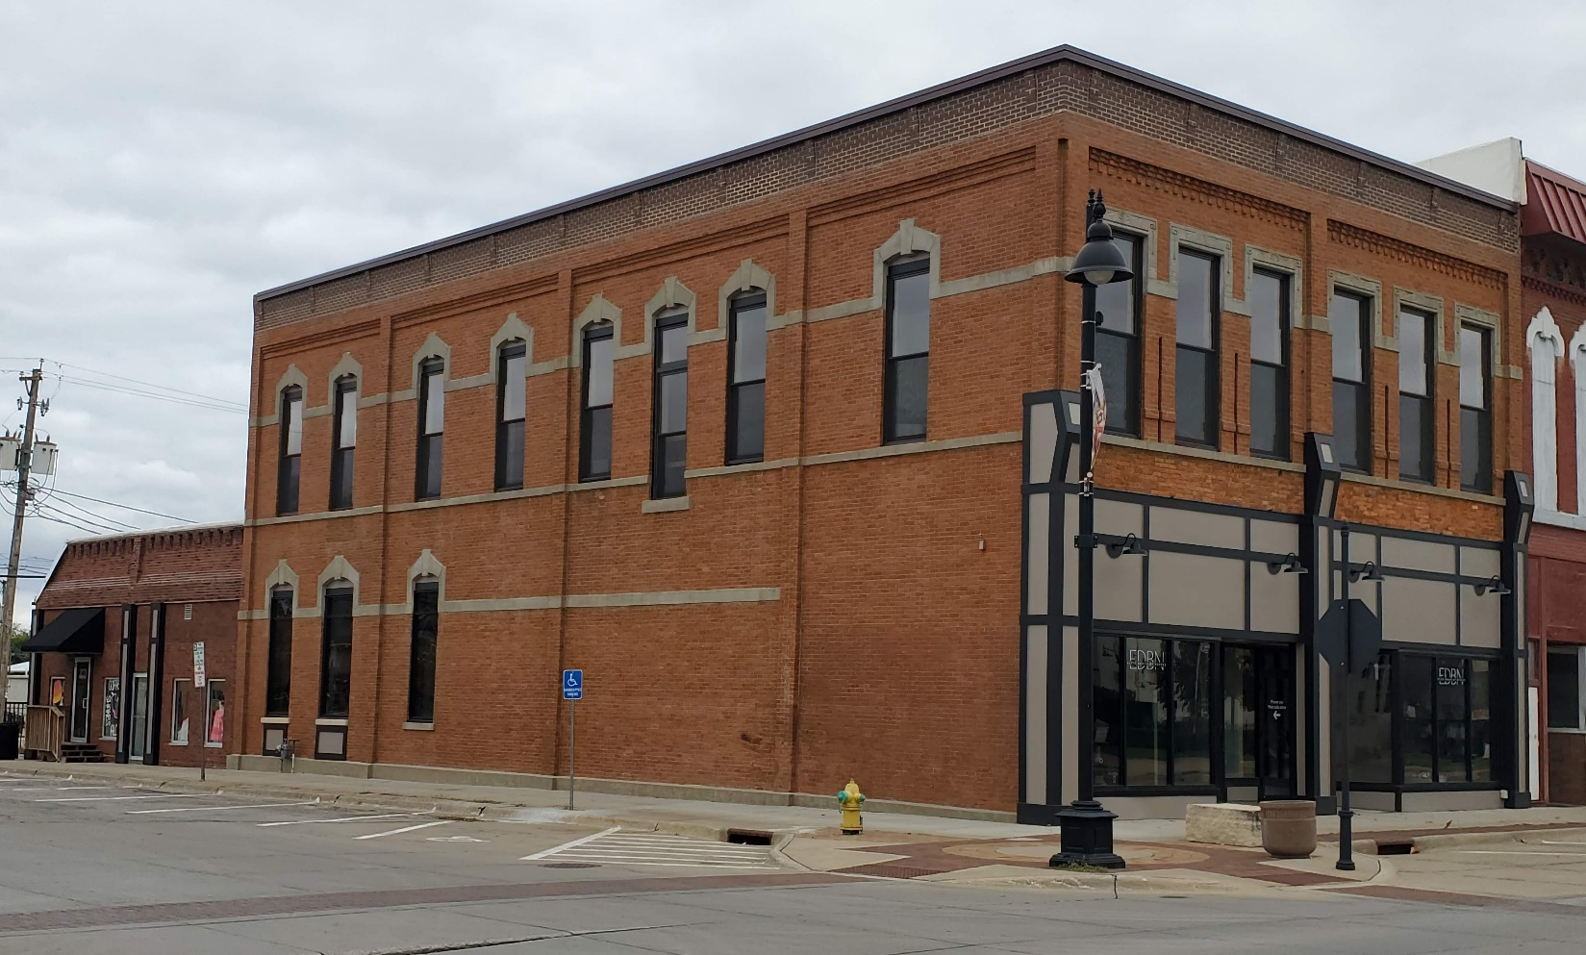
Knoxville CDBG Façade Project
Thank you to Knoxville for allowing MIPA to be a part of this project and congrats on your continued downtown revitalization

Slide 42
January 26, 2024 AGENDA
Call to Order
VOTE: Approval of Agenda
VOTE: Approval of Meeting Minutes
CONSENT and VOTE: Contracts and Expenses
REPORT: Planning Services and Administration Agreement with CIRTPA
REPORT and VOTE: Transition Plan
REPORT and VOTE: Job Descriptions and Hiring of Staff
REPORT: FY 2025 Work Program and Budget Development
REPORT: Update on Board Representatives and Officers Selection
REPORT: Update from MIPA Staff
Other Non-Action Items of Interest to the Committee
Next Meeting Date – February 23, 2024
Adjournment

