Slide 1

Board of directors Meeting
June 24, 2024

Slide 2

June 24, 2024 AGENDA
Call to Order
VOTE: Approval of Agenda
VOTE: Approval of Meeting Minutes
PRESENTATION: Iowa Northland Regional Council of Governments (INRCOG)
PRESENTATION: City of Knoxville
REPORT and VOTE: Fiscal Year 2025 Budget
REPORT and VOTE: MIPA Bylaws Update
REPORT and VOTE: MIPA Employee Handbook & Policies and Procedures Manual
REPORT and VOTE: Executive Director
REPORT: MIPA Transition Update
Other Non-Action Items of Interest to the Committee
Next Meeting Date – As needed in FY 2025
Adjournment

Slide 3
Mid Iowa Planning Alliance
June 24, 2024

Slide 4
ICOG Overview
17 Councils of Government
Codified in 28H of the Iowa Code (formed by 28E agreement)
Considered a “public” entity
Adhere to public requirements-open meetings, records, hearings
COG Directors serve as ICOG Board
Conduct staff training and education opportunities
Staffed by management consultant(s)

Slide 5
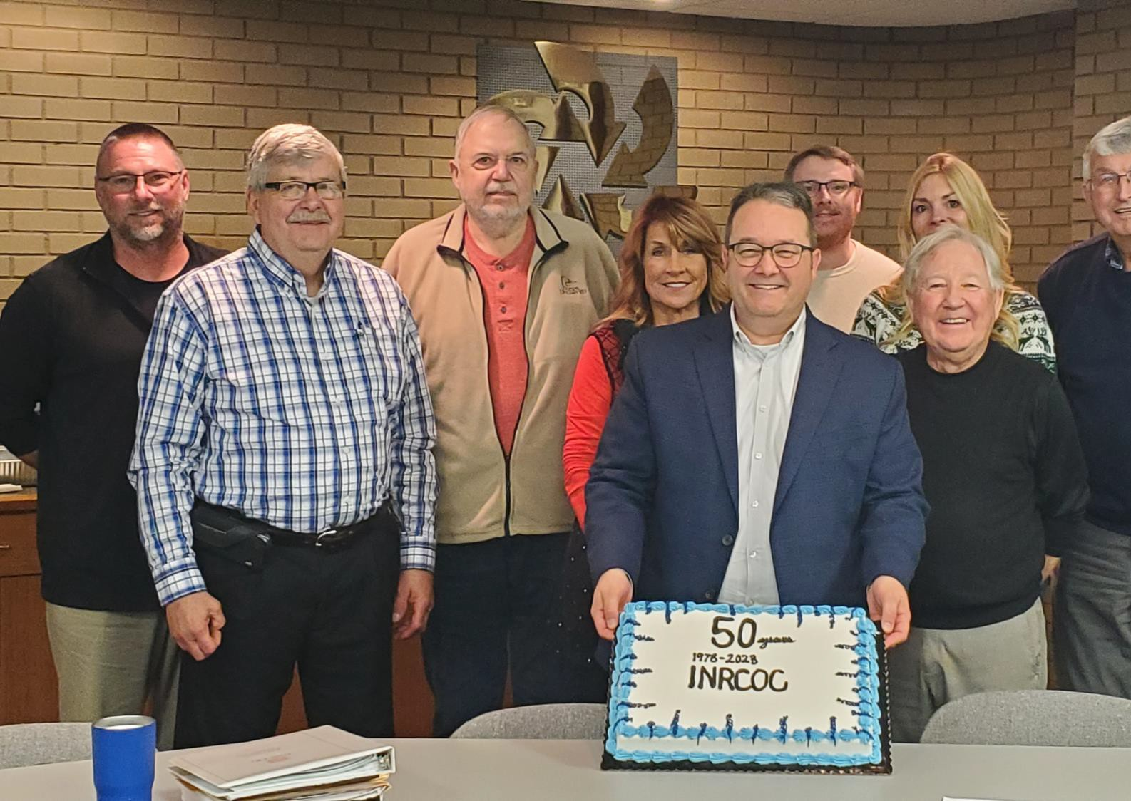

INRCOG
Overview
Voluntary association; formed in 1973; 6 counties; 54 cities; 215,000 persons…we view ourselves as an extension of member staff
Members pay dues ($0.54/person)
Board of Directors and Executive Board-Oversight
15 INRCOG employees; 16 RTC/OBPT drivers)
Umbrella for:
  Iowa Northland Regional Transit Commission/On
Board Public Transit
  Iowa Northland Regional Economic Development Commission
  Iowa Northland Regional Housing Council
  Metropolitan Transportation Organization (MPO)
  Iowa Northland Regional Transportation Authority

Slide 6
INRCOG Overview
Other Organizations:
  Waterloo Housing Trust Fund (NPO)
  Cedar River Partnership (NPO)
  Cedar Falls Housing Trust Fund (anticipated) (NPO)
  Safe Routes to School
  Iowa Waste Exchange
  Cedar Valley Coalition (volunteer)

Slide 7
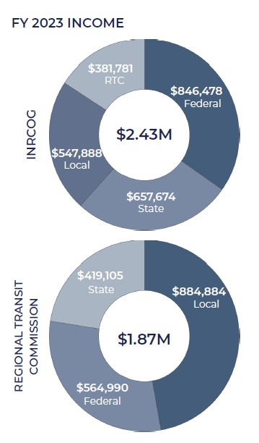
INRCOG Overview

Slide 8
INRCOG Overview
Budget ($5M for INRCOG and RTC/OBPT):
  Federal Funding Sources
    US Department of Commerce; Economic Development Administration (PPG; 2 RLFs; and project administration (fiber, whitewater currently))
    Community Development Block Grant (through IEDA and HUD-Entitlement Program)
    Homeland Security/FEMA (through HSEMD) (hazard mitigation plans, projects, buyouts, sirens, shelters)
    US Department of Agriculture-Housing Preservation Grant (New Hampton)
    Federal Home Loan Bank-Affordable Housing Grant (Regional)
    Federal Highway, Rail, and Transit Administrations (through IDOT)
    American Rescue Program (Destination Iowa-IEDA)
    Emergency Food and Shelter Program

Slide 9


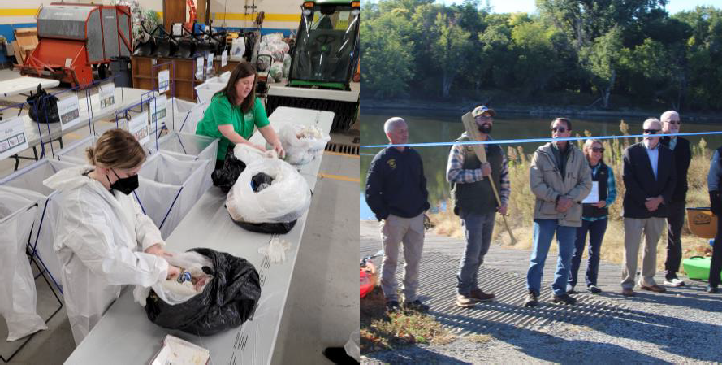
INRCOG Overview
Budget ($5M for INRCOG and RTC/OB):
  State Funding Sources
    Local Housing Trust Funds (through IFA)
    Housing Assistance Fund (ARPA through IFA)
    Resource Enhancement and Protection (REAP through IDNR)
    Water Trails Planning and Designation (through IDNR)
    Safe Routes to School-TAP; INRCOG, UERPC, IBC (through
IDOT)
    Iowa Waste Exchange-Region XII COG administers (through IDNR)
    Metro trail maps (land and water) (paper, QR Code- interactive) (MPO and/or RTA)

Slide 10
INRCOG Overview
Budget ($5M for INRCOG and RTC/OBPT):
  Local Funding Sources
    Membership Dues-per capita; used as program match for ED and transportation
    Local Contracts-Planning projects (i.e. Comprehensive plans, Zoning ordinances, Subdivision ordinances, 2-Mile agreements, Capital improvements programs)
    Mapping and GIS projects (zoning maps, tax abatement districts, tax increment financing
districts)

Slide 11

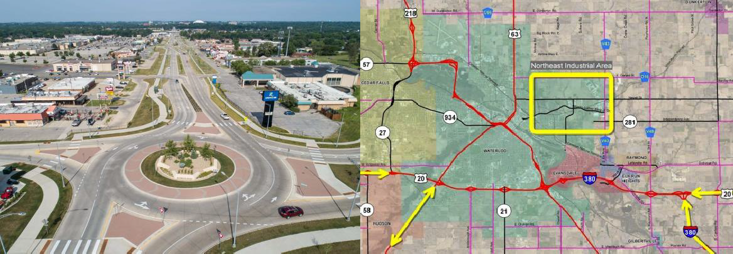
INRCOG Overview
Unique Projects (Recent)
  NE Bypass Study Project (metro area)
  Iowa Highway 58 Corridor Projects
(interchanges)
  University Avenue Redesign (road diet, roundabouts, other modes)
  Water Trail (Cedar River in Black Hawk
County) (plan and designation)
  Reconnecting Communities and Neighborhoods Grant

Slide 12
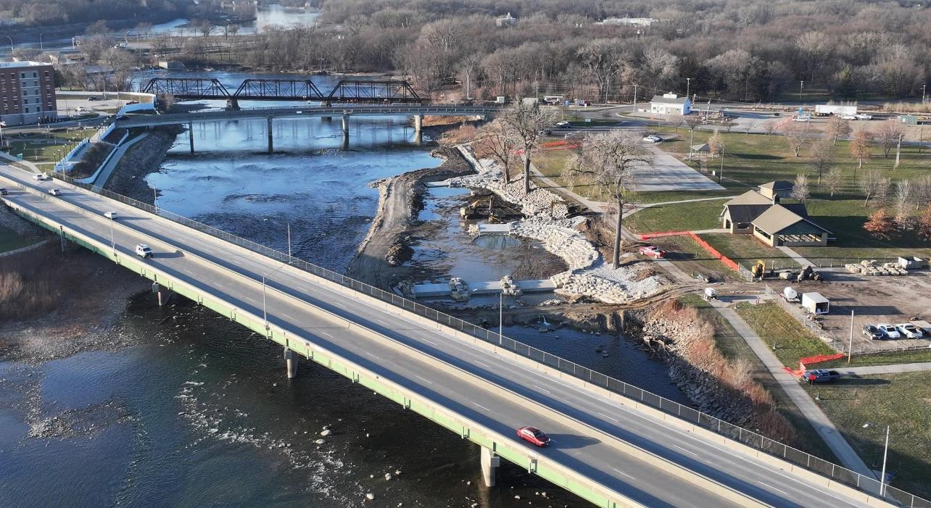

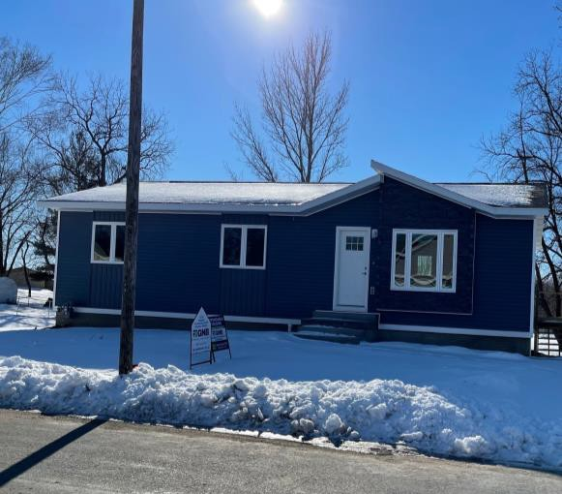
INRCOG Overview
Unique Projects (Recent)
  Neighborhoods Grant
  Railroad Crossing Elimination Program
  National Park Service-American WW II Heritage City Program
  Broadband/Fiber
  Whitewater Recreation Area (Gateway
Water Trail)
  Homes for Iowa

Slide 13
Thank you!
Brian Schoon, AICP
Executive Director INRCOG
229 East Park Avenue
Waterloo, Iowa 50703 bschoon@inrcog.org
(319) 235-0311

Slide 14


Slide 15


Knoxville: A Thriving Iowa Community
Sprint Car Capital
of the World
Des Moines Skydiving Club’s
New Home

Slide 16
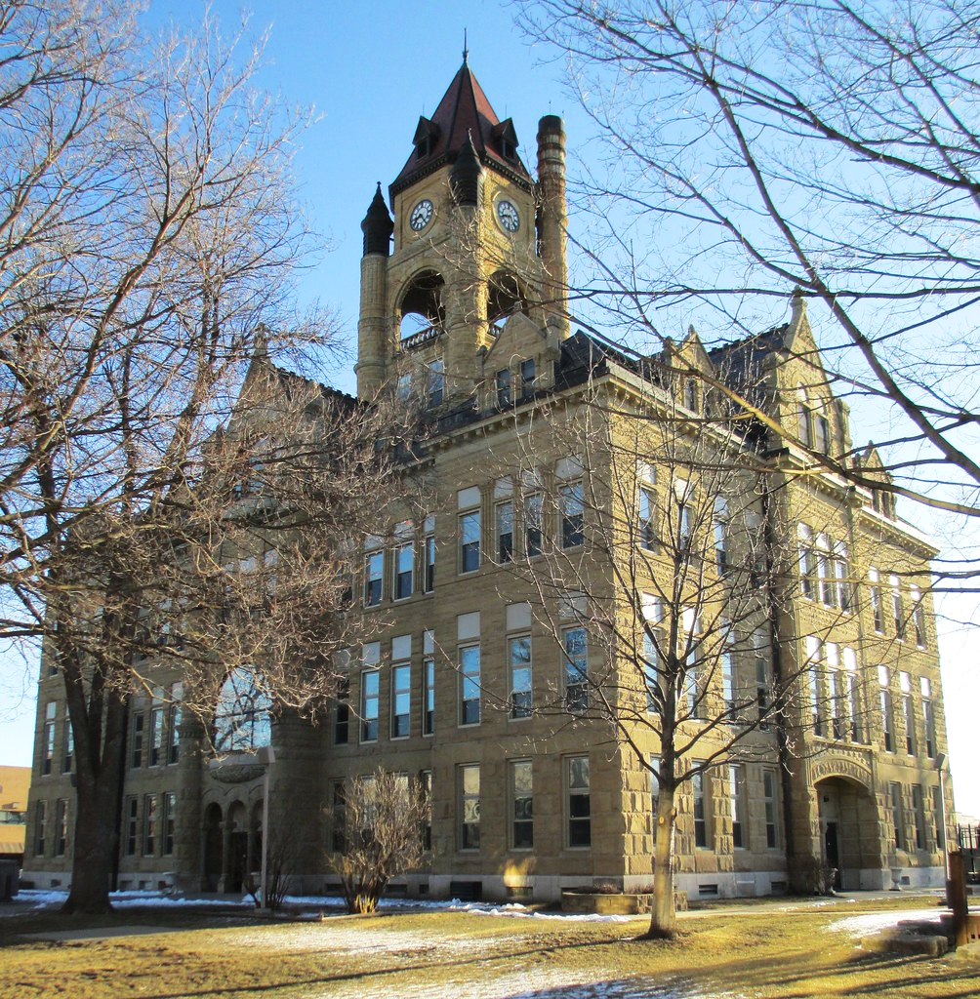
Knoxville
Marion County Seat
Home to 7,600 people
Population has grown over the last decade
Knoxville would have grown more if there hadn’t been a shortage of land for housing

Slide 17

Employment
Knoxville is a Manufacturing Center with 3M, Hormel and Weiler employing more than 1,500 people.
Twice as many manufacturing jobs per capita than the Iowa average
More people commute to work in Knoxville than travel to work elsewhere

Slide 18

Attractions
Red Rock Lake is the largest in Iowa, with many campgrounds
Sprint Car Nationals attract 25,000 visitors every August & offers 6 months of racing
National Sprint Car Hall of Fame attracts thousands and is open all year long

Slide 19

Civic Priorities
Housing
Downtown Revitalization
New Civic Building

Slide 20
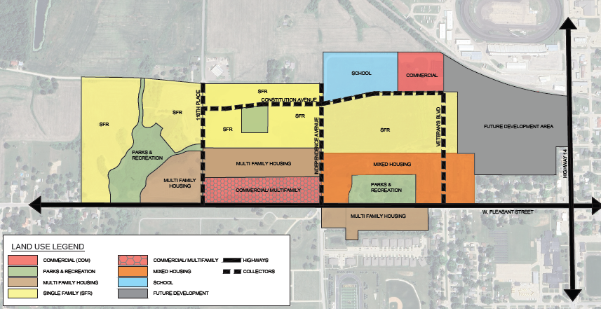
Housing – Veterans District
Former VA Hospital Site
152 acres of developable land
City/County joint development
$16 M invested to date
$11 M to demolish hospital
$5 M to build phase 1

Slide 21
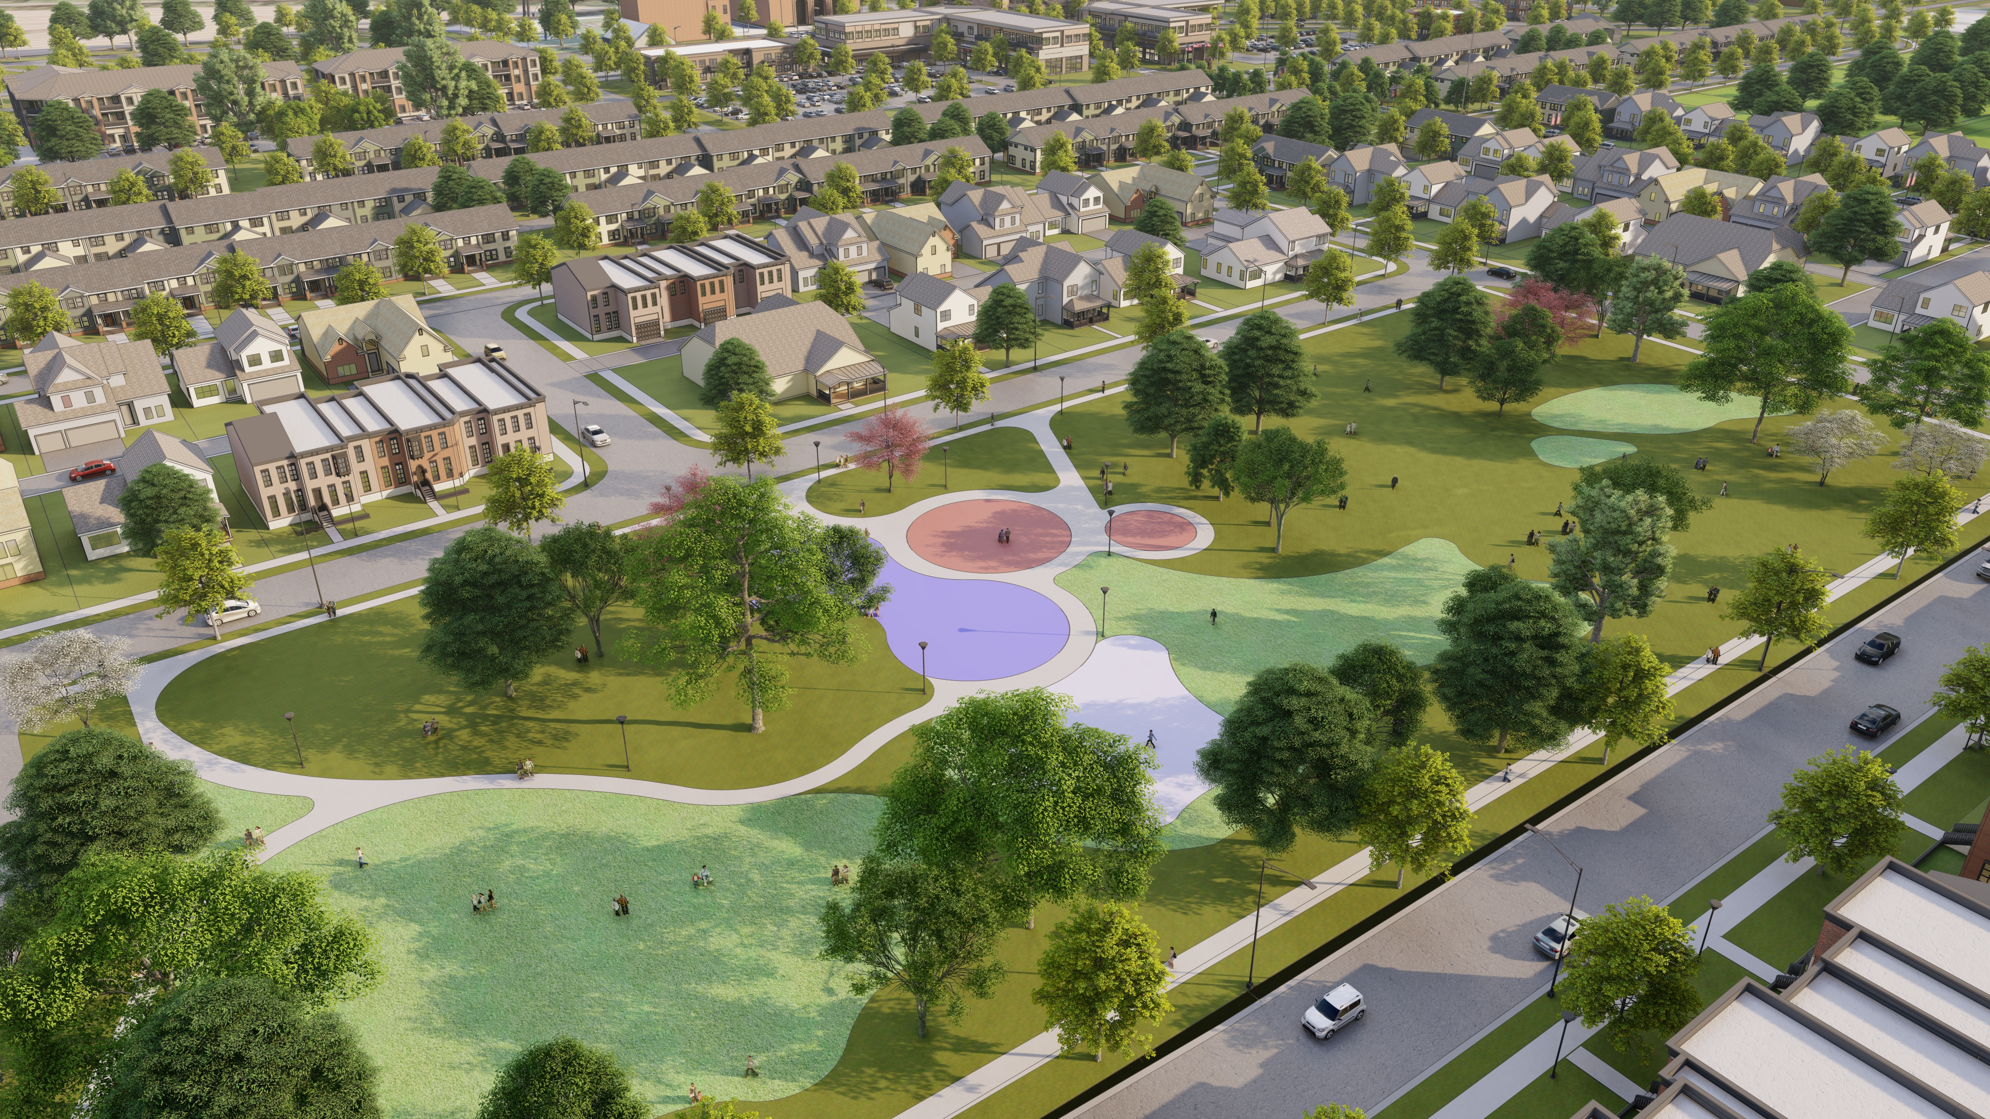
Veterans District Development to Date
Veterans Park with splash pad open
Veterans Trail in use
34 lot subdivision completed, 18 lots sold
9 houses finished
48-unit Seniors LIHTC application
50-unit Workforce Housing application

Slide 22
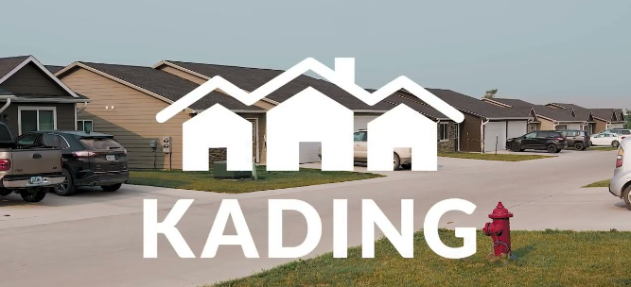
Market Rental Housing
Kading comes to town
A Pleasant Surprise
Terrace View – 155 units completed & fully leased
150+ person waiting list
Villas on Bell – 247 units WFH application

Slide 23
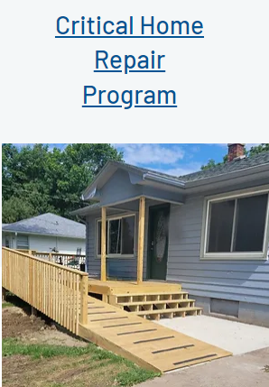
Habitat for Humanity of Marion County
Habitat for Humanity is managing a Critical Home Repair Program in Knoxville
2 Central Iowa Housing Trust Fund Grants received
City provides the local match

Slide 24
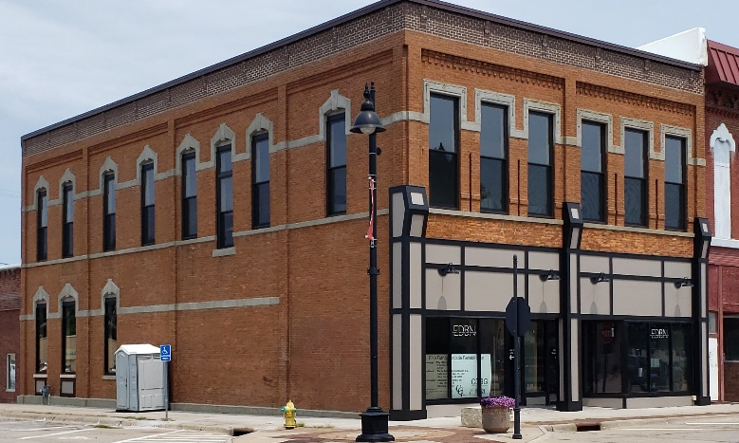
Downtown Revitalization
45 Municipal Façade Grants in 3 years (Avg. Grant =$7,000)
5 State Grants, including:
- 2 Community Catalyst Grants
- 1 Downtown Housing Grant
- 2 CDBG Façade Grants
MIPA is administering both CDBG Grants

Slide 25
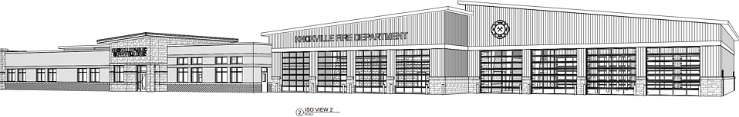
New Civic Building
Will include new City Hall, Police & Fire Stations
Located on former Middle School Site
2025 Construction Start Date
$13 M estimated cost
$ 2.7 M Federal Grant proposed by Congressman Miller-Meeks

Slide 26
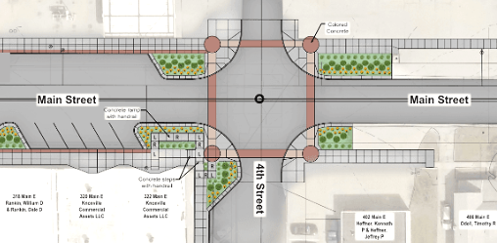
Other Related Work
Downtown Streetscape Additions (2 blocks)
Revisions to Zoning Code (Residential, Commercial, Parking, & Subdivision Rules)
New Comprehensive Plan
IEDA Thriving Community Designation for WF Housing Tax Credits

Slide 27
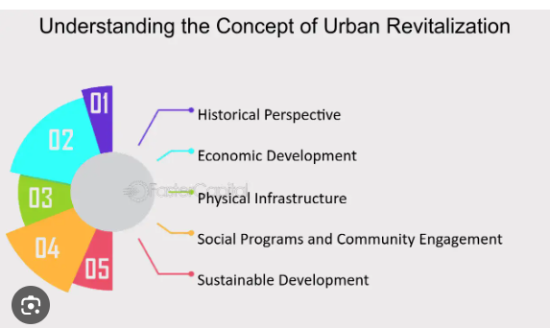
Knoxville
Is committed to change
Prepared to invest in revitalization efforts
Willing to go on its own when it has to (e.g. DT Municipal Façade Grants, Phase I VA land development)
Seeks assistance when it can (e.g., IEDA and MIPA)

Slide 28
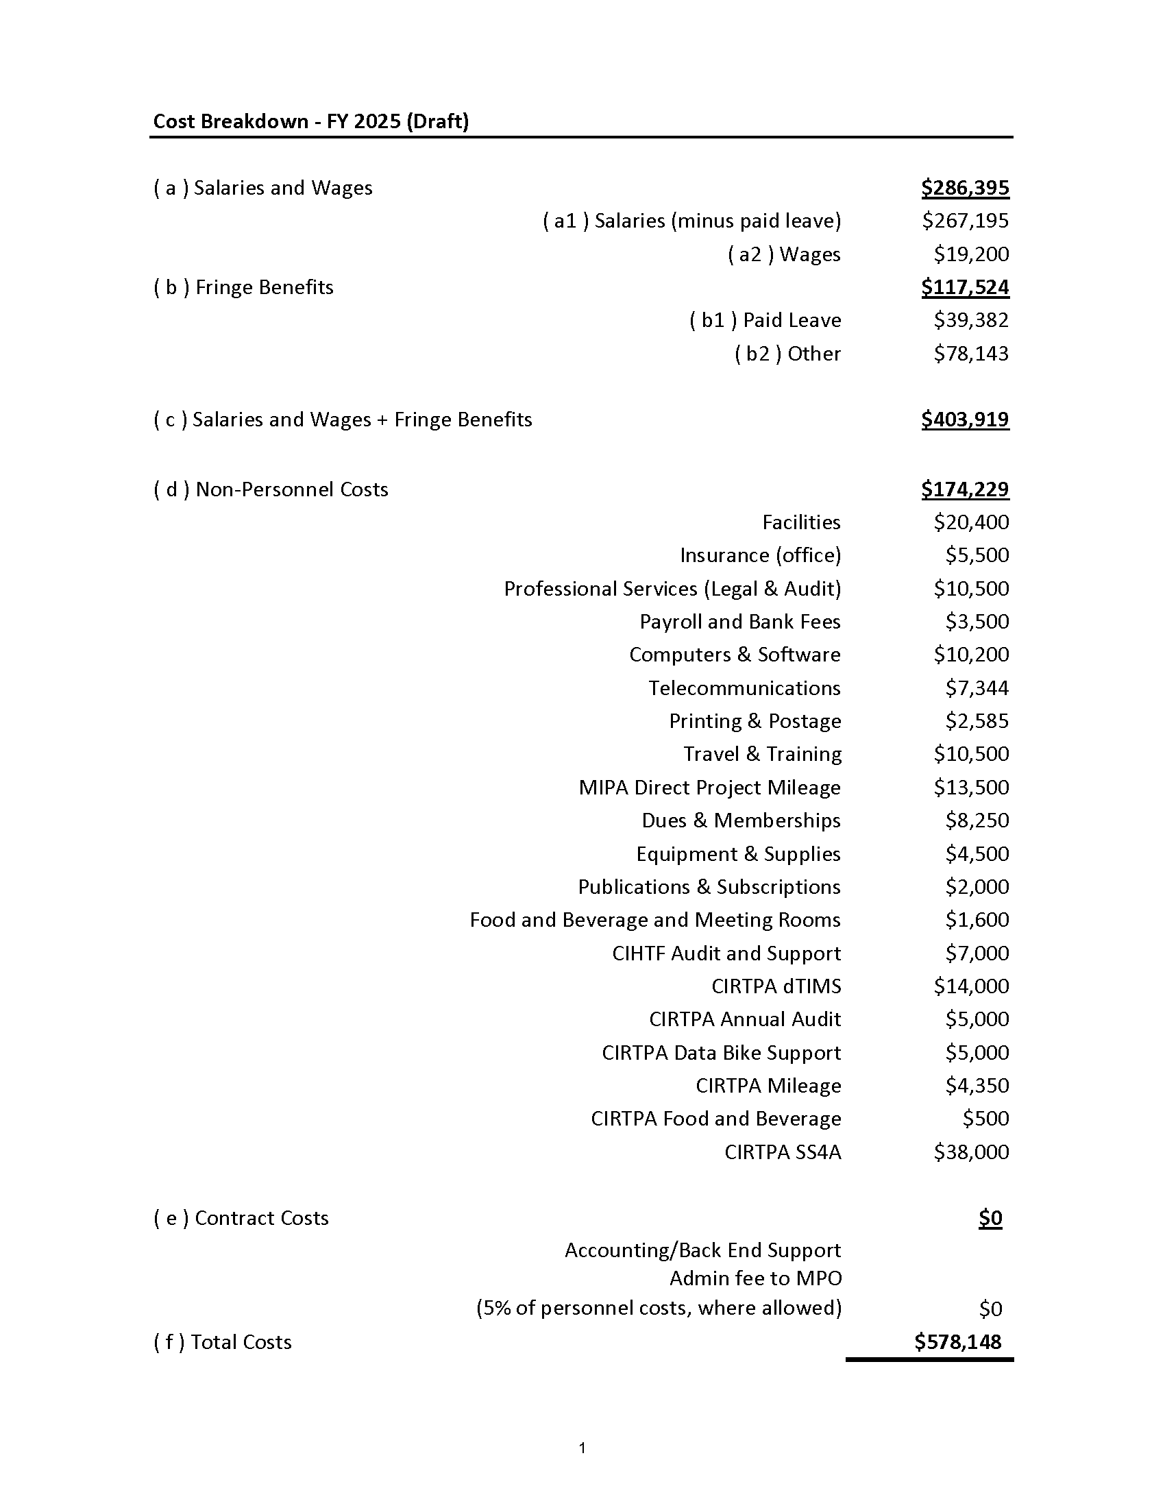
Fiscal Year 2025 Budget

Slide 29
Fiscal Year 2025 Budget

Slide 30
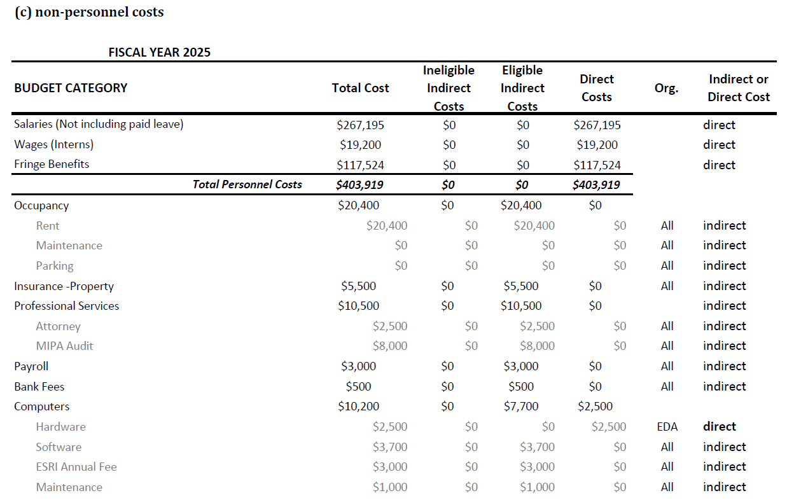
Fiscal Year 2025 Budget

Slide 31
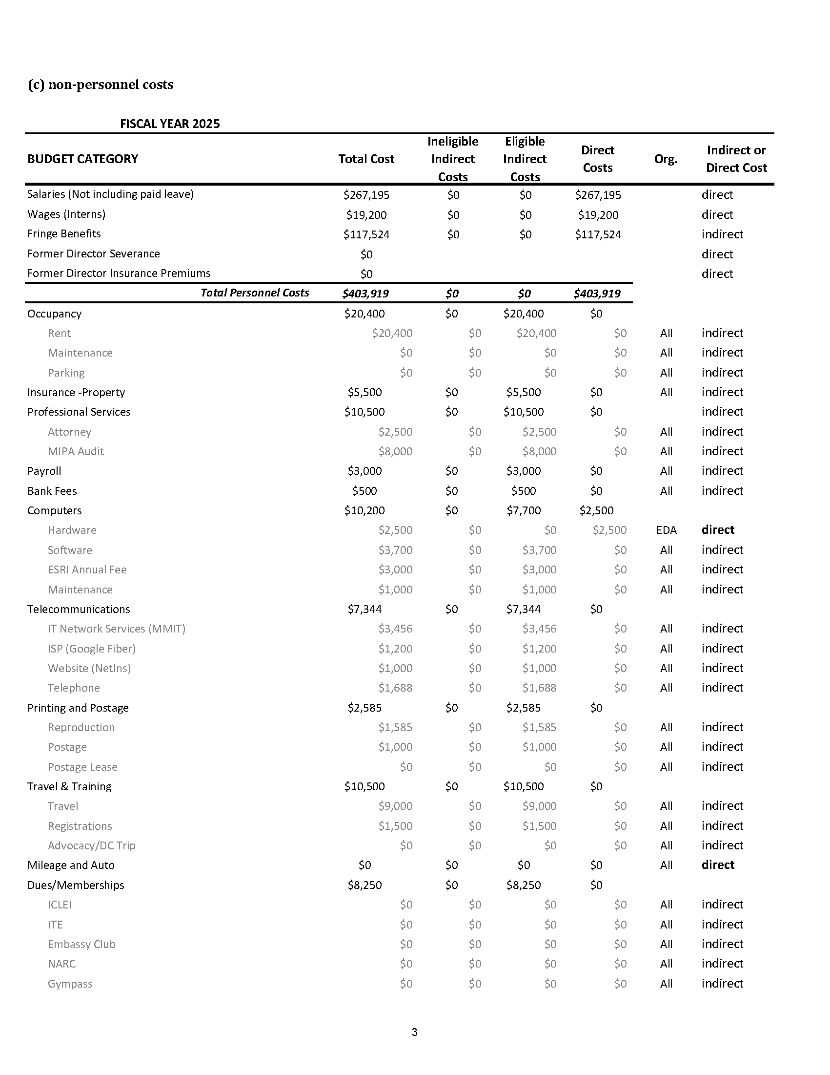
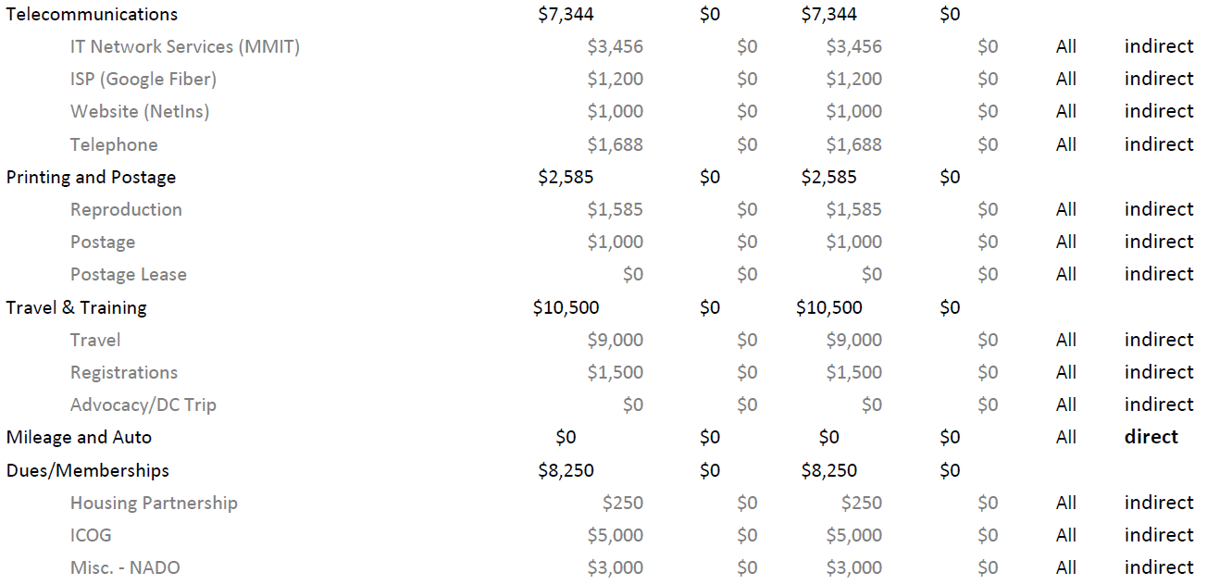
Fiscal Year 2025 Budget

Slide 32
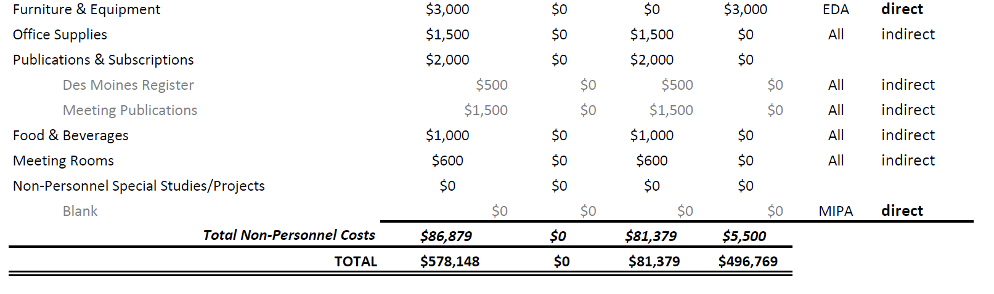
Fiscal Year 2025 Budget

Slide 33
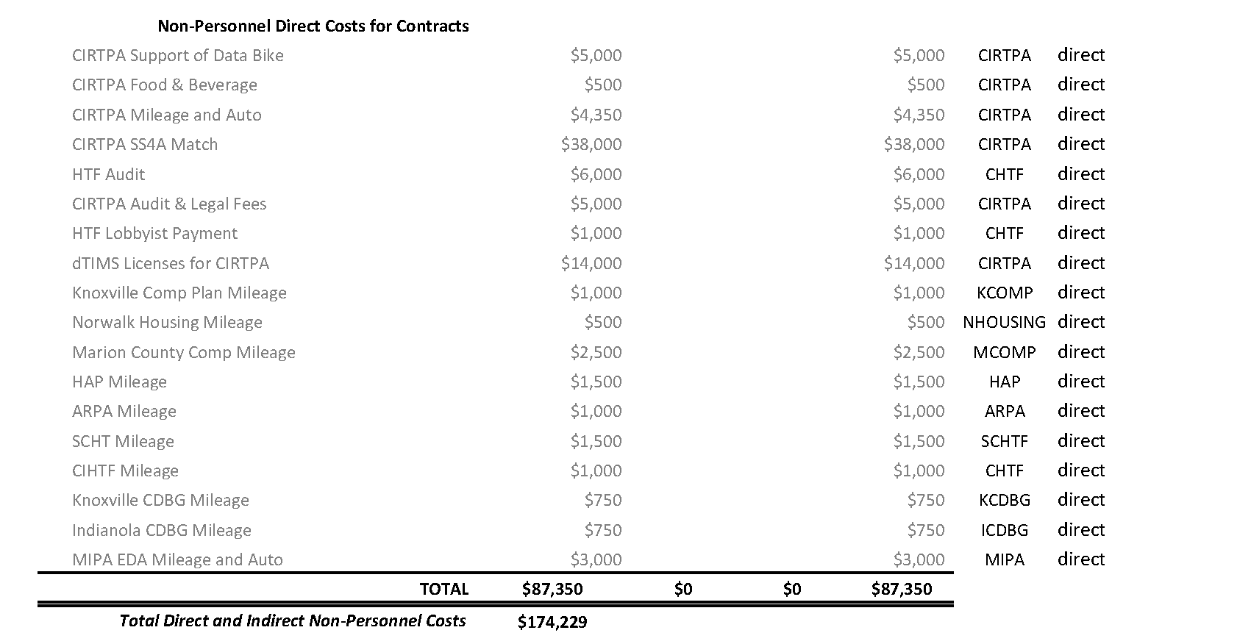
Fiscal Year 2025 Budget

Slide 34
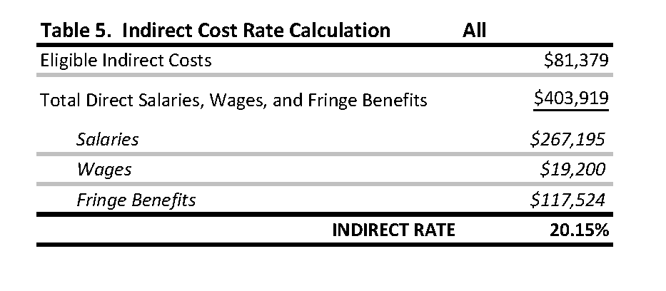
Fiscal Year 2025 Budget

Slide 35
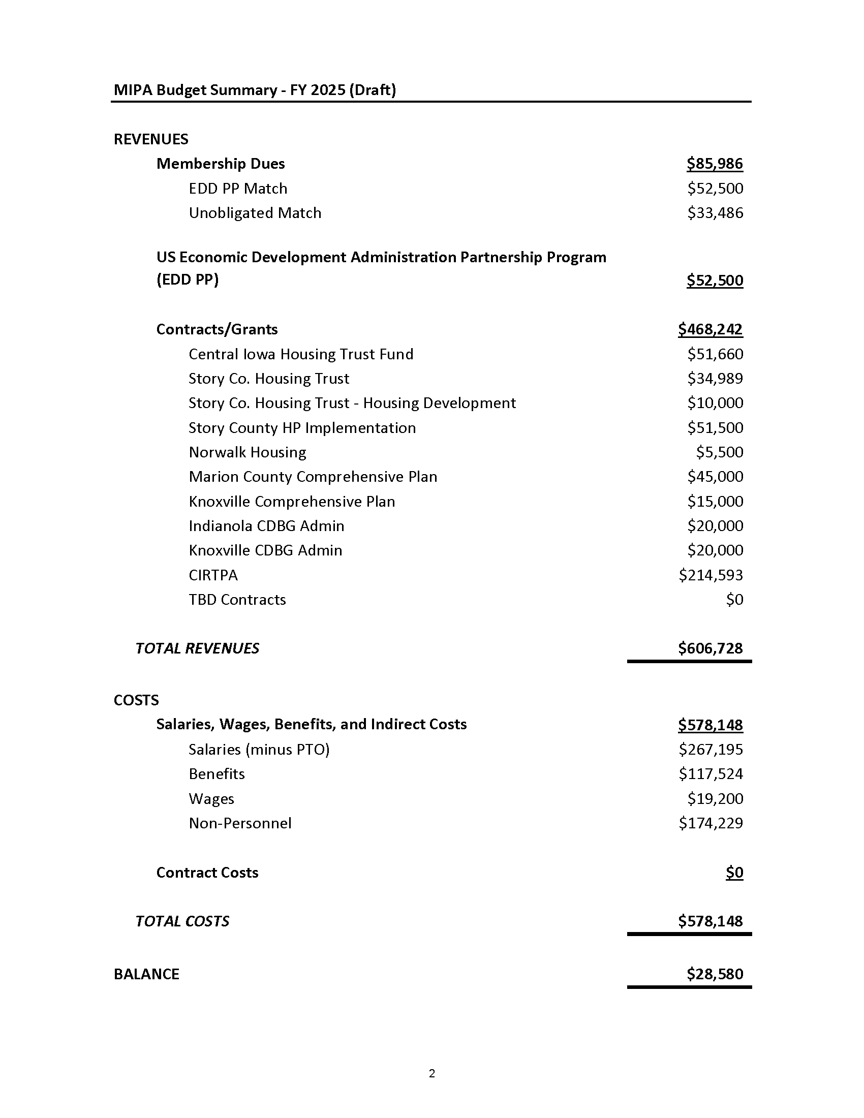
Fiscal Year 2025 Budget

Slide 36
Fiscal Year 2025 Budget

Slide 37
MIPA Bylaws Update
A MIPA Bylaws Committee was formed last year that consists of:
  Supervisor Murken
  Councilman Murray
  Director Buydos
The committee met three times to provide input and recommend changes. Denton Davis Brown reviewed proposed changes for compliance

Slide 38
MIPA Bylaws Update
Notable proposed changes include:
  Changing the Annual Meeting to June
  Allowing communities to appoint alternates
  If a representative counts for multiple communities their vote equals the number of members that are represented
  Combine the Secretary and Treasurer position
  General cleanup
Changes were approved by the Executive Committee

Slide 39
MIPA Employee Handbook and Policies and Procedures Manual
Staff prepared the MIPA Employee Handbook and MIPA Policies and Procedures Manual based on the recent work of the Des Moines Area MPO
The MIPA Employee Handbook outlines employee benefits and expectations and the MIPA Policies and Procedures Manual identifies policies, procedures, and guidelines to help direct MIPA’s operations.
Notable changes from policies used by MIPA while under the MPO include:
  Loss of IPERS eligibility and other changes to differed compensation
  Changes to health insurance coverage, including the addition of a Health Savings Account (HSA)
  Changes to the vacation and sick time policies

Slide 40
Executive Director
A Hiring Committee was formed to solicit applications and conduct interviews for the Executive Director position. The Hiring Committee consisted of:
  Supervisor Murken – Story County
  Director Parris – City of Norwalk
  Director Lyons – City of Knoxville
At the Joint Executive Committee and Board of Directors Meeting in April a motion was made to hire Andrew Collings as the Executive Director based on the recommendation of the Hiring Committee
Because the Board of Directors did not have a quorum, that motion was amended to hire the position on an interim basis and approved by the Executive Committee

Slide 41
MIPA Transition Update
When FY 2024 began, the Des Moines Area MPO Executive Committee decided that MIPA should leave the MPO by the end of FY 2025. MIPA staff then began planning the transition away from the MPO and worked closely with the MIPA Executive Committee to complete the process, which included providing monthly updates to the Executive Committee
On April 1, the administration contract with the MPO ended and MIPA began administering CIRTPA, as well as continuing to administer the CIHTF and SCHT
MIPA has now moved into new offices located at 939 Office Park Road, Suite 306 in West Des Moines
Staff has finalized operational setup

Slide 42
June 24, 2024 AGENDA
Call to Order
VOTE: Approval of Agenda
VOTE: Approval of Meeting Minutes
PRESENTATION: Iowa Northland Regional Council of Governments (INRCOG)
PRESENTATION: City of Knoxville
REPORT and VOTE: Fiscal Year 2025 Budget
REPORT and VOTE: MIPA Bylaws Update
REPORT and VOTE: MIPA Employee Handbook & Policies and Procedures Manual
REPORT and VOTE: Executive Director
REPORT: MIPA Transition Update
Other Non-Action Items of Interest to the Committee
Next Meeting Date – As needed in FY 2025
Adjournment

