Slide 1
Executive Committee Meeting
April 26, 2024

Slide 2
April 26, 2024 AGENDA
Call to Order
VOTE: Approval of Agenda
VOTE: Approval of Meeting Minutes
REPORT and VOTE: Contracts and Expenses
REPORT and VOTE: MIPA Calendar Year 2024 Officers
REPORT and VOTE: Des Moines Area MPO Invoice to MIPA for the 3rd Quarter of Fiscal Year 2024
REPORT and VOTE: SIMPLE IRA Plan Documentation
REPORT and OPTIONAL VOTE: Logo and Branding
REPORT: MIPA Bylaws Update
Other Non-Action Items of Interest to the Committee
Next Meeting Date – May 31, 2024 – Executive Committee Only
Adjournment

Slide 3
Contracts and Expenses
Contracts
VENDOR | PURPOSE | NOTES/INFORMATION | AMOUNT REQUESTED
Marion County | Implementation of the comprehensive planning development process for Marion County. | Marion County has already approved the proposed contract. | $46,000.00
Expenses
VENDOR | PURPOSE | NOTES/INFORMATION | AMOUNT REQUESTED
None | None | None | None

Slide 4
MIPA CY 2024 Officers
MIPA staff reported on the selection of MIPA officers in January, who are selected from and approved by the Executive Committee
The current slate of officers are:
  Chair – Brenda Dryer
  Vice-Chair – Vacant
  Secretary* – Charlie Dissell
  Treasurer* - Vacant
*Note - The Secretary and Treasurer positions are proposed to be combined in the updated By-Laws

Slide 5
MIPA CY 2024 Officers
The following is the proposed slate of officers for CY 2024:
  Chair – Brenda Dryer
  Vice-Chair – Charlie Dissell
  Secretary/Treasurer – Seek Nominations
Brenda Dryer and Charlie Dissell have offered to continue as the transition to a stand-alone organization continues. The consistency in leadership has been helpful to staff, especially as the Executive Director role has not been permanently filled

Slide 6
MPO 3rd Quarter Invoice to MIPA
The MPO bills MIPA for work conducted on MIPA’s behalf on a quarterly basis
The 3rd quarter invoice is available in the agenda packet
This will be the last invoice from the MPO for services

Slide 7
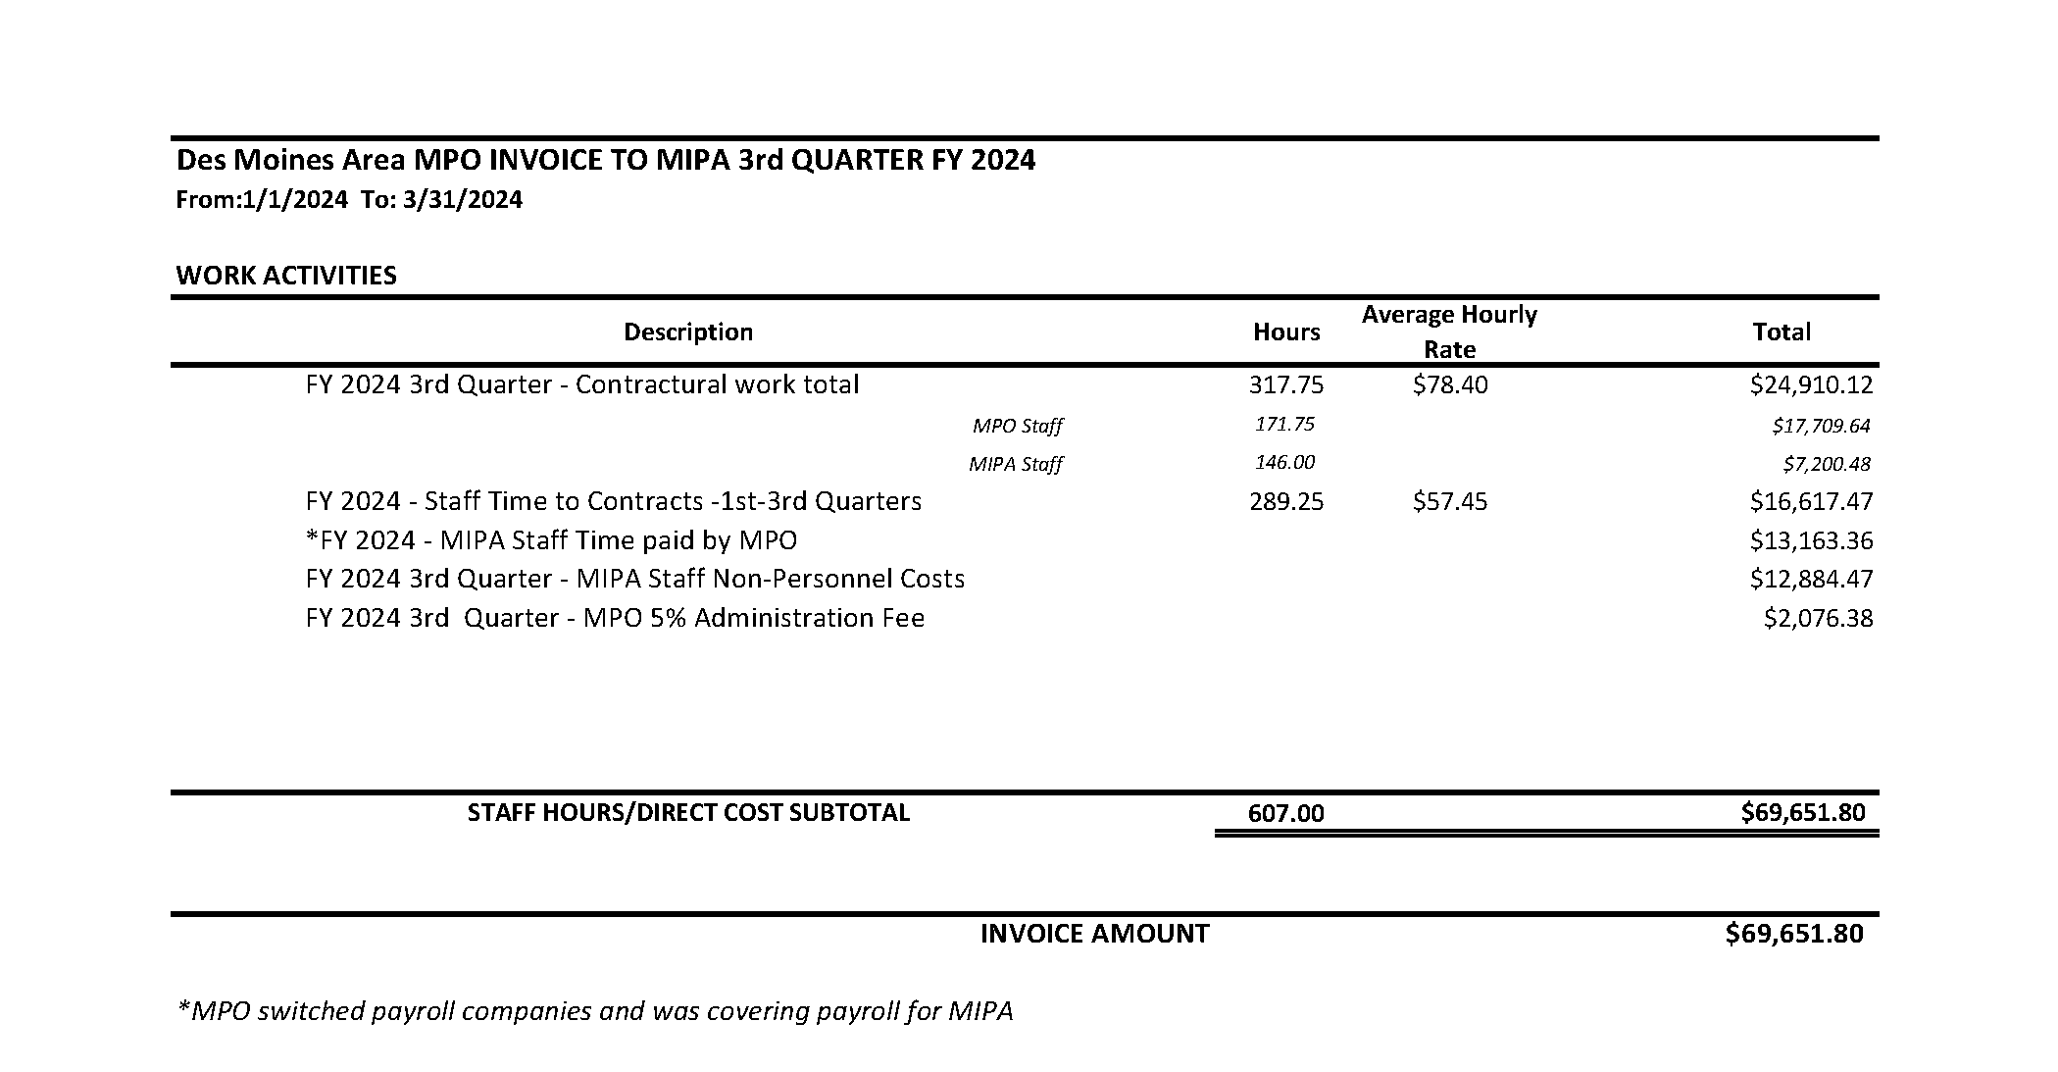
MPO 3rd Quarter Invoice to MIPA

Slide 8
MPO 3rd Quarter Invoice to MIPA
The following is a breakdown of the invoice:
FY 2024 3rd Quarter – Contractual work total - $24,910.12
  MPO Staff – Time spent by MPO staff doing work on behalf of MIPA for EDA related activities
  MIPA Staff – The 20% of MIPA staff salary that was paid for by the Des Moines MPO
FY 2024 Staff Time to Contracts – 1st-3rd Quarters - $16,617.47
  MPO staff time spent on projects that were not previously billed for and were not EDA funded activities

Slide 9
MPO 3rd^{nd} Quarter Invoice to MIPA
FY 2024 – MIPA Staff Time paid by MPO - $13,163.36
  The MPO switched payroll companies during the 3rd quarter. As part of that process, the MPO paid 100% of MIPA employee salaries. In previous quarters it had only been 20% the $13,163.36 would have been paid by MIPA.
FY 2024 3rd Quarter – MIPA Staff Non-Personnel Costs - $12,884.47
  Non-Personnel costs associated with MIPA staffing
FY 2024 3rd Quarter – MPO 5% Administration Fee - $2,076.38
  5% fee charged by the MPO for work completed by the MPO

Slide 10
MPO 3rd Quarter Invoice to MIPA
This invoice is notably larger because 100% of MIPA salaries were covered by the MPO for a part of the 3rd quarter
Following approval for payment, MIPA will still have approximately $30,000 of cash reserves
It is also worth noting that there are several receivables that have been drawn or will be drawn in the next 60 days. These include:
  Story County Housing Action Plan - $29,000
  Story County Housing Trust Administration - $13,995
  Central Iowa Housing Trust Fund Administration - $20,664
  Q2 and Q3 EDA Reimbursement - $35,000
  Q4 EDA Advancement of Funds - $17,500
  Total Due to MIPA - $116,159

Slide 11
SIMPLE IRA Plan Documentation
To establish a SIMPLE IRA plan for MIPA employees, an Information and Services Agreement and IRS Form 5305-SIMPLE must be approved. Once approved they will be send to T Rowe Price for their approval and staff will move forward with the plan set-up process
This plan is inline with what is in the employee handbook and there are no fees or costs to MIPA with this set up

Slide 12
Logo and Branding
MIPA’s logo was developed expeditiously in 2021 as part of the effort to swiftly launch the organization.
In April of 2023, staff presented a proposed new logo and branding, but no action was taken to approve the new design.
As staff looks to update printed materials and digital assets, now is the time to implement any changes.

Slide 13


Slide 14







Slide 15

Logo and Branding
Since that time, staff has reviewed and revised some of the proposed items. Most notably is a change to the main color scheme. The current teal color is hard to read, both in print and online. The proposal is to utilize a darker version of the existing teal color. The intent is to use the new logos and favicons in black, white, and the new green color

Slide 16
MIPA Bylaws Update
A MIPA Bylaws Committee was formed last year that consists of:
  Supervisor Murken
  Councilman Murray
  Director Buydos
The committee met three times to provide input and recommend changes. Denton Davis Brown has reviewed the changes and added additional feedback

Slide 17
MIPA Bylaws Update
Notable proposed changes include:
  Changing the Annual Meeting to June
  Allowing communities to appoint alternates
  If a representative counts for multiple communities their vote equals the number of members that are represented
  Combine the Secretary and Treasurer position on the board
  Removal and clean up of superfluous language
Changes will be voted on in May by the Executive Committee and in June by the full Board of Directors

Slide 18
MIPA Transition Report
On April 1, the administration contract with the MPO ended and MIPA began administering CIRTPA
MIPA has now moved into new offices located at 939 Office Park Road, Suite 306 in West Des Moines
Staff is in the process of finalizing operational setup
Address, phone, and email changes were sent out in this month’s newsletter

Slide 19
Board Meeting Dates
The Board of Directors has not had a quorum twice in a row. The second meeting utilized the new lower quorum requirement of 35%
Staff will be sending out a survey to board members to determine if the current date and time is the best to ensure a quorum for the Executive Committee and full Board

Slide 20
New Staff
Dawn Green was hired as MIPA’s bookkeeper and started April 15
She will be responsible for most financial and administrative matters
Welcome Dawn!

Slide 21
April 26, 2024 AGENDA
Call to Order
VOTE: Approval of Agenda
VOTE: Approval of Meeting Minutes
REPORT and VOTE: Contracts and Expenses
REPORT and VOTE: MIPA Calendar Year 2024 Officers
REPORT and VOTE: Des Moines Area MPO Invoice to MIPA for the 3rd Quarter of Fiscal Year 2024
REPORT and VOTE: SIMPLE IRA Plan Documentation
REPORT and OPTIONAL VOTE: Logo and Branding
REPORT: MIPA Bylaws Update
Other Non-Action Items of Interest to the Committee
Next Meeting Date – May 31, 2024 – Executive Committee Only
Adjournment

