Slide 1

Executive Committee Meeting
May 31, 2024

Slide 2

May 31, 2024 AGENDA
Call to Order
VOTE: Approval of Agenda
VOTE: Approval of Meeting Minutes
REPORT and VOTE: Fiscal Year 2025 Budget
REPORT and VOTE: MIPA Bylaws Update
REPORT and VOTE: Commitment of Local Match to EDA
REPORT and OPTIONAL VOTE: New Executive Committee Meeting Time
Other Non-Action Items of Interest to the Committee
Next Meeting Date – TBD in July
Adjournment

Slide 3
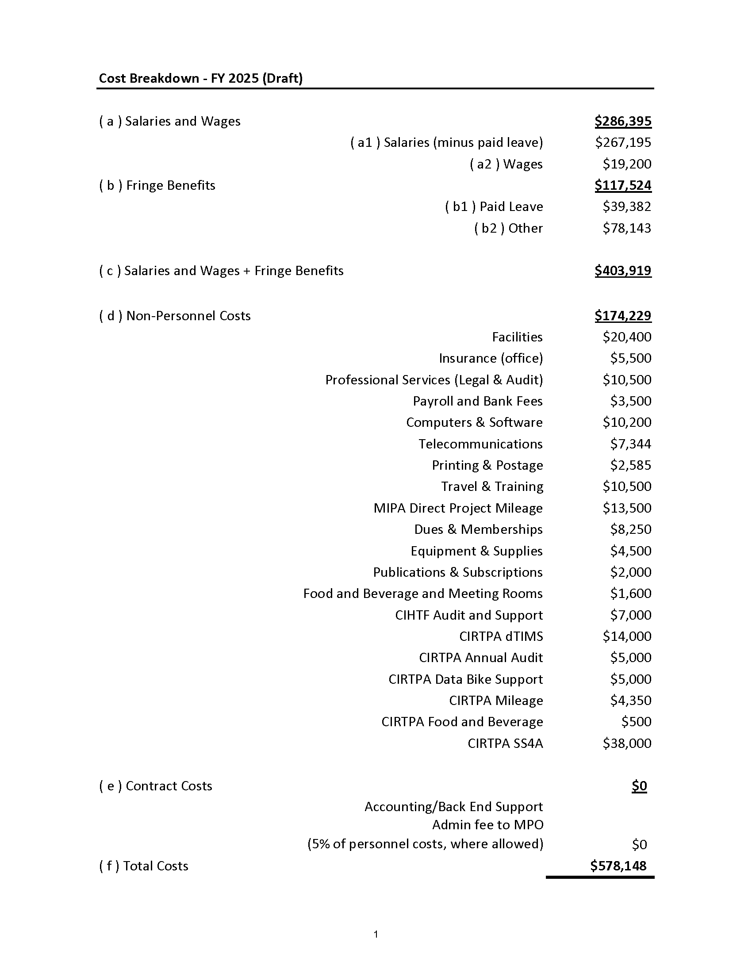
Fiscal Year 2025 Budget

Slide 4
Fiscal Year 2025 Budget

Slide 5
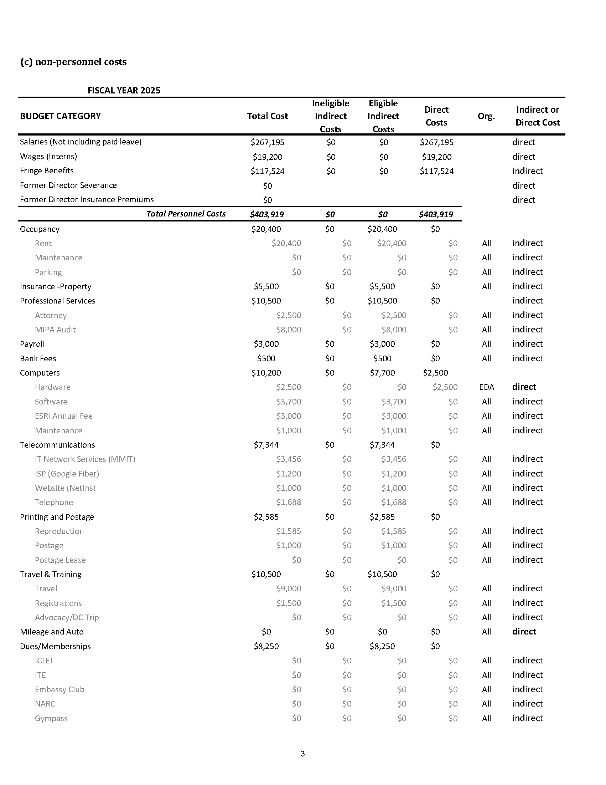
Fiscal Year 2025 Budget

Slide 6
Fiscal Year 2025 Budget

Slide 7
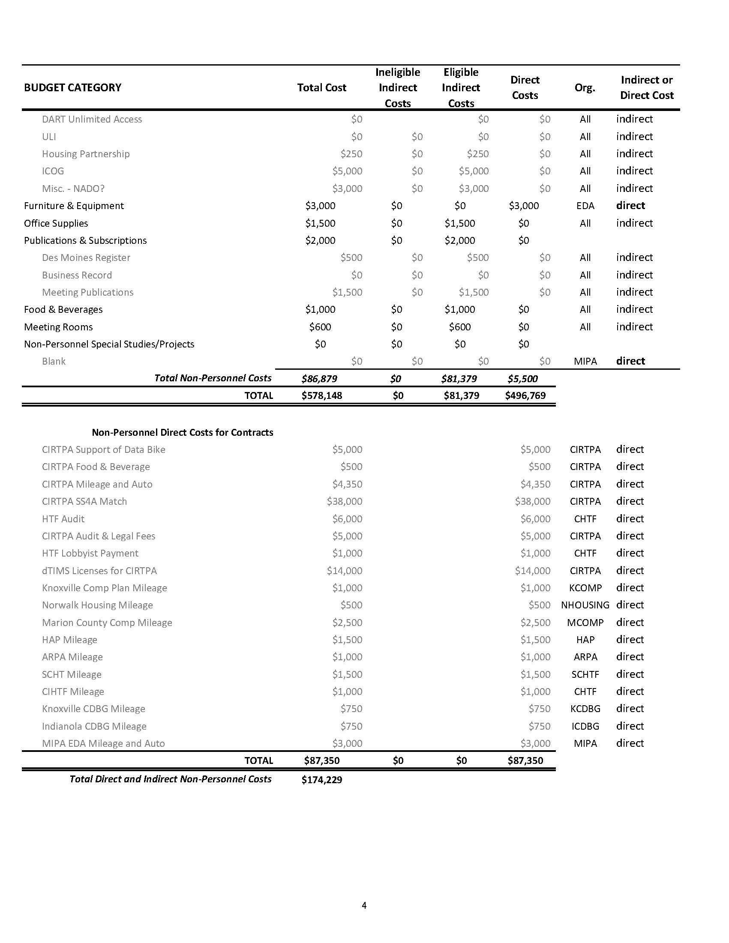
Fiscal Year 2025 Budget

Slide 8
Fiscal Year 2025 Budget

Slide 9
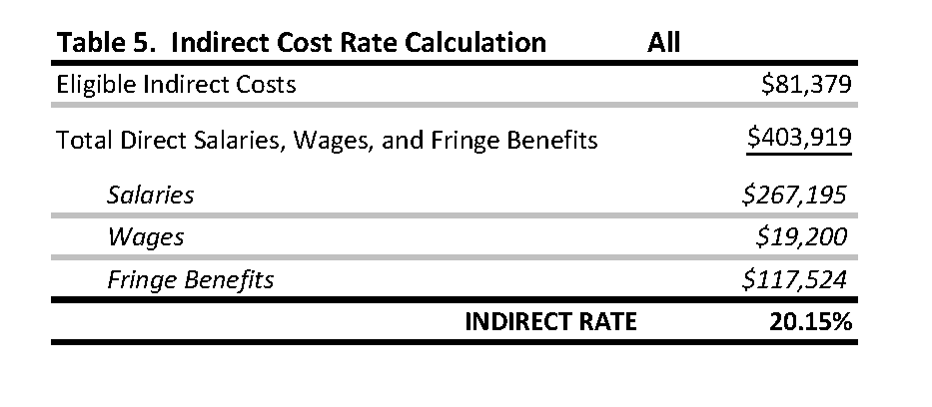
Fiscal Year 2025 Budget

Slide 10
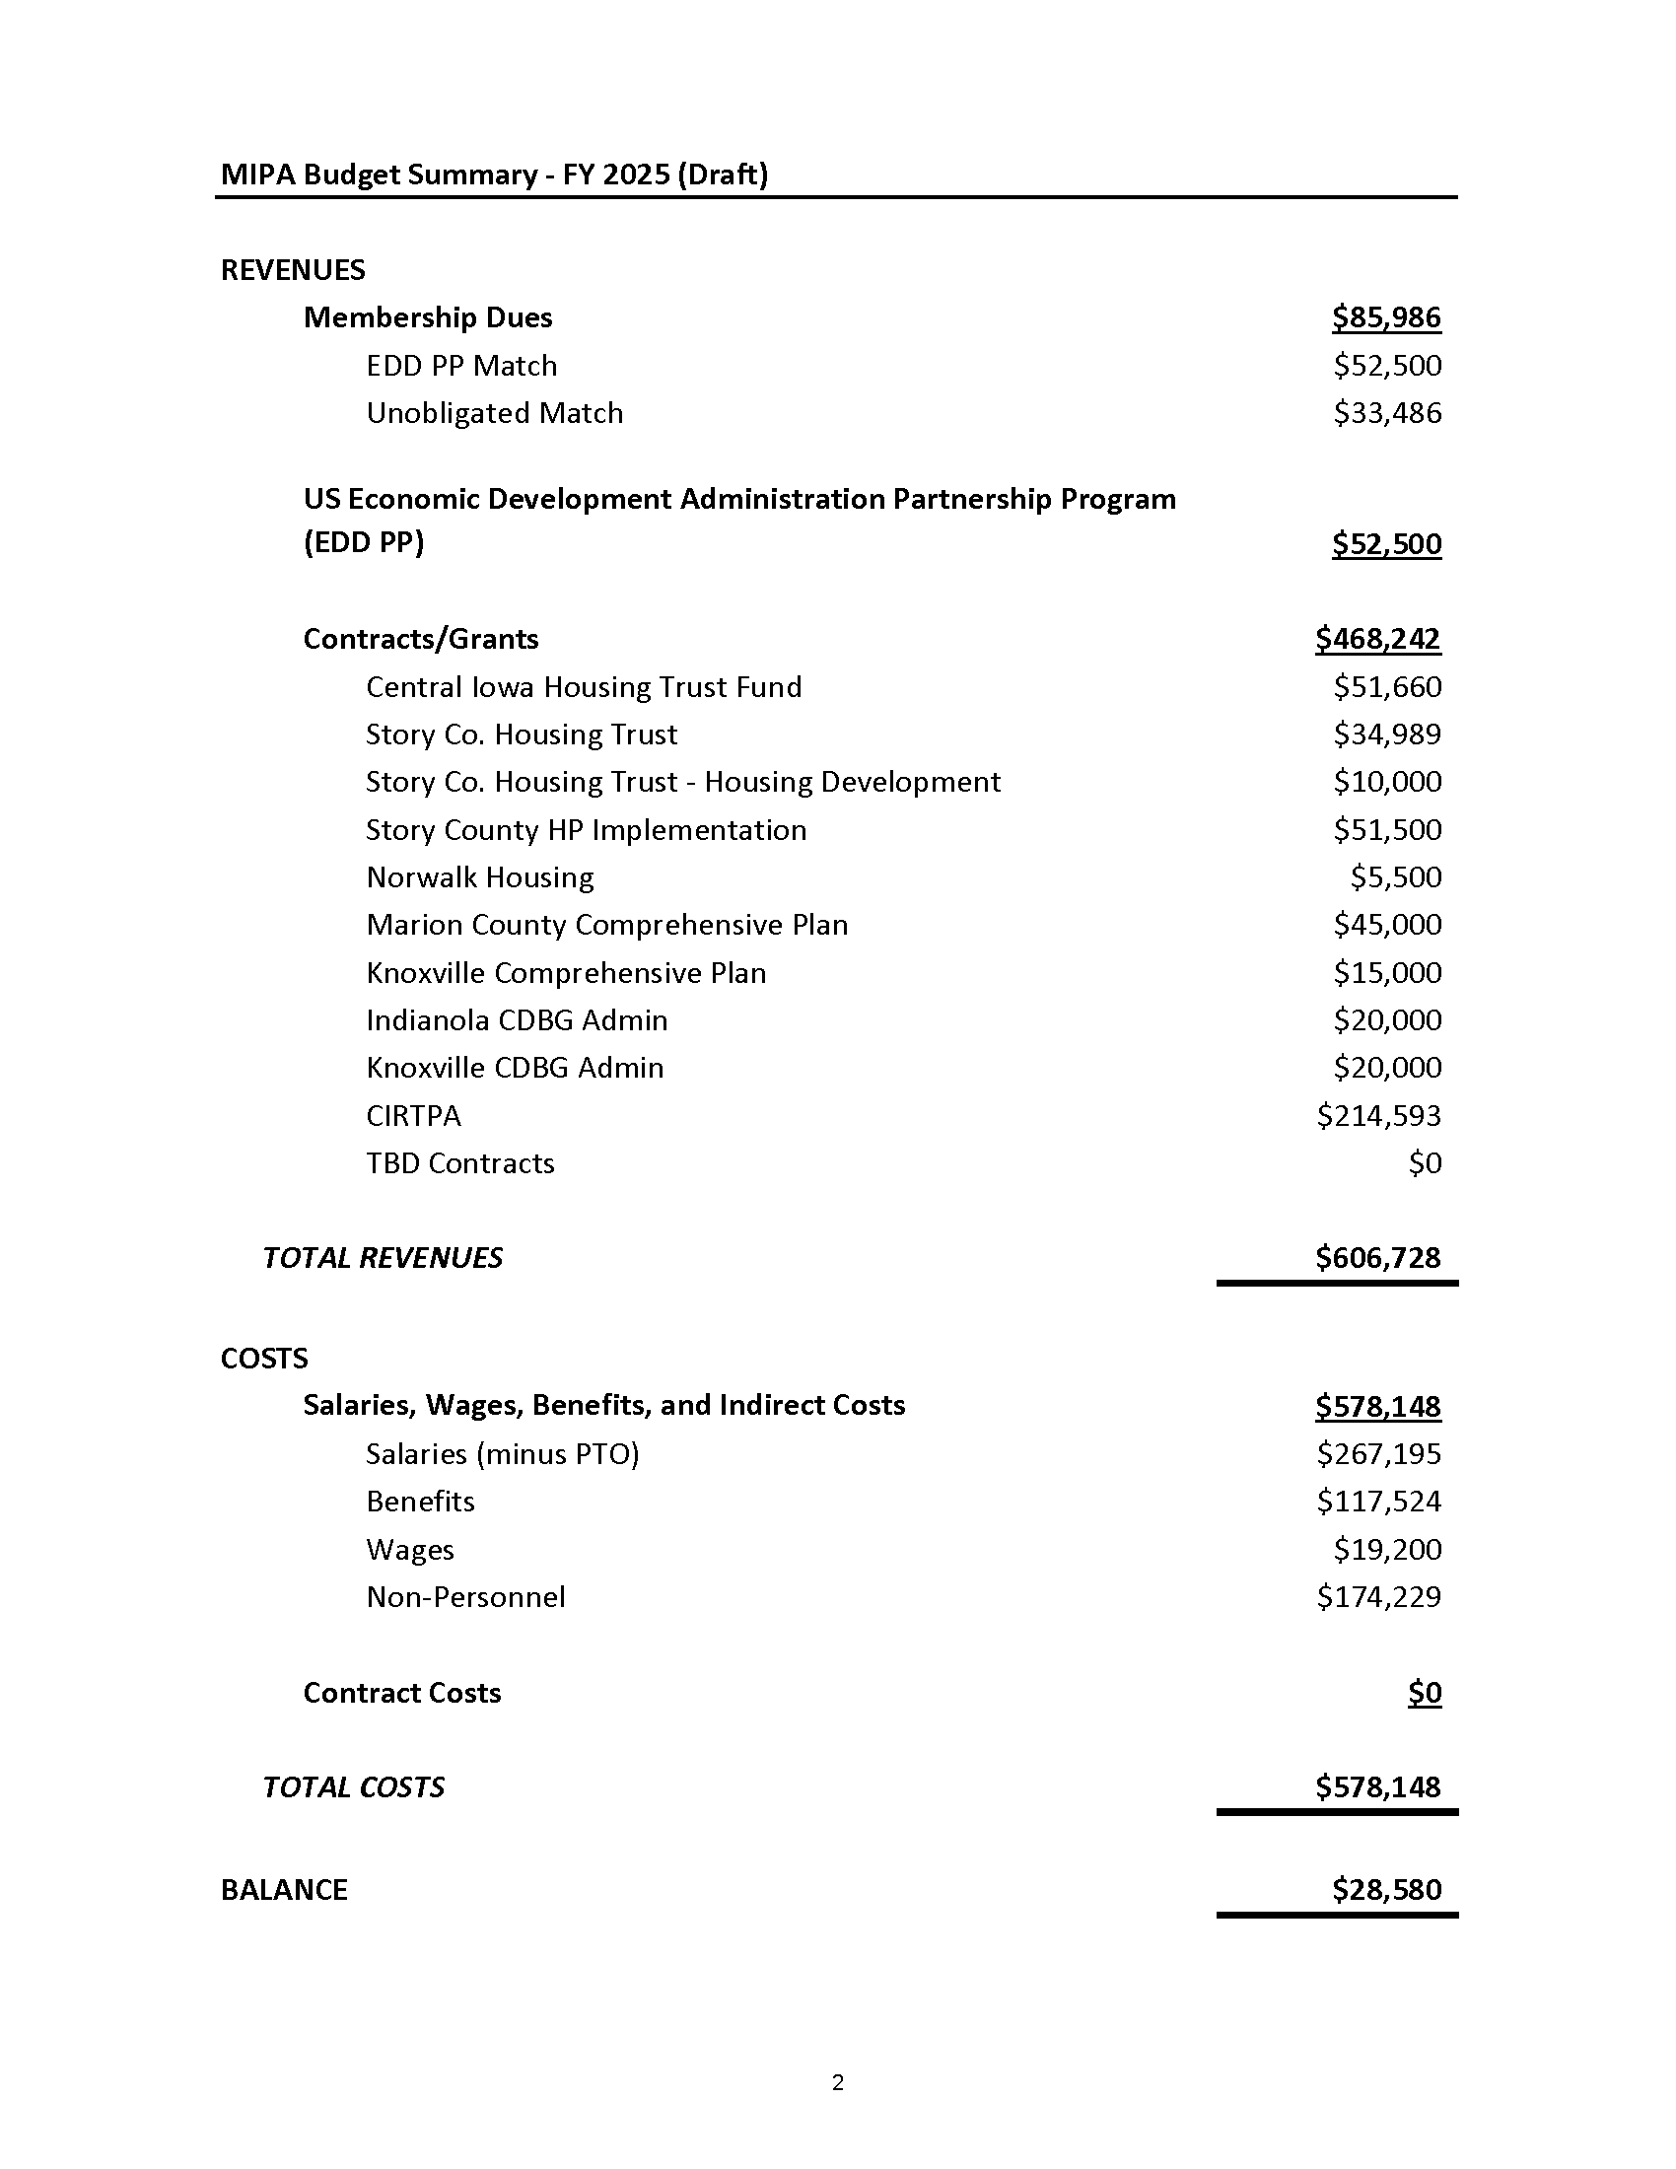
Fiscal Year 2025 Budget

Slide 11
Fiscal Year 2025 Budget

Slide 12
Fiscal Year 2025 Budget – Potential Projects
Polk County Climate Pollution Reduction Grant - $49 Million
  MIPA would get administration funding of up to $1 Million over 5 years for administering approximate $38 Million in housing funds outside of Polk County
Comprehensive Plans - $40k
EDA Economic Adjustment and Public Works Funding Administration - $20k
Other CDBG Grants - $40k - $60k

Slide 13
MIPA Bylaws Update
A MIPA Bylaws Committee was formed last year that consists of:
  Supervisor Murken
  Councilman Murray
  Director Buydos
The committee met three times to provide input and recommend changes. Denton Davis Brown has reviewed the changes and added additional feedback

Slide 14
MIPA Bylaws Update
Notable proposed changes include:
  Changing the Annual Meeting to June
  Allowing communities to appoint alternates
  If a representative counts for multiple communities their vote equals the number of members that are represented
  Combine the Secretary and Treasurer position
  General cleanup
Changes will also be voted on in June by the full Board of Directors

Slide 15
EDA Commitment of Local Match
In April of 2022 MIPA received a 3-year planning grant from EDA for $210,000. Each year, MIPA must reaffirm its commitment of local match of $70,000 for each year
MIPA is currently in its 3rd year of the grant ending March 31, 2025 at which point MIPA will receive another 3-year planning grant

Slide 16
Executive Committee Meeting Time
When the MIPA Executive Committee was first formed, it was determined that the morning of the last Friday of every month worked best to hold Executive Committee meetings
Numerous changes have occurred in the last 2 years, and it is appropriate to reevaluate the schedule
To help establish a more advantageous time for members, staff sent out a doodle poll to identify which dates and times generally work better for Board Members

Slide 17
Executive Committee Meeting Time
The top responses are:
  3rd Monday at 2 PM – 12 votes
  2nd Monday at 2 PM – 11 votes
  2nd Thursday at 2 PM, 3rd Monday at 10 AM, 3rd Thursday at 11 AM, 3rd Friday at 10 AM, and 4th Monday at 2 PM – 9 votes
The goal is to find a date and time that will allow the greatest opportunity for a quorum, so there may not be a time that works for all Board Members

Slide 18
May 31, 2024 AGENDA
Call to Order
VOTE: Approval of Agenda
VOTE: Approval of Meeting Minutes
REPORT and VOTE: Fiscal Year 2025 Budget
REPORT and VOTE: MIPA Bylaws Update
REPORT and VOTE: Commitment of Local Match to EDA
REPORT and OPTIONAL VOTE: New Executive Committee Meeting Time
Other Non-Action Items of Interest to the Committee
Next Meeting Date – TBD in July
Adjournment

