Slide 1
Mid Iowa Planning Alliance
June 24, 2024

Slide 2
ICOG Overview
17 Councils of Government
Codified in 28H of the Iowa Code (formed by 28E agreement)
Considered a “public” entity
Adhere to public requirements-open meetings, records, hearings
COG Directors serve as ICOG Board
Conduct staff training and education opportunities
Staffed by management consultant(s)

Slide 3
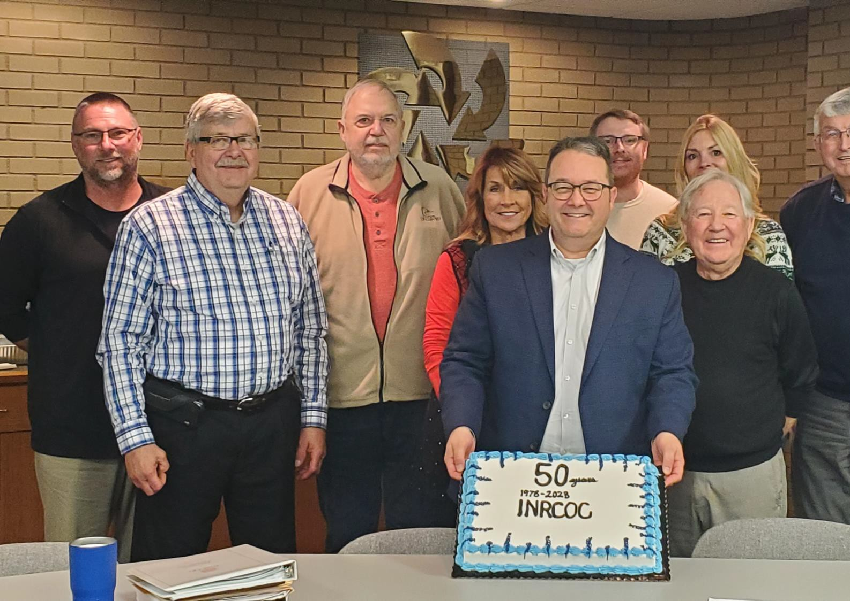

INRCOG
Overview
Voluntary association; formed in 1973; 6 counties; 54 cities; 215,000 persons…we view ourselves as an extension of member staff
Members pay dues ($0.54/person)
Board of Directors and Executive Board-Oversight
15 INRCOG employees; 16 RTC/OBPT drivers)
Umbrella for:
  Iowa Northland Regional Transit Commission/On
Board Public Transit
  Iowa Northland Regional Economic Development Commission
  Iowa Northland Regional Housing Council
  Metropolitan Transportation Organization (MPO)
  Iowa Northland Regional Transportation Authority

Slide 4
INRCOG Overview
Other Organizations:
  Waterloo Housing Trust Fund (NPO)
  Cedar River Partnership (NPO)
  Cedar Falls Housing Trust Fund (anticipated) (NPO)
  Safe Routes to School
  Iowa Waste Exchange
  Cedar Valley Coalition (volunteer)

Slide 5
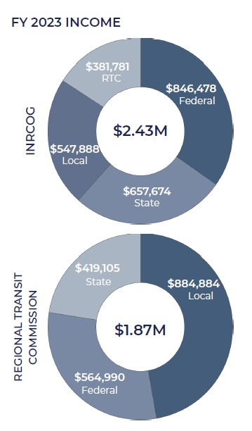
INRCOG Overview

Slide 6
INRCOG Overview
Budget ($5M for INRCOG and RTC/OBPT):
  Federal Funding Sources
    US Department of Commerce; Economic Development Administration (PPG; 2 RLFs; and project administration (fiber, whitewater currently))
    Community Development Block Grant (through IEDA and HUD-Entitlement Program)
    Homeland Security/FEMA (through HSEMD) (hazard mitigation plans, projects, buyouts, sirens, shelters)
    US Department of Agriculture-Housing Preservation Grant (New Hampton)
    Federal Home Loan Bank-Affordable Housing Grant (Regional)
    Federal Highway, Rail, and Transit Administrations (through IDOT)
    American Rescue Program (Destination Iowa-IEDA)
    Emergency Food and Shelter Program

Slide 7
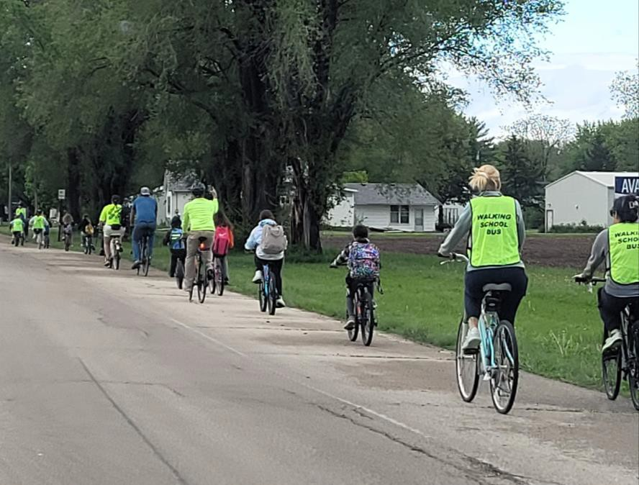

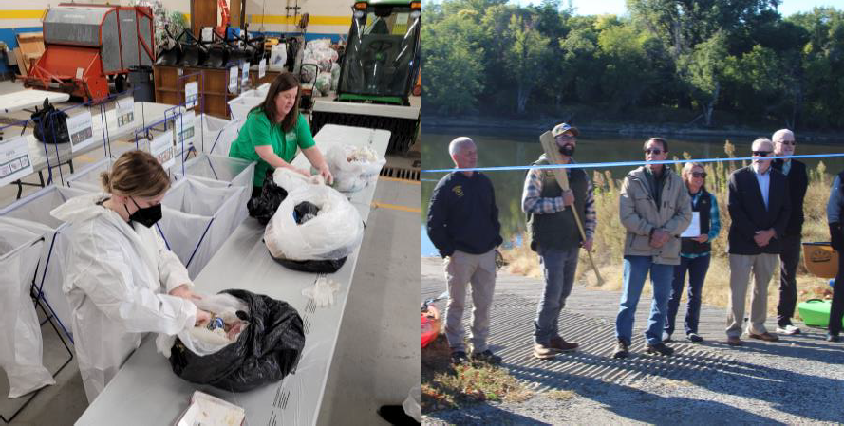
INRCOG Overview
Budget ($5M for INRCOG and RTC/OB):
  State Funding Sources
    Local Housing Trust Funds (through IFA)
    Housing Assistance Fund (ARPA through IFA)
    Resource Enhancement and Protection (REAP through IDNR)
    Water Trails Planning and Designation (through IDNR)
    Safe Routes to School-TAP; INRCOG, UERPC, IBC (through
IDOT)
    Iowa Waste Exchange-Region XII COG administers (through IDNR)
    Metro trail maps (land and water) (paper, QR Code- interactive) (MPO and/or RTA)

Slide 8
INRCOG Overview
Budget ($5M for INRCOG and RTC/OBPT):
  Local Funding Sources
    Membership Dues-per capita; used as program match for ED and transportation
    Local Contracts-Planning projects (i.e. Comprehensive plans, Zoning ordinances, Subdivision ordinances, 2-Mile agreements, Capital improvements programs)
    Mapping and GIS projects (zoning maps, tax abatement districts, tax increment financing
districts)

Slide 9
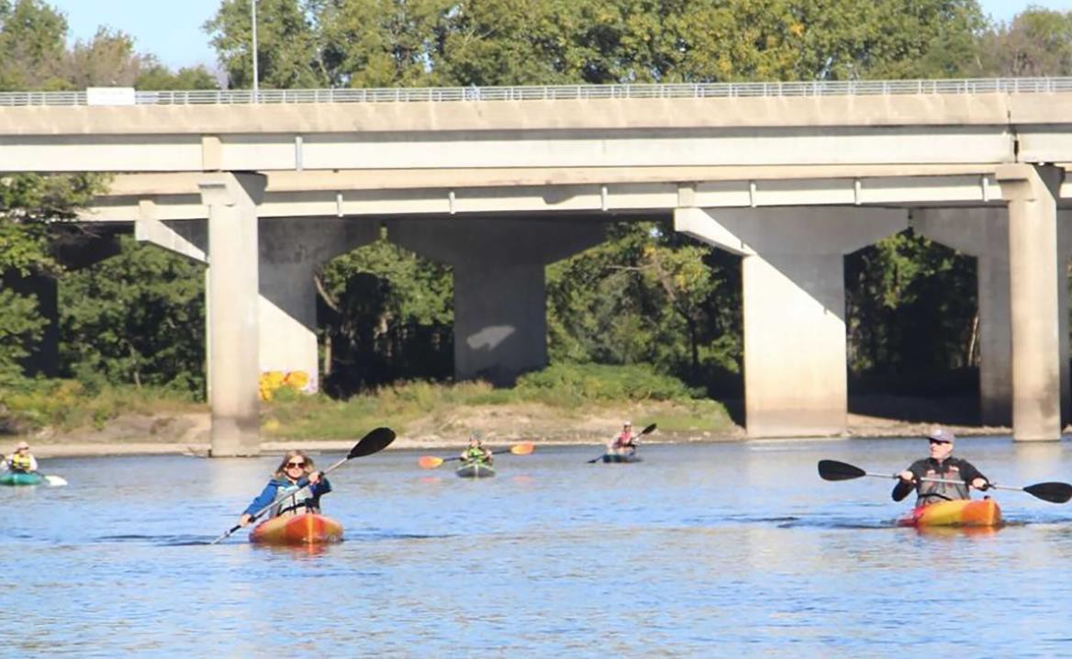
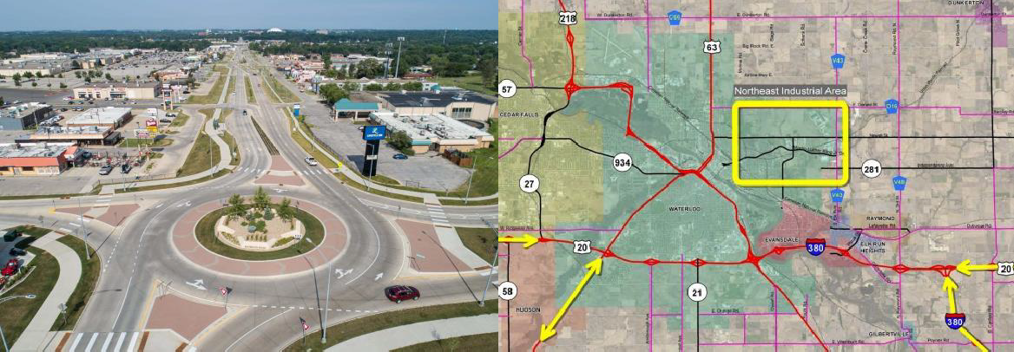
INRCOG Overview
Unique Projects (Recent)
  NE Bypass Study Project (metro area)
  Iowa Highway 58 Corridor Projects
(interchanges)
  University Avenue Redesign (road diet, roundabouts, other modes)
  Water Trail (Cedar River in Black Hawk
County) (plan and designation)
  Reconnecting Communities and Neighborhoods Grant

Slide 10
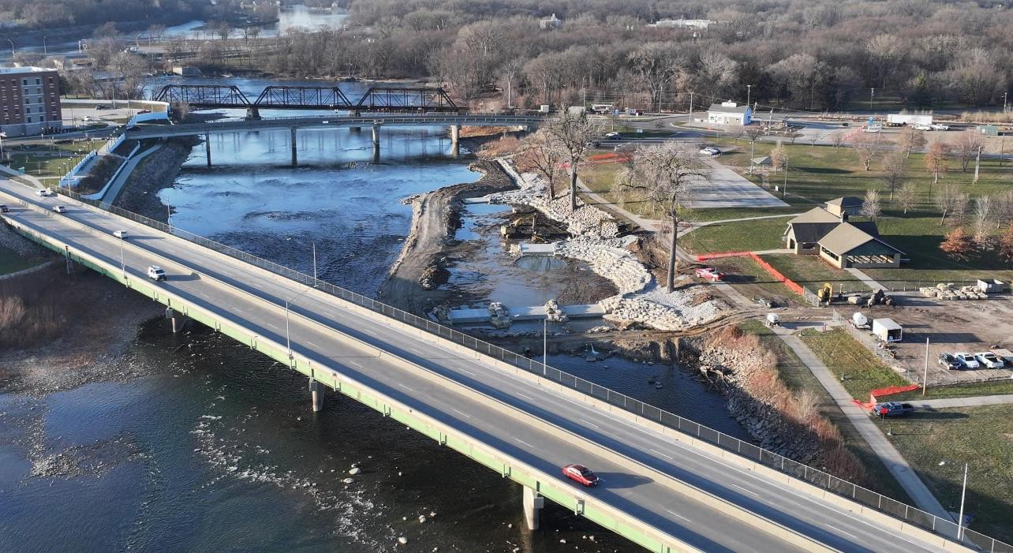
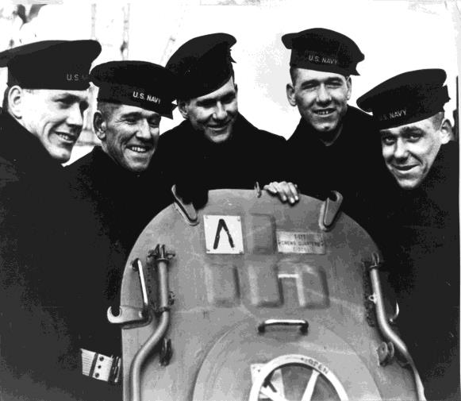
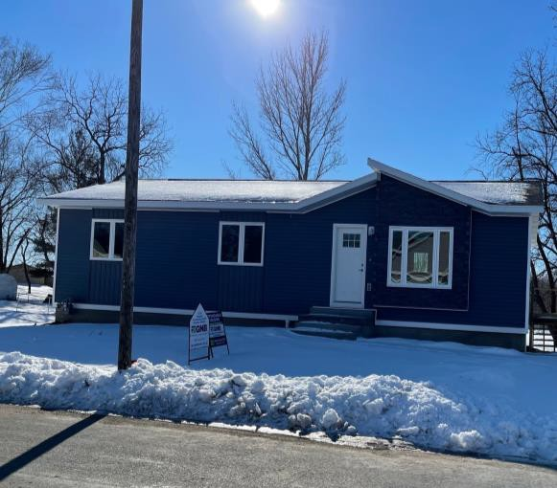
INRCOG Overview
Unique Projects (Recent)
  Neighborhoods Grant
  Railroad Crossing Elimination Program
  National Park Service-American WW II Heritage City Program
  Broadband/Fiber
  Whitewater Recreation Area (Gateway
Water Trail)
  Homes for Iowa

Slide 11
Thank you!
Brian Schoon, AICP
Executive Director INRCOG
229 East Park Avenue
Waterloo, Iowa 50703 bschoon@inrcog.org
(319) 235-0311

