Slide 1

Executive Committee Meeting
December 16, 2024

Slide 2

December 16, 2024 AGENDA
Call to Order
VOTE: Approval of Agenda
VOTE: Approval of Meeting Minutes
REPORT and VOTE: Invoices and Contracts
REPORT and VOTE: Financial Statements
REPORT and OPTIONAL VOTE: Updated Organizational Chart
REPORT and OPTIONAL VOTE: FY 2025 Budget Amendment and FY 2026 Budget Overview
REPORT: Central Iowa Local Workforce Development Board Update
REPORT: Representative and Officers Update
REPORT: General Update
Other Non-Action Items of Interest to the Committee
Next Meeting Date – January 20th at 2 PM
Adjournment

Slide 3
Invoices and Contracts
Invoices
None | $-
Contracts
City of Pleasantville Comprehensive Plan | $21,500

Slide 4
Financial Statements
Information regarding MIPA’s financial accounts
  Balance Sheet
  Statement of Activity
Note that both reports show $293,808 as due for the Metro Home Improvement Program in the Revenue category. This funding is tied specifically to that program and does not impact MIPA’s organizational funding
$187,395 in revenue vs $199,895 in expenditures since July 1
Working to increase more frequent billings for projects – Approximately $60k needs to be invoiced

Slide 5
Updated Organizational Chart
Given the increased demand for MIPA services, MIPA will need to expand staff to meet its organizational commitments. To formalize the ability to hire staff, a new organizational chart has been created to show the new positions. The following are the proposed changes to currently approved staffing levels:
  Workforce Director – This position is tied to the CILWDB contract. Work duties will include staffing the CILWDB boards and ensuring the Title 1 workforce funding is administered appropriately. The position will be staffed by Eric Kress starting July 1
  Finance Director/Compliance Administrator – Partially tied to the CILWDB contract. Work duties will be to be responsible for overseeing all financial aspects of MIPA, including budgeting, financial reporting, risk management, and compliance, ensuring the organization's long-term financial health and growth by making informed financial decisions. This position would also be a part time compliance administrator for the CILWDB contract by supporting the Workforce Director in compliance matters
  Associate Planner – This position is not tied to any one contract. Having additional staffing would give MIPA flexibility to meet future needs for planning services

Slide 6
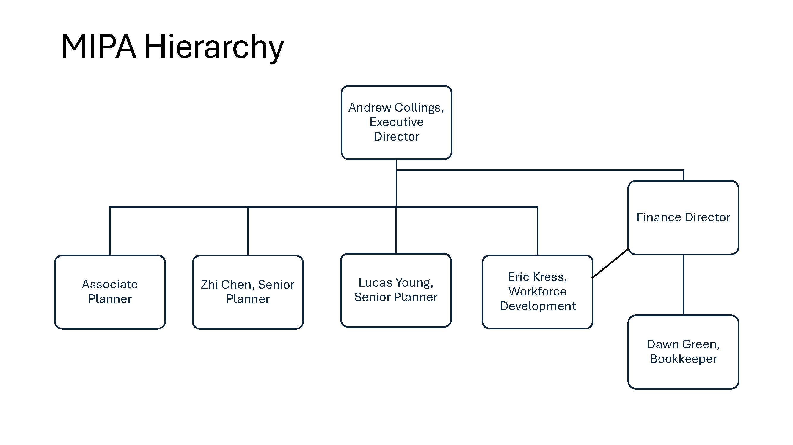
Updated Organizational Chart

Slide 7
FY 2025 Budget Amendment
Since the start of the fiscal year on July 1, MIPA has undertaken several new contracts of varying financial size. The two largest, and long-term, contracts are with the Dallas County Local Housing Trust Fund and the Metro Home Improvement Program
Because of this increase in funding, there have been additional costs incurred by MIPA incidental to running those programs, as well as the other contracts that MIPA has secured. Additionally, MIPA is moving towards administering the Central Iowa Local Workforce Development Board (CILWDB) and the $2 Million in funding it (now MIPA) would receive. MIPA is also potentially going to administer CDBG funds for Polk County on a yearly basis

Slide 8
FY 2025 Budget Amendment
Budget Amendment 1 (Optimistic) - This budget includes all the work committed to date, plus anticipated work the rest of the FY. This includes funding from Polk County and additional EDA funds (beyond the standard $70k) starting April 1. Additional costs are set aside for the renting and improvement of the office space next door. Staffing includes all existing staff, the new planner starting soon, an associate level planner, and the finance director starting sometime in April. The proposed indirect rate is 26.39% with a budget surplus of $78,374
Budget Amendment 2 (Pessimistic) – This budget includes all the work committed to date but no additional work. This includes no funding from Polk County and no additional EDA funds starting April 1. Additional costs are set aside for the renting and improvement of the office space next door. Staffing includes all existing staff, the new planner starting soon, an associate level planner, and the finance director starting sometime in April. The proposed indirect rate is 26.39% with a budget surplus of $11,874

Slide 9
FY 2025 Budget Amendment
Budget Amendment 1 (Optimistic) - This budget includes all the work committed to date, plus anticipated work the rest of the FY. This includes funding from Polk County and additional EDA funds (beyond the standard $70k) starting April 1. Additional costs are set aside for the renting and improvement of the office space next door. Staffing includes all existing staff, the new planner starting soon, an associate level planner, and the finance director starting sometime in April. The proposed indirect rate is 26.39% with a budget surplus of $78,374
  Total Revenues increase $168,751 or 28%
  Total Costs increase $118,957 or 21%
    Total Salaries and Fringe Benefits costs increase $50,076 or 12%
    Total Non-Personnel costs increase by $68,881 or 40%
  Net gain of $49,794

Slide 10
FY 2025 Budget Amendment
Budget Amendment 2 (Pessimistic) – This budget includes all the work committed to date but no additional work. This includes no funding from Polk County and no additional EDA funds starting April 1. Additional costs are set aside for the renting and improvement of the office space next door. Staffing includes all existing staff, the new planner starting soon, an associate level planner, and the finance director starting sometime in April. The proposed indirect rate is 26.39% with a budget surplus of $11,874
  Total Revenues increase $96,251 or 16%
  Total Costs increase $112,957 or 20%
    Total Salaries and Fringe Benefits costs increase $50,076 or 12%
    Total Non-Personnel costs increase by $652,881 or 36%
  Net decrease of $16,706

Slide 11
FY 2026 Budget Development
FY 2026 Budget #1 (Optimistic) – This budget includes all the work committed to date, plus anticipated work for FY 2026. This includes funding from Polk County, additional EDA funds (an additional $100k in funding), and administration of the CILWDB. Staffing includes all existing staff, the new senior planner starting soon, an associate level planner, the workforce director, and the finance director. The proposed indirect rate is 19.16% with a budget surplus of $67,839
FY 2026 Budget #2 (Middle of the Road) – This budget includes all the work committed to date, but no additional anticipated work for FY 2026 beyond what is noted. This includes CDBG funding from Polk County, additional EDA funds (an additional $70k in funding), and administration of the CILWDB. Staffing includes all existing staff, the new senior planner starting soon, an associate level planner, the workforce director, and the finance director. The proposed indirect rate is 19.16% with a budget surplus of $12,839
FY 2026 Budget #3 (Pessimistic) – This budget includes all the work committed to date, but no additional work for FY 2026 beyond what is noted. This includes additional EDA funds (an additional $70k in funding) and administration of the CILWDB. Staffing includes all existing staff, the new senior planner starting soon, the workforce director, and the finance director. The proposed indirect rate is 21.03% with a budget loss of $28,031

Slide 12
Central Iowa Local Workforce Development Board Update
MIPA staff continues to work with the Central Iowa Local Workforce Development Board (CILWDB) to facilitate the transfer of the administration of the Title 1 workforce funding and the CILWDB to MIPA. Currently, the CILWDB receives around $2 Million in funding that is distributed to other agencies for implementation. 10% of funding, or $200k, is used for administration
At the November CILWDB Chief Elected Officials meeting, MIPA was unanimously designated the recipient of the Title 1 funding starting on July 1, 2025. This was the first official step towards MIPA administering these funds. The CILWDB is also in the process of amending its 28E agreement to redesignate risk amongst the participating counties
Moving forward, staff will be bringing back additional information on what is needed to fully complete the transition of administrative responsibility. However, MIPA staff will continue with preparing for CILWDB administration by expanding office space and hiring a Finance Director, amongst other activities

Slide 13
General Update – Office Space
Staff has engaged with two general contractors to provide bids for buildout of offices in the vacant space adjoining the MIPA office. Both contractors have viewed the space and will be preparing a bid. Staff plans to present the bids and draft lease terms at the next board meeting

Slide 14
General Update – EDA Reauthorization
EDA has not been reauthorized since 2004 and legislation to reauthorize has been attached to the Water Resources Development Act (WRDA). On December 10, the House voted 399-18 to pass the proposed bill. It has been sent to the Senate and is being fast tracked. It is believed that the final bill will be sent for the President’s signature before the end of the year
EDA reauthorization would increase the funding provided to EDDs such as MIPA ($35 Million pot to $95 Million) and would increase funding available to community projects significantly (double or more)

Slide 15
General Update – Membership
There are very few outstanding invoices for membership. The largest outstanding invoice is from the City of Perry. The City of Des Moines, City of Altoona, and Polk County were not sent invoices for FY 2025. Note that Story County is mentioned in the report, however, that is for an invoice related to a specific project and not their dues which have been paid in full

Slide 16
December 16, 2024 AGENDA
Call to Order
VOTE: Approval of Agenda
VOTE: Approval of Meeting Minutes
REPORT and VOTE: Invoices and Contracts
REPORT and VOTE: Financial Statements
REPORT and OPTIONAL VOTE: Updated Organizational Chart
REPORT and OPTIONAL VOTE: FY 2025 Budget Amendment and FY 2026 Budget Overview
REPORT: Central Iowa Local Workforce Development Board Update
REPORT: Representative and Officers Update
REPORT: General Update
Other Non-Action Items of Interest to the Committee
Next Meeting Date – January 20th at 2 PM
Adjournment

