Slide 1

Executive Committee Meeting
April 21, 2025

Slide 2

April 21, 2025 AGENDA
Call to Order
VOTE: Approval of Agenda
VOTE: Approval of Meeting Minutes
REPORT and VOTE: Financial Statements
REPORT and OPTIONAL VOTE: Iowa Clean Cities and Communities Coalition Job
Description
REPORT and OPTIONAL VOTE: MIPA Handbook Amendment
REPORT: Central Iowa Local Workforce Development Board (CILWDB)/MIPA Agreements
REPORT: MIPA IRS Redesignation
REPORT: FY 2026 Budget Draft Update
Other Non-Action Items of Interest to the Committee
Next Meeting Date – May 19th at 2 PM
Adjournment

Slide 3
Financial Statements
Information regarding MIPA’s financial accounts
  January – March 2025 Transaction List
  March Balance Sheet
  March Statement of Financial Position
  List of Approved Vendors on Autopay

Slide 4
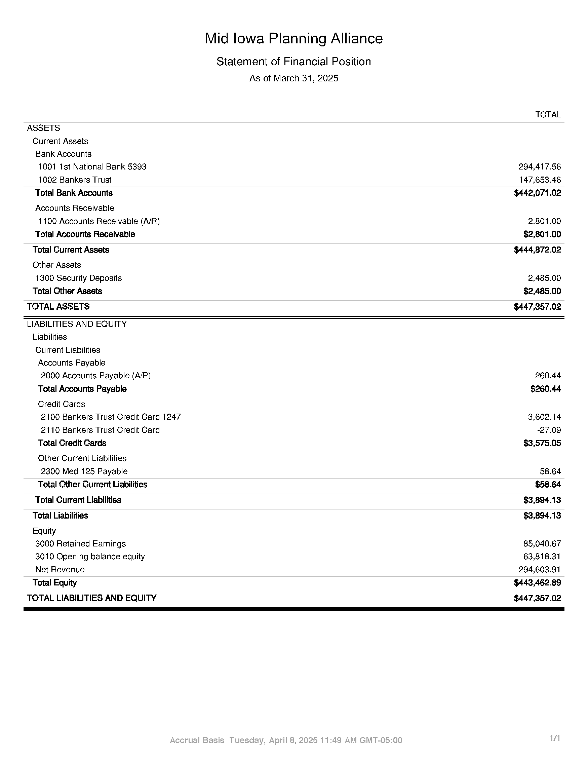
Financial Statements
March 31, 2025 Total Equity = $152,939.46
March 31, 2024 Total Equity = $107,824.46

Slide 5
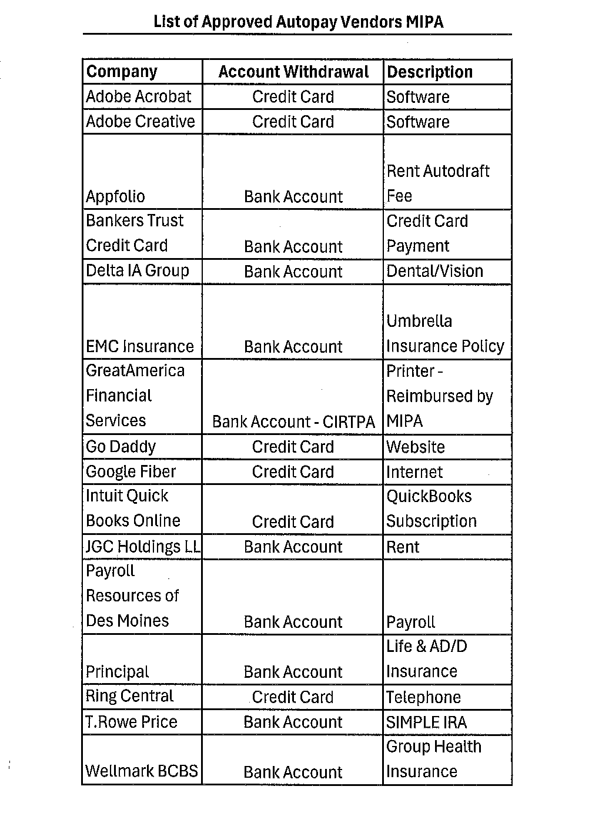
Financial Statements

Slide 6

Iowa Clean Cities and Communities Coalition Job Description
At the March Meeting, the Executive Committee approved MIPA serving as the host entity for the Iowa CC&C program. To move forward with hiring a CC&C Director, an official job description is needed
A draft copy of the proposed CC&C Director Job Description was developed using CC&C guidance and materials from the U.S. Department of Energy Office of Energy Efficiency & Renewable Energy, the agency overseeing the CC&C program
MIPA is currently soliciting for the CC&C Director position. Applications are due May 9. The position will not be filled until the corresponding grant has been awarded

Slide 7
MIPA Handbook Amendment
On April 1, there was an increase in the Maximum Out of Pocket and Deductible amounts for MIPA’s health insurance plan for single ($5,500 to $6,000) and family ($11,000 to $12,000) insurances. To offset this increase, the amount deposited into a Health Savings Account (HSA) for employees, currently $4,000 for single and $8,000 for families, is proposed to increase to the IRS limit. The current IRS limit is $4,300 for single coverage and $8,550 for family coverage

Slide 8
MIPA Handbook Amendment
Following sixty (60) days of continuous employment, all regular, full-time, and permanent part-time employees are eligible to participate in the MIPA’s Health Savings Account (HSA), which allows employees to contribute pre-tax dollars to a health savings account to pay for eligible medical and dependent care expenses. MIPA will provide up to $4,000 for single employees and $8,000 for employees with families per year as a deposit into an HAS, subject to contribution limits established by the IRS. For specific information regarding this benefit, please see the Executive Director.
Following their hiring, all regular, full-time employees are eligible to participate in the MIPA’s Health Savings Account (HSA), which allows employees to contribute pre-tax dollars to a health savings account to pay for eligible medical and dependent care expenses. MIPA will provide up to the IRS limit for single employees and for employees with families per year as a deposit into an HSA. For specific information regarding this benefit, please see the Executive Director.

Slide 9
Central Iowa Local Workforce Development Board (CILWDB)/MIPA Agreements
As MIPA continues towards being the grant recipient on behalf of the CILWDB, MIPA will need to execute agreements with the WIOA Title I providers that implement WIOA Title I funding. Polk County currently has the agreements with the providers on behalf of the CILWDB. Below are the current contracts Polk County has for the CILWDB:
  Central Iowa Core Partners Consortium
  National Able Network
  Youth & Shelter Services
  IWD WIOA Grant Subrecipient

Slide 10
MIPA IRS Redesignation
MIPA is currently designated a 501(c)4 by the IRS. 501(c)(3) and 501(c)(4) are both tax-exempt organizations, but their purposes and allowable activities differ. 501(c)(3)s focus on charitable, religious, educational, scientific, or literary purposes, and donations to them are tax-deductible. 501(c)(4)s are for social welfare, civic leagues, or local employee associations, and donations to them are generally not tax-deductible
501(c)(4)s can also engage in more lobbying and political activities than 501(c)(3)s

Slide 11
MIPA IRS Redesignation
MIPA staff believes it would be advantageous to explore switching from a 501(c)4 to a 501(c)3 for the following reasons:
  There are a greater number and variety of grant opportunities that requires being a 501(c)3 rather than a 501(c)4. This would allow MIPA to apply for more grants on behalf of communities
  Being tax exempt would be beneficial for several of the new programs that MIPA is undertaking, specifically the CC&C program and the CILWDB. Being tax exempt would allow for an expanded ability to fundraise, which would benefit these programs
  MIPA currently undertakes very limited lobbying and is restricted to the housing trust funds that it manages. Those costs amount to around $2k a year. MIPA is currently under the cap placed on 501(c)3s for lobbying ($150k) and will be for the foreseeable future

Slide 12
FY 2026 Budget Draft Update
Describes the scope of work and budget for the period of July 1, 2025, through June 30, 2026
  Identifies the different contracts and scope of work for MIPA staff
  Communicates to member communities and the public MIPA’s intended work
  Development of the budget is tied to Iowa DOT deadlines of April 1 for a draft and June 1 for a final (through the administration of CIRTPA)

Slide 13
FY 2026 Budget Draft Update
Original Budget included:
  6.75 FTEs
  Staff to be added includes an ICCC staff person, CILWDB Director, and part time bookkeeper
  Does not include Polk County CDBG Administration. If MIPA does administer that funding, an additional staff person would be hired, and the budget surplus would increase approximately $15k

Slide 14
FY 2026 Budget Draft Update
Original Budget included:
  EDA Partnership Grant Funding of $70,000 has been removed
  The bookkeeper position has been removed
  2 new comprehensive plan contracts have been added ($15,000 each)

Slide 15
FY 2026 Budget Draft Update
Anticipated Costs | Amount | Percent of Total
Salaries | $449,970 | 49%
Wages | $0 | 0%
Fringe Benefits | $190,321 | 21%
Other Direct Costs | $192,340 | 21%
Indirect | $94,235 | 10%
Total | $927,866 | 100%
Anticipated Revenues | Amount | Percent of Total
EDD PP | $0 | 0%
Membership Dues | $85,986 | 9%
Ongoing Contracts (CIRTPA, HTFs, CILWDB, CCC, etc.) | $759,193 | 76%
Other Contracts | $152,333 | 15%
Total | $997,512 | 100%
Surplus/Deficit | $69,646 | 6.9%

Slide 16
Other Items of Interest
Annual MIPA Board of Directors Meeting - June 16, 2:00 PM
New Executive Committee Members:
  Dallas County – John Cook, City of Dallas Center
  Dallas County – Jessica Drake, City of Van Meter
  Warren County – Councilmember Bob Lane, City of Indianola
  Warren County – Councilmember George Meinecke, City of Norwalk

Slide 17
April 21, 2025 AGENDA
Call to Order
VOTE: Approval of Agenda
VOTE: Approval of Meeting Minutes
REPORT and VOTE: Financial Statements
REPORT and OPTIONAL VOTE: Iowa Clean Cities and Communities Coalition Job
Description
REPORT and OPTIONAL VOTE: MIPA Handbook Amendment
REPORT: Central Iowa Local Workforce Development Board (CILWDB)/MIPA Agreements
REPORT: MIPA IRS Redesignation
REPORT: FY 2026 Budget Draft Update
Other Non-Action Items of Interest to the Committee
Next Meeting Date – May 19th at 2 PM
Adjournment

