Slide 1

Executive Committee Meeting
February 19, 2025

Slide 2

February 19, 2025 AGENDA
Call to Order
VOTE: Approval of Agenda
VOTE: Approval of Meeting Minutes
REPORT and VOTE: Financial Statements
REPORT and OPTIONAL VOTE: EDA Partnership Planning Grant
REPORT and OPTIONAL VOTE: Finance Director Job Description
Other Non-Action Items of Interest to the Committee
Next Meeting Date – March 17th at 2 PM
Adjournment

Slide 3

EDA Partnership Planning Grant
MIPA receives a planning grant from EDA to perform economic and community development work for MIPA communities. The planning grant is awarded on a 3-year cycle with the current grant ending on March 31, 2025. The upcoming 3-year grant will begin on April 1, 2025 and end on March 31, 2027
Funding for the proposed grant is $70,000 a year for a total of $210,000 in EDA funds. This is the same funding level as the current grant cycle.
The match requirement will be reduced from a 50/50 split to a 60/40 split. The annual local match will be $46,667 or $140,000 over the grant term.
To submit the grant, a resolution is required from MIPA to guarantee the local match. A proposed match resolution was included in the agenda packet

Slide 4
EDA Partnership Planning Grant
EDA Standard Scope of Work
  COMPREHENSIVE ECONOMIC DEVELOPMENT STRATEGY
    Update the CEDS which is required for EDA funding
  PARTNERSHIP COORDINATION
    Coordinate economic/community development planning with other economic development partners
  BUILDING STAFF CAPACITY AND MANAGEMENT STRENGTH
    Provide staff support and training to develop skills and management expertise that will expand the ability to seek, obtain and successfully implement other economic opportunities
  TECHNICAL ASSISTANCE
    Provide technical assistance as appropriate to member agencies regarding topics such as industrial parks, land use regulations, grant training workshops, district committees, economic development programs, business development, tribal entity or local governments
  OTHER ACTIVITIES

Slide 5
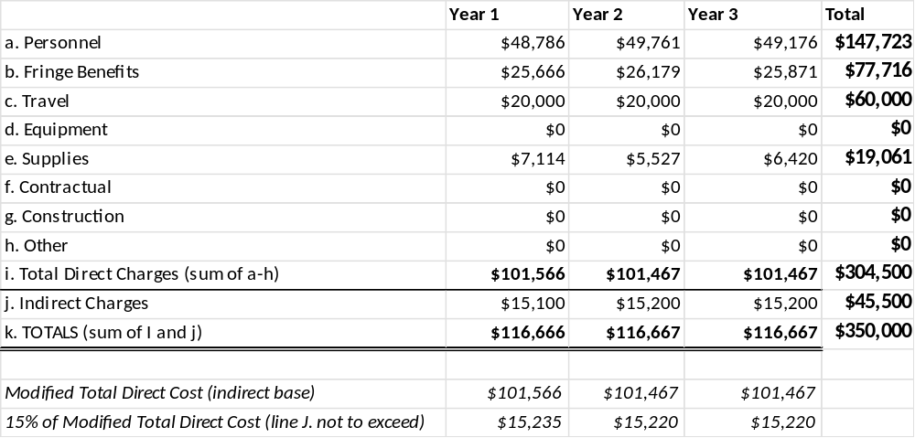
EDA Partnership Planning Grant

Slide 6
Finance Director Job Description
At the December meeting, the Executive Committee approved a new organizational chart that included a Finance Director position. However, the job description for that position was not included in the initial job description approvals from the January meeting of last year (2024), therefore an approved job description is needed
A proposed job description was included in the agenda packet
The Finance Director job description is based on the Bookkeeper job description with more responsibility and a focus on overall organizational financial health

Slide 7
Grant Funding
FY25 Grant Submissions
Municipality | Amount | Funding Source | Project | Status
Regional Effort | ~$1,200,000 | NTIA – Digital Broadband Equity | Projects to improve internet access | Denied
SCHT | $382,074 | IFA – SHTF | Affordable Housing | Awarded
CIHTF | $565,690 | IFA – SHTF | Affordable Housing | Awarded
DCLHTF | $384,356 | IFA – SHTF | Affordable Housing | Awarded
Martensdale | $500,000 | WTFAP | Wastewater plant improvements | Awarded
Hartford | $733,226 | State TAP Program | Safe Routes to School | Awarded
Indianola | $35,497 | FEMA – AFG | PPE washer/extractor and dryer | Submitted
Carlisle | $145,849 | FEMA – AFG | Radios for every seated position | Submitted
Nevada | $650,000 | IEDA – CDBG | Façade improvements for 6 buildings | Submitted
MIPA | $210,000 | EDA | Partnership Program | Pending

Slide 8
Grant Funding
Total Grants Submitted - $4,806,692
Total Awarded - $2,565,346
Total Denied - $1,200,000
Total Outstanding - $1,041,346

Slide 9
February 19, 2025 AGENDA
Call to Order
VOTE: Approval of Agenda
VOTE: Approval of Meeting Minutes
REPORT and VOTE: Financial Statements
REPORT and OPTIONAL VOTE: EDA Partnership Planning Grant
REPORT and OPTIONAL VOTE: Finance Director Job Description
Other Non-Action Items of Interest to the Committee
Next Meeting Date – March 17th at 2 PM
Adjournment

