Slide 1

Board of directors
June 16, 2025

Slide 2

June 16, 2025 AGENDA
Call to Order
VOTE: Approval of Agenda
VOTE: Approval of Meeting Minutes
REPORT and VOTE: Financial Statements
REPORT and VOTE: Invoices and Contracts
REPORT and VOTE: FY 2024 Audit
REPORT and VOTE: FY 2026 Budget
REPORT and VOTE: Executive Director Review
REPORT and VOTE: : Central Iowa Local Workforce Development Board (CILWDB) MOU and Recipient Agreements and Services Agreements
REPORT and VOTE: MIPA IRS Redesignation to a 501(C)3
REPORT and VOTE: MIPA Handbook Amendment
REPORT: MIPA Year in Review
Other Non-Action Items of Interest to the Committee
Next Meeting Date – TBD – Fall 2025
Adjournment

Slide 3
Financial Statements
Information regarding MIPA’s financial accounts
  May 2025 Transaction List
  May Budget vs Actual FY 2025
  May Statement of Activity
  May Statement of Financial Position W/MHIP
  May Statement of Financial Position W/O-MHIP

Slide 4

Contracts
Contract: GRATUS Development NEPA - $5,000
MIPA works with the Iowa Economic Development Administration (IEDA) on various federally funded projects and completes the NEPA requirements for member communities. Because of this relationship, IEDA desires to work with MIPA on other similar federally funded projects, such as development projects funded with HOME dollars. GRATUS Development has such a project and was connected to MIPA through IEDA NEPA personnel. This contract would strengthen MIPA’s relationship with IEDA and help in future dealings with other community projects

Slide 5
Contracts
Contract: City of Baxter Comprehensive Plan - $23,000
The City of Baxter needs a new Comprehensive Plan for the community and reached out to several organizations, including MIPA, to determine who would be best to create the plan. MIPA submitted a proposal to Council. Ultimately, MIPA was chosen, and the proposal was approved by the City

Slide 6
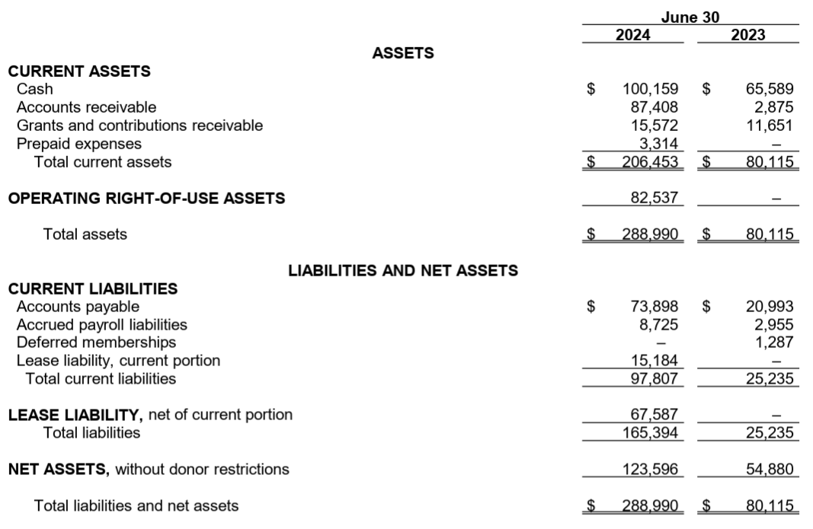
FY 2024 Audit
In May, Denman & Company, LLP completed a draft version of the Fiscal Year (FY) 2024 Audit of MIPA’s Finances

Slide 7
FY 2024 Audit
Final Audit sent to staff on Friday, June 13
Internal Control Letter identified two items:
  Material Weakness – Financial Reporting
  Significant Deficiency – Segregation of Duties
Staff has worked to correct these deficiencies moving forward

Slide 8
FY 2026 Budget
Describes the scope of work and budget for the period of July 1, 2025, through June 30, 2026
  Identifies the different contracts and scope of work for MIPA staff
  Communicates to member communities and the public MIPA’s intended work

Slide 9
FY 2026 Budget
Proposed Budget includes:
  5.0 FTEs
  Staff to be added is Eric Kress as the CILWDB Director
  Staffing levels may fluctuate as other funding programs become available
  EDA Partnership Grant Funding of $70,000 has been removed
  The bookkeeper position and Iowa Clean Cities Director have been removed

Slide 10
FY 2026 Budget – Administrative Budget
Anticipated Costs | Amount | Percent of Total | Percent Change from FY 2025
Salaries | $382,656 | 46% | 29%
Wages | $5,760 | 1% | -47%
Fringe Benefits | $160,060 | 19% | 10%
Other Direct Costs | $191,759 | 23% | 44%
Indirect | $92,735 | 11% | -15%
Total | $830,730 | 100% | 19%
Anticipated Revenues | Amount | Percent of Total | Percent Change from FY 2025
EDD PP | $0 | 0% | -100%
Membership Dues | $85,986 | 10% | 0%
Ongoing Contracts (CIRTPA, HTFs, CILWDB, CCC, etc.) | $661,447 | 73% | 52%
Other Contracts | $152,333 | 17% | -18%
Total | $899,766 | 100% | 16%
Surplus/Deficit | $66,796 | 7.4% | -15%

Slide 11
FY 2026 Budget – Organizational Budget
Anticipated Costs | Amount | Percent of Total
Salaries | $382,656 | 11%
Wages | $5,760 | 1%
Fringe Benefits | $160,060 | 5%
Other Direct Costs | $2,808,350 | 81%
Indirect | $92,735 | 2%
Total | $3,449,561 | 100%
Anticipated Revenues | Amount | Percent of Total
EDD PP | $0 | 0%
Membership Dues | $85,986 | 2%
Ongoing Contracts (CIRTPA, HTFs, CILWDB, CCC, etc.) | $3,278,038 | 93%
Other Contracts | $152,333 | 5%
Total | $3,516,357 | 100%
Surplus/Deficit | $66,796 | 1.9%

Slide 12
Executive Director Review
The Review Committee, comprised of the MIPA Officers, completed an assessment of the Executive Director and met to discuss the Executive Director’s review. The MIPA Officers are:
  Brenda Dryer – Chair
  Supervisor Linda Murken – Vice-Chair
  Glenn Lyons – Secretary/Treasurer
A copy of the Review Committee’s ratings were sent out prior to the meeting
Recommendation of a 5% increase

Slide 13

Central Iowa Local Workforce Development Board
In Iowa, there are currently six different Local Workforce Development Boards who are a staring point for making policy decision about which workforce programs and resources should be priorities in each area. The local areas work with the State Workforce Development Board to make certain that each region has the resources necessary to support employment programs across the state. They also receive Title 1 funding as a sub-recipient from Iowa’s State Workforce Development Board
In central Iowa, that is about $2 Million a year and is facilitated by the Central Iowa Local Workforce Development Board (CILWDB)

Slide 14
Central Iowa Local Workforce Development Board
The CILWDB is currently made up of eight counties in central Iowa. They are:
  Boone
  Dallas
  Jasper
  Madison
  Marion
  Polk
  Story
  Warren

Slide 15
Central Iowa Local Workforce Development Board
The CILWDB currently has two boards. There is the Chief Elected Official Board which has a County Supervisor representative from each county. This board is financially responsible for the performance of the grant, oversees the grant administration, appoints local grant recipients, and appoints the Central Iowa Workforce Development Board which is the second board of record
Currently, the CILWDB is not an incorporated organization. Rather, the Chief Elected Official Board designates a Chief Elected Official who serves as the CEO. This role is currently filled by Story County Supervisor Heddens

Slide 16
Central Iowa Local Workforce Development Board
MIPA was originally contacted and identified as a potential partner to serve as the grant recipient, fiscal agent, and employer of record due to the significant overlap of area and MIPA member communities, the similar work that MIPA already undertakes through existing programming, and the ability to combine resources for both the CILWDB and MIPA to sustainably expand and improve the work that each entity does
As discussions moved forward, MIPA Staff determined that support would be provided in much the same way that services are provided for CIRTPA, but that MIPA would be the grant recipient and would sign sub-recipient contracts and incur costs on behalf of the CILWDB utilizing Title 1 WIOA funding

Slide 17
Central Iowa Local Workforce Development Board
The CILWDB has had periodic issues with vendors who implement Title 1 programming and spending in the past. Most notable was the Central Iowa Employment and Training Consortium (CIETC) around 2006. Another was more recent with an Audit completed by the State Auditors Office for the Children & Families of Iowa regarding the misappropriation of WIOA Title 1 Funding
MIPA staff believes that the CILWDB, particularly current staff, has worked to mitigate previous issues. Moving forward there is a need for sound administrative knowledge and oversight implementation, services that MIPA can provide

Slide 18
Central Iowa Local Workforce Development Board
The current 28E agreement that each County is party to has a shared-liability aspect. WIOA Title 1 Funding, by design, holds the Counties ultimately responsible for any misspent funding. There are a series of different level to Title 1 liability:
  1st – Any misspent funding is attempted to be recovered by the offending agency (sub-recipients) who also hold specific insurances required by the contract
  2nd – The CILWDB has separate insurance that is purchased every year
  3rd – As a last resort, which has never been used, the 8 Counties would have to pay back funding

Slide 19
Central Iowa Local Workforce Development Board
Two contracts are needing approval:
  An MOU between MIPA and the CILWDB outlining roles and expectations between all parties. This is primarily based on guidance on Title 1 WIOA Funding
  Subrecipient agreements between MIPA and agencies that complete the technical work for Title 1 WIOA Funding
    Awards are based on available federal funding and if funding is reduced or eliminated, there are clauses within the contract to rescind the agreement
A funding agreement with Iowa Workforce Development is forthcoming

Slide 20
MIPA IRS Redesignation
MIPA is currently designated a 501(c)4 by the IRS. 501(c)(3) and 501(c)(4) are both tax-exempt organizations, but their purposes and allowable activities differ. 501(c)(3)s focus on charitable, religious, educational, scientific, or literary purposes, and donations to them are tax-deductible. 501(c)(4)s are for social welfare, civic leagues, or local employee associations, and donations to them are generally not tax-deductible
501(c)(4)s can also engage in more lobbying and political activities than 501(c)(3)s

Slide 21
MIPA IRS Redesignation
MIPA staff believes it would be advantageous to explore switching from a 501(c)4 to a 501(c)3 for the following reasons:
  There are a greater number and variety of grant opportunities that requires being a 501(c)3 rather than a 501(c)4. This would allow MIPA to apply for more grants on behalf of communities
  Being tax exempt would be beneficial for several of the new programs that MIPA is undertaking, specifically the CC&C program and the CILWDB. Being tax exempt would allow for an expanded ability to fundraise, which would benefit these programs
  MIPA currently undertakes very limited lobbying and is restricted to the housing trust funds that it manages. Those costs amount to around $2k a year. MIPA is currently under the cap placed on 501(c)3s for lobbying ($150k) and will be for the foreseeable future

Slide 22
MIPA Handbook Amendment
On April 1, there was an increase in the Maximum Out of Pocket and Deductible amounts for MIPA’s health insurance plan for single ($5,500 to $6,000) and family ($11,000 to $12,000) insurances. To offset this increase, the amount deposited into a Health Savings Account (HSA) for employees, currently $4,000 for single and $8,000 for families, is proposed to increase to the IRS limit. The current IRS limit is $4,300 for single coverage and $8,550 for family coverage

Slide 23
MIPA Handbook Amendment
Original
Following sixty (60) days of continuous employment, all regular, full-time, and permanent part-time employees are eligible to participate in the MIPA’s Health Savings Account (HSA), which allows employees to contribute pre-tax dollars to a health savings account to pay for eligible medical and dependent care expenses. MIPA will provide up to $4,000 for single employees and $8,000 for employees with families per year as a deposit into an HAS, subject to contribution limits established by the IRS. For specific information regarding this benefit, please see the Executive Director.
Amended
Following their hiring, all regular, full-time employees are eligible to participate in the MIPA’s Health Savings Account (HSA), which allows employees to contribute pre-tax dollars to a health savings account to pay for eligible medical and dependent care expenses. MIPA will provide up to the IRS limit for single employees and for employees with families per year as a deposit into an HSA. For specific information regarding this benefit, please see the Executive Director.

Slide 24
MIPA Year in Review
MIPA staff will provide an overview of Fiscal Year 2025
Current MIPA staff:
  Andrew Collings – Executive Director
  Ethan Wherry – Finance Director and Planner
  Lucas Young – Senior Planner
  Zhi Chen - Senior Planner

Slide 25

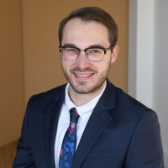
MIPA Year in Review
New Staff in Fiscal Year 2025
    Zhi Chen, AICP
    M.S. in Urban and Regional Planning (University of Iowa)
    Previously at the Des Moines Area Metropolitan Planning Organization (MPO)
    Ethan Wherry
    M.S. in Urban and Regional Planning
    from the University of Iowa (Dec. 2024)
    Prior experience assisting small businesses
    with accounting and bookkeeping needs

Slide 26
MIPA Year in Review
Growth in Fiscal Year 2025
    Addition of Metro Home Improvement (MHIP) Administration
    Addition of Dallas County Local Housing Trust Fund (DCLHTF) Administration
    Addition of the Clean Cities Coalition
    Facilitated the addition of the Central Iowa Local Workforce Development Board (CILWDB)

Slide 27
MIPA Year in Review
    Addition of Metro Home Improvement Program (MHIP) Administration
    The MHIP is a 28E agreement with Altoona, Ankeny, Bondurant, Grimes, Polk City, Urbandale, West Des Moines, & Windsor Heights to implement the long-standing home repair program
    City of West Des Moines previously administered the program and approached MIPA, as a regional entity, to take over the administration as the City refocused efforts

Slide 28
MIPA Year in Review
Addition of the Dallas County Local Housing Trust Fund (DCLHTF) Administration
    The DCLHTF is designated by the Iowa Finance Authority as the local housing trust fund for Dallas County.
    The DCLHTF directs its annual allocation to owner occupied repair projects
    City of West Des Moines previously administered the program and transitioned with MHIP

Slide 29
MIPA Year in Review
    Addition of the Iowa Clean Cities Coalition
    Meant to incorporate a variety of public and private stakeholders to coordinate education and technical assistance on alternative fuels and advanced vehicle technologies
    Federal funding for this was cut but MIPA will consider alternate ways to support the initiative

Slide 30
MIPA Year in Review
    Facilitated the addition of the Central Iowa Local Workforce Development Board
    Starting July 1, 2025, MIPA will employ the CILWDB staff person
    Approached by a MIPA board member to fill this role as the CILWDB and MIPA have overlapping territories
    The addition of this position shows the flexibility to provide support to the region, as needed

Slide 31
MIPA Year in Review
Ongoing Projects
Administration of the Central Iowa Regional Transportation Agency (CIRTPA)
Administration of the Story County Housing Trust (SCHT)
Administration of the Central Iowa Housing Trust Fund (CIHTF)
Administration of the Norwalk Rehabilitation Program
Implementation of the Story County Housing Action Plan

Slide 32
MIPA Year in Review
New Projects
    Comprehensive Plans
      Marion County
      Pleasantville
      Sully
    Housing Needs Assessments
      Boone
      Huxley
      Nevada
    CDBG Administration
      Nevada Façade
      Knoxville Façade
      Indianola Façade

Slide 33
MIPA Year in Review
Grant Applications
    Funded
    Hartford Safe Routes to School (SRTS) – $733,226
    Roland Derelict Building – $20,500
    Nevada CDBG Façade – $650,000
    Martensdale WTFAP – $500,000
    Story City EDA – $681,130
    Total - $2,584,856
Pending
Carlisle FEMA AFG – $145,849
Indianola FEMA AFG – $35,497
  Not Funded
  Regional Digital Equity Broadband Grant – $12 Million

Slide 34
MIPA Year in Review
Fiscal Year 2025 has been unpredictable
    The federal landscape has shifted making it difficult to plan for the future
    Funding streams are likely to remain unpredictable
    Applications for programs like CDBG will be more competitive and harder to estimate availability
    MIPA staff is focused on planning for the unknown and dealing with challenges as they arise

Slide 35
June 16, 2025 AGENDA
Call to Order
VOTE: Approval of Agenda
VOTE: Approval of Meeting Minutes
REPORT and VOTE: Financial Statements
REPORT and VOTE: Invoices and Contracts
REPORT and VOTE: FY 2024 Audit
REPORT and VOTE: FY 2026 Budget
REPORT and VOTE: Executive Director Review
REPORT and VOTE: : Central Iowa Local Workforce Development Board (CILWDB) MOU and Recipient Agreements and Services Agreements
REPORT and VOTE: MIPA IRS Redesignation to a 501(C)3
REPORT and VOTE: MIPA Handbook Amendment
REPORT: MIPA Year in Review
Other Non-Action Items of Interest to the Committee
Next Meeting Date – TBD – Fall 2025
Adjournment

