Slide 1

Executive Committee Meeting
July 21, 2025

Slide 2

July 21, 2025 AGENDA
Call to Order
VOTE: Approval of Agenda
VOTE: Approval of Meeting Minutes
REPORT and VOTE: Financial Statements
REPORT and VOTE: Invoices and Contracts
REPORT and VOTE: Administrative Approval of WIOA Title 1 Expenses
REPORT and VOTE: Investment Policy
REPORT and VOTE: Additional Signatory on Checks
REPORT and VOTE: FY 2026 Budget Amendment
REPORT: MIPA Designation as a Council of Governments
Other Non-Action Items of Interest to the Committee
Next Meeting Date – August 18th at 2 PM
Adjournment

Slide 3
Financial Statements
Information regarding MIPA’s financial accounts
  June 2025 Transaction List
  Budget vs Actual FY 2025
  Year End Statement of Activity with and without MHIP
  June Statement of Financial Position without MHIP

Slide 4
Invoices and Contracts
Invoices
None | $-
Contracts
Great River Corridor Collaboration | $80,000 – Revenue
IWD WIOA Funding | $2,050,561 - Revenue
National Able Network | $1,292,730 - Expense
YSS | $838,000 - Expense
Thom Diehl, CPA | $5,000 (Est.) - Expense
Human Capital Strategies and Solutions | $7,000 (Est.) - Expense

Slide 5

Administrative Approval of WIOA Title 1 Expenses
The National Able Network and YSS provide the Title 1 services as sub-recipients of MIPA and the CILWDB. Due to the timing of funding submittals, it would be necessary for the MIPA Executive Committee to meet two times a month to approve the reimbursement of funding according to the existing policy
Staff is requesting the ability to administratively approve WIOA Title 1 reimbursement requests from those two agencies subject to all rules, regulations, and requirements of the Department of Labor, Iowa Workforce Development, and the contract with MIPA

Slide 6
Investment Policy
As MIPA continues to grow and diversify the types of assistance and programming it provides member communities, a formal policy on how MIPA invests funds is needed. The proposed Investment Policy was developed to meet the requirements of Iowa Code Chapter 12B and Chapter 12 C, the investment of public funds
Funding that would be subject to this policy includes, but is not limited to:
  MIPA Operating and Reserve Funding
  MHIP Operating Funding
  CILWDB Operating and Reserve Funding

Slide 7
Additional Signatory on Checks
MIPA Staff has been working with Denman, MIPA’s auditor, to address the segregation of duties finding noted in the FY 2024 Audit
One solution is to have two signatories on all checks issued by MIPA and affiliate organizations. The elimination of a single signature removes the possibility that one person can write a check without involving another staff person
Staff proposes the requirement of two signatures on all checks for MIPA and affiliate organizations and add Lucas Young as a signatory to meet the auditor’s requirements

Slide 8
FY 2026 Budget Amendment
Since the Board of Directors meeting in June, MIPA has seen its funding increase with the release of the EDA Planning Grant. These funds, $70k, were not included in the original budget that was approved
Due to the increase in workload, the proposed budget amendment would add funding to hire an additional planner to complete general planning activities associated with assisting member communities

Slide 9
FY 2026 Budget Amendment – Administrative Budget
Anticipated Costs | Amount | Percent of Total | Percent Change from FY 2026 Original
Salaries | $447,289 | 48% | 17%
Wages | $5,760 | 1% | 0%
Fringe Benefits | $184,624 | 20% | 15%
Non-Personnel Costs | $297,994 | 31% | 5%
Total | $935,676 | 100% | 12%
Anticipated Revenues | Amount | Percent of Total | Percent Change from FY 2026 Original
EDD PP | $70,000 | 7% | N/A
Membership Dues | $85,986 | 8% | 0%
Ongoing Contracts (CIRTPA, HTFs, CILWDB, CCC, etc.) | $661,447 | 65% | 0%
Other Contracts | $197,333 | 19% | 30%
Total | $1,014,766 | 100% | 13%
Surplus/Deficit | $79,090 | 7.4% | 18%

Slide 10
FY 2026 Budget Amendment – Organizational Budget
Anticipated Costs | Amount | Percent of Total
Salaries | $447,298 | 13%
Wages | $5,760 | 1%
Fringe Benefits | $184,624 | 5%
Non-Personnel Costs | $2,914,585 | 85%
Total | $3,449,561 | 100%
Anticipated Revenues | Amount | Percent of Total
EDD PP | $70,000 | 2%
Membership Dues | $85,986 | 2%
Ongoing Contracts (CIRTPA, HTFs, CILWDB, CCC, etc.) | $3,434,024 | 95%
Other Contracts | $197,333 | 1%
Total | $3,516,357 | 100%
Surplus/Deficit | $79,090 | 2%

Slide 11

COG Overview
Created more than 45 years ago, Iowa’s Councils of Governments (COGs) provide professional planning, programming, and technical assistance to Iowa’s cities, counties, businesses, and community organizations
COGs are organizations formed by counties and cities to serve local governments and their regional citizenry. Their governing boards are made up of local elected officials, business and education leaders, economic development professionals, and others

Slide 12
COG Overview
Duties of COGs as listed in Chapter 28H include:
  Provide planning services or technical assistance to the region defined in section 28H.1
  Coordinate regional community development planning to assist community development and planning
  Coordinate delivery of community development programs and services with local, state, and federal programs and activities
  Prepare a regional community development plan which shall be updated annually

Slide 13
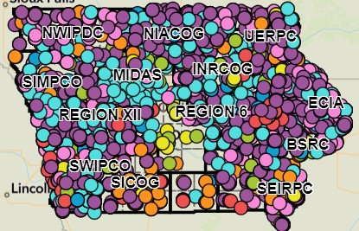
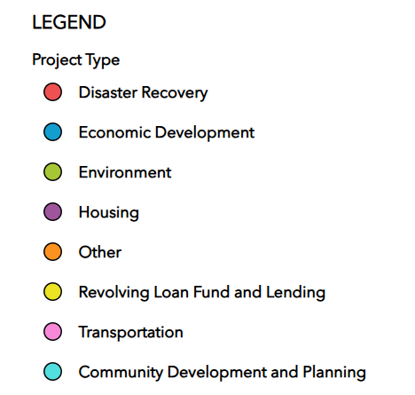
Benefits of Being Designated a COG
Additional funding from the State of Iowa. The estimated amount, if not increased by the legislature, is ~$18k a year
Official recognition would allow MIPA to participate in statewide initiatives that utilize the COG network such as 5-2-1-0 Healthy Choices. This could increase the types of services MIPA may provide member communities
Being a COG would allow MIPA access to the Iowa Public Agency Investment Trust (IPAIT), which provides investment services specifically for Iowa governments and governmental entities. This would improve MIPA’s ability to invest operating and reserve funding and meet Iowa Code requirements of investing public funds
MIPA staff would gain access to the Iowa Public Employees’ Retirement System (IPERS) which would improve staff recruitment and retention
MIPA would be treated as a 28E organization in state law which would allow MIPA to more effectively work with local governments

Slide 14
Steps to Being Designated a COG
To be designated a COG, the State of Iowa Legislature would need to amend Chapter 28H to add MIPA to the list of COGs. Staff has been conducting research into what additional steps would be needed but additional conversations with legislators throughout the region will be necessary
Cities and counties could speak out against COG designation if it were to move forward.

Slide 15
Previous COG in Central Iowa
A paper was written by Prof. Carlton Basmajian from ISU called An Absent Space: The Story of the Central Iowa Regional Association of Local Governments (CIRLAG)
CIRLAG and its predecessor first formed in early 1965 covering Polk and surrounding counties
By the end of 1977, CIRLAG reached its peak size, employing more than 80 people managing a very wide range of planning activities
Ultimately CIRLAG dissolved in 1983 leaving nearly $600k owed to the federal government
Services provided by CIRLAG included:
  Entitlement CDBG administration
  Comprehensive Employment and Training Act (CETA) funding
  Urban Development Action Grants (UDAG)
  Aging programs
  Transportation – Des Moines MPO
  Regional wastewater management
  Central Iowa Regional Housing Authority (CIRHA)

Slide 16
July 21, 2025 AGENDA
Call to Order
VOTE: Approval of Agenda
VOTE: Approval of Meeting Minutes
REPORT and VOTE: Financial Statements
REPORT and VOTE: Invoices and Contracts
REPORT and VOTE: Administrative Approval of WIOA Title 1 Expenses
REPORT and VOTE: Investment Policy
REPORT and VOTE: Additional Signatory on Checks
REPORT and VOTE: FY 2026 Budget Amendment
REPORT: MIPA Designation as a Council of Governments
Other Non-Action Items of Interest to the Committee
Next Meeting Date – August 18th at 2 PM
Adjournment

