Slide 1

Executive Committee Meeting
August 18, 2025

Slide 2

August 18, 2025 AGENDA
Call to Order
VOTE: Approval of Agenda
VOTE: Approval of Meeting Minutes
REPORT and VOTE: Financial Statements
REPORT and VOTE: Invoices and Contracts
REPORT and VOTE: MIPA Designation as a Council of Governments
Other Non-Action Items of Interest to the Committee
Next Meeting Date – September 15th at 2 PM
Adjournment

Slide 3
Financial Statements
Information regarding MIPA’s financial accounts
  July 2025 Transaction List
  Budget vs Actuals July FY 26
  Revised FY 25 Statement of Activity
  Statement of Activity July FY 26
  Statement of Financial Position July FY 26

Slide 4
Invoices and Contracts
Invoices
Neighborly Software | $8,280
Contracts
Polk County Consolidated Plan | $8,000 – Revenue
IWD WIOA Funding Amendment #1 | $0 - Revenue
City of Nevada CDBG Façade Administration | $30,000 – Revenue

Slide 5


COG Overview
Created more than 45 years ago, Iowa’s Councils of Governments (COGs) provide professional planning, programming, and technical assistance to Iowa’s cities, counties, businesses, and community organizations
COGs are organizations formed by counties and cities to serve local governments and their regional citizenry. Their governing boards are made up of local elected officials, business and education leaders, economic development professionals, and others

Slide 6
COG Overview
Duties of COGs as listed in Chapter 28H include:
  Provide planning services or technical assistance to the region defined in section 28H.1
  Coordinate regional community development planning to assist community development and planning
  Coordinate delivery of community development programs and services with local, state, and federal programs and activities
  Prepare a regional community development plan which shall be updated annually

Slide 7
Previous COG in Central Iowa
A paper was written by Prof. Carlton Basmajian from ISU called An Absent Space: The Story of the Central Iowa Regional Association of Local Governments (CIRLAG)
CIRLAG and its predecessor first formed in early 1965 covering Polk and surrounding counties
By the end of 1977, CIRLAG reached its peak size, employing more than 80 people managing a very wide range of planning activities
Ultimately CIRLAG dissolved in 1983 leaving nearly $600k owed to the federal government
Services provided by CIRLAG included:
  Entitlement CDBG administration
  Comprehensive Employment and Training Act (CETA) funding
  Urban Development Action Grants (UDAG)
  Aging programs
  Transportation – Des Moines MPO
  Regional wastewater management
  Central Iowa Regional Housing Authority (CIRHA)

Slide 8
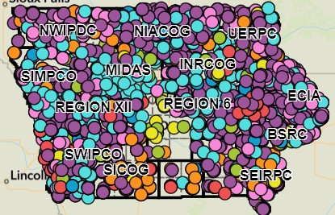
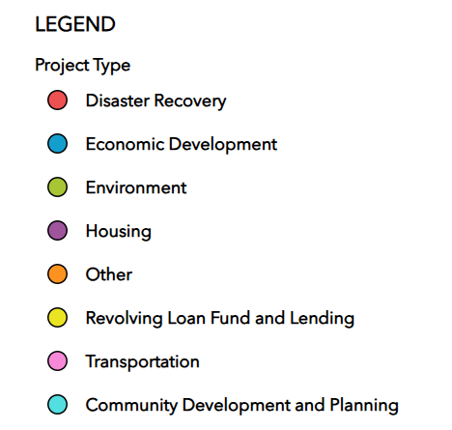
Benefits of Being Designated a COG
Additional funding from the State of Iowa. The estimated amount, if not increased by the legislature, is ~$18k a year
Official recognition would allow MIPA to participate in statewide initiatives that utilize the COG network such as 5-2-1-0 Healthy Choices. This could increase the types of services MIPA may provide member communities
Being a COG would allow MIPA access to the Iowa Public Agency Investment Trust (IPAIT), which provides investment services specifically for Iowa governments and governmental entities. This would improve MIPA’s ability to invest operating and reserve funding and meet Iowa Code requirements of investing public funds
MIPA staff would gain access to the Iowa Public Employees’ Retirement System (IPERS) which would improve staff recruitment and retention
MIPA would be treated as a 28E organization in state law which would allow MIPA to more effectively work with local governments

Slide 9
Steps to Being Designated a COG
To be designated a COG, the State of Iowa Legislature would need to amend Chapter 28H to add MIPA to the list of COGs. Staff has been conducting research into what additional steps would be needed but additional conversations with legislators throughout the region will be necessary
Cities and counties could speak out against COG designation if it were to move forward.

Slide 10
August 18, 2025 AGENDA
Call to Order
VOTE: Approval of Agenda
VOTE: Approval of Meeting Minutes
REPORT and VOTE: Financial Statements
REPORT and VOTE: Invoices and Contracts
REPORT and VOTE: MIPA Designation as a Council of Governments
Other Non-Action Items of Interest to the Committee
Next Meeting Date – September 15th at 2 PM
Adjournment

