Slide 1

Executive Committee Meeting
January 22, 2025

Slide 2

January 22, 2025 AGENDA
Call to Order
VOTE: Approval of Agenda
VOTE: Approval of Meeting Minutes
PRESENTATION: MIPA Insurance Coverage
REPORT and VOTE: Financial Statements
REPORT and VOTE: Invoices and Contracts
REPORT and VOTE: MIPA Depository List and Autopay Vendors
Other Non-Action Items of Interest to the Committee
Next Meeting Date – February 16th at 2 PM
Adjournment

Slide 3
Insurance Coverage Presentation
As MIPA has increased the size and scope of work that the organization has undertaken, the need for additional insurance coverages has grown. MIPA staff has worked with Jester Insurance to identify coverage deficiencies and secure additional insurance to ensure adequate coverage for existing operations
MIPA has added:
  Professional Liability Coverage
  Management Liability Coverage
Heith Hockenberry from Jester Insurance will provide an overview of these new coverages

Slide 4
Financial Statements
Information regarding MIPA’s financial accounts
  November 2025 Financial Statements
  December 2025 Financial Statements
  November and December Transactional Detail

Slide 5
Invoices and Contracts
Invoices
Cincinnati Insurance | $5,178
Denman CPA LLP | $5,000
Contracts - Revenue
CIRHA 5-Year Plan NEPA | $14,000
City of Indianola EECBG Admin | $3,500

Slide 6
MIPA Depository List and Autopay Vendors
According to MIPA’s Investment Policy “All MIPA funds deposited and held in a depository shall be in depositories approved by the MIPA Executive Committee.” To ensure compliance, MIPA asks that the Executive Committee approve the list of financial institutions where money shall be held
Current Depository List
Bankers Trust – MIPA | $219,881.79
First National Bank – MHIP | $262,593.91
First National Bank – CIWD | $6,442.43
GreenState Credit Union - CIWD | $370,597.34

Slide 7
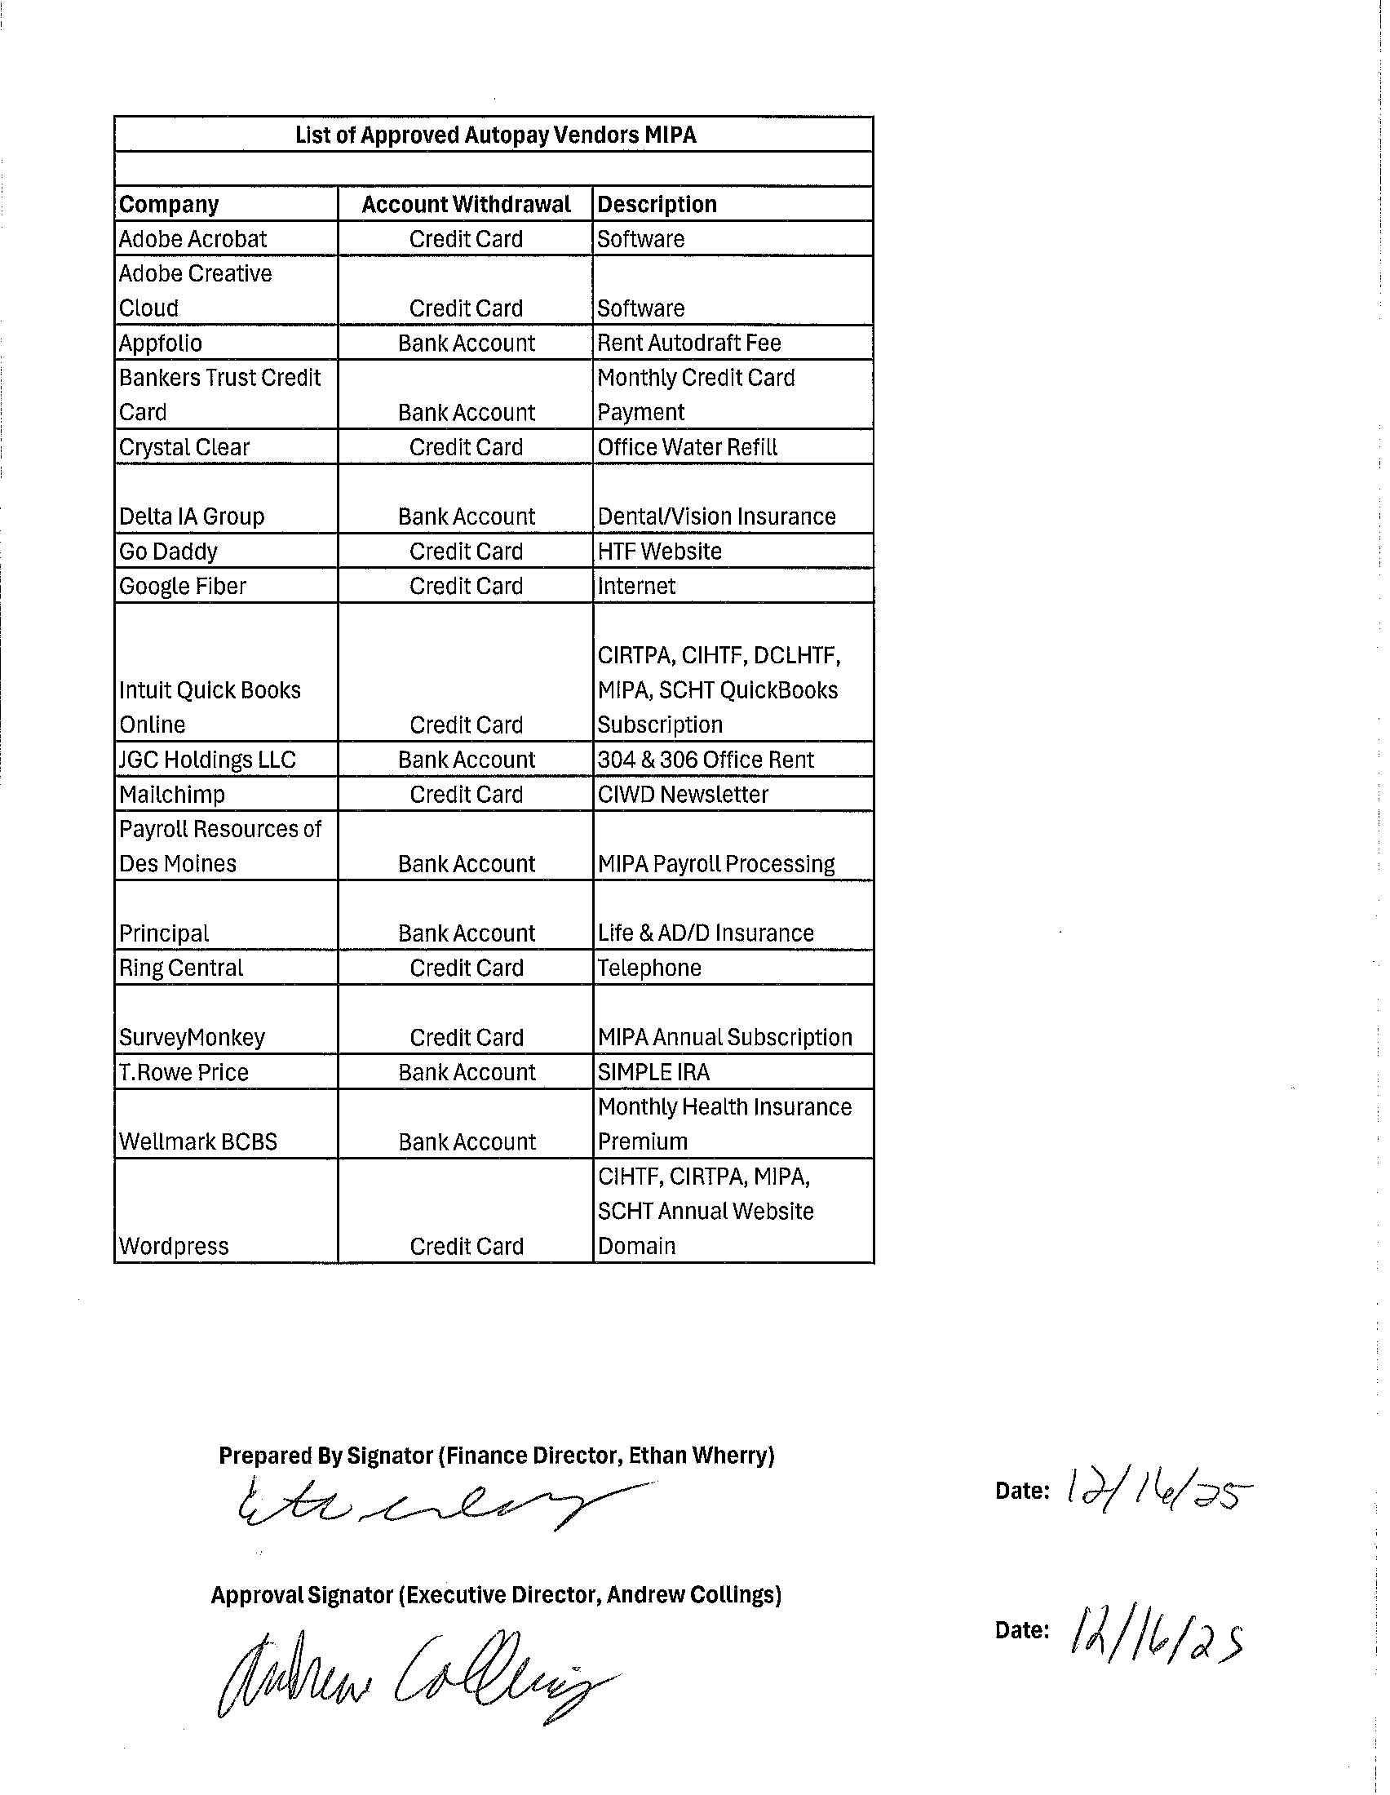
MIPA Depository List and Autopay Vendors
Various vendors that MIPA utilizes and are billing on a routine basis are set up to use Autopay. Included in the agenda was a list of vendors utilizing Autopay

Slide 8
January 22, 2025 AGENDA
Call to Order
VOTE: Approval of Agenda
VOTE: Approval of Meeting Minutes
PRESENTATION: MIPA Insurance Coverage
REPORT and VOTE: Financial Statements
REPORT and VOTE: Invoices and Contracts
REPORT and VOTE: MIPA Depository List and Autopay Vendors
Other Non-Action Items of Interest to the Committee
Next Meeting Date – February 16th at 2 PM
Adjournment

