Slide 1

Board of Directors Meeting
December 11, 2025

Slide 2

December 11, 2025 AGENDA
Call to Order
VOTE: Approval of Agenda
VOTE: Approval of Meeting Minutes
REPORT and VOTE: MIPA Designation as a Council of Governments
Other Non-Action Items of Interest to the Committee
Next Meeting Date – TBD – June 2026
Adjournment

Slide 3

COG Designation Overview
Since July, the Executive Committee has been evaluating whether MIPA should pursue State designation as a Council of Governments (COG)
On September 30, MIPA staff emailed all member community representatives to inform them of the upcoming opportunity for MIPA to pursue official State COG designation. Staff also offered to present on the topic at city council and county supervisor meetings
Staff has received positive feedback from member communities that have inquired about the initiative. In addition to member communities, staff also notified the City of Des Moines, City of Altoona, Polk County, and Dallas County but has not received a response

Slide 4

COG Designation Overview
Staff has since collected and distributed information on what a COG is and what COGs do in Iowa
As part of those data collection efforts, staff sent out documents to the Board of Directors that provide additional information on COGs. These include:
  MIPA COG Overview two pager - September
  MIPA COG Designation Q&A – November
Central Iowa is the only region in Iowa that does not have a State designated COG

Slide 5
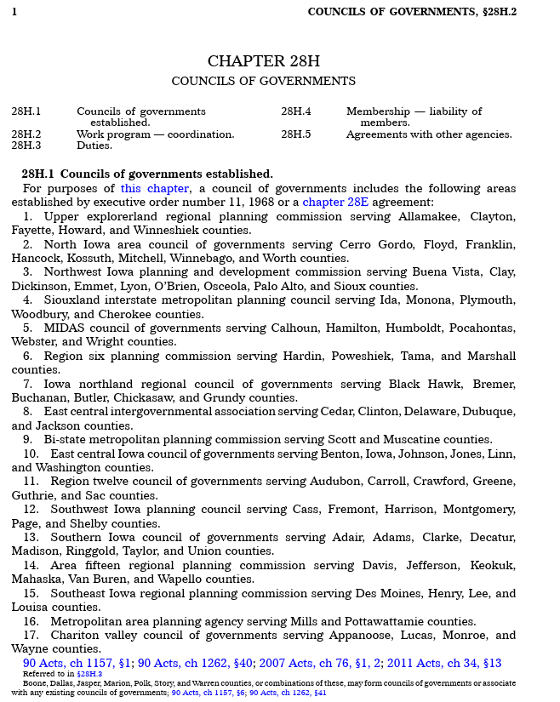
What Does COG Designation Mean?
MIPA designation as a COG by the State of Iowa means being added to the list of COGs in Chapter 28H.1
This designation would identify the area (counties) that MIPA would serve. It would not require any communities or other entities to join the organization as members but rather designate, for the State, MIPA’s planning area
MIPA would be subject to Chapter 28H moving forward

Slide 6
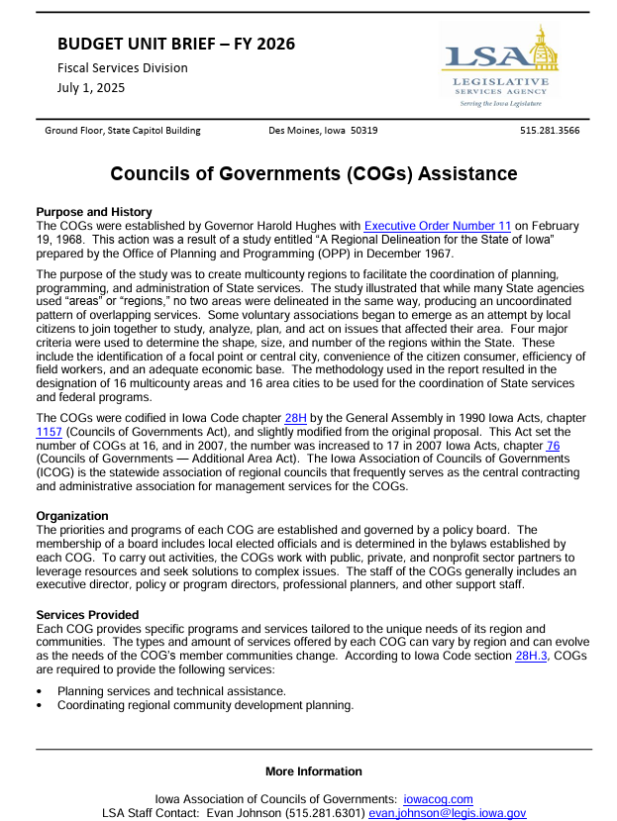
What Would Change if MIPA was Designated a COG?
MIPA would receive additional funding from the State of Iowa. The estimated amount, based on recent state budgets, is about $20,000 a year. This funding would be used to pay staffing costs to provide additional support to communities (e.g. grant applications, technical assistance)
Official recognition would allow MIPA to participate in statewide initiatives that utilize the COG network. Initiatives have included Low-Income Housing Tax Credit inspections, Iowans Fit for Life program, and the Iowa Waste Exchange
Being a COG would allow MIPA access to the Iowa Public Agency Investment Trust (IPAIT), which provides investment services specifically for Iowa governments and governmental entities. This would improve MIPA’s ability to invest operating and reserve funding and meet Iowa Code requirements of investing public funds
MIPA staff would gain access to the Iowa Public Employees’ Retirement System (IPERS) which would improve staff recruitment and retention
MIPA would be treated as a 28E organization in state law which would allow MIPA to more effectively work with local governments
The burden of MIPA’s procurement for certain activities (e.g. State CDBG) is greatly reduced by virtue of being a state designated COG
MIPA would be subject to Chapter 28H

Slide 7
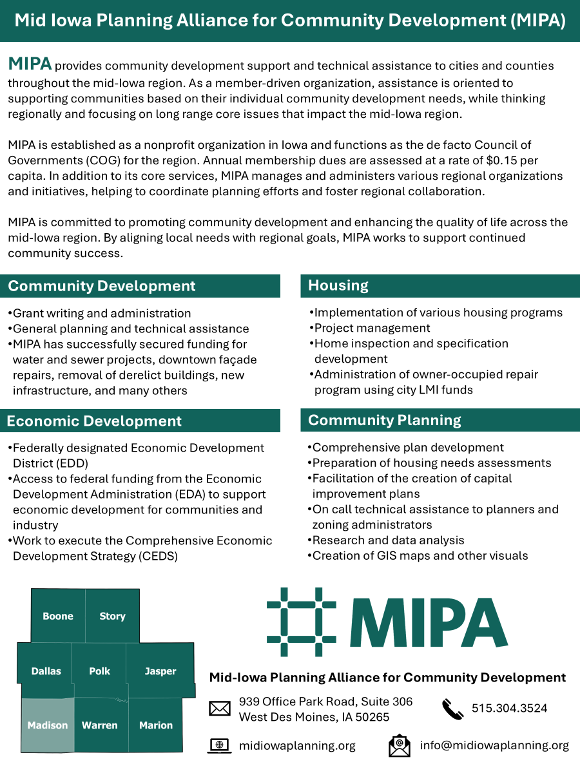
What Wouldn’t Change if MIPA was Designated a COG?
MIPA’s membership dues - MIPA communities pay annual dues equal to $0.15 per capita and there are no plans to change how much communities pay
MIPA membership - Membership with MIPA will always be voluntary. Being designated as a COG only defines the region that MIPA covers, not that entities within that region must be members
MIPA voting – Each community of MIPA receives one vote on the Board of Directors and Executive Committee. There is not mechanism for a weighted vote, so each community has the same number of votes regardless of population
MIPA – MIPA is governed by its By-Laws and other governing documents. These documents were approved and only can be changed by the MIPA Board. Whether MIPA is designated a COG or not, it will still be an incorporated non-profit entity in the State of Iowa, governed by it’s Board of Directors, and with a mission to support communities in MIPA’s 7 County region
COG designation gives MIPA access to additional resources and tools to support member communities but does not change what MIPA is or does as an organization

Slide 8
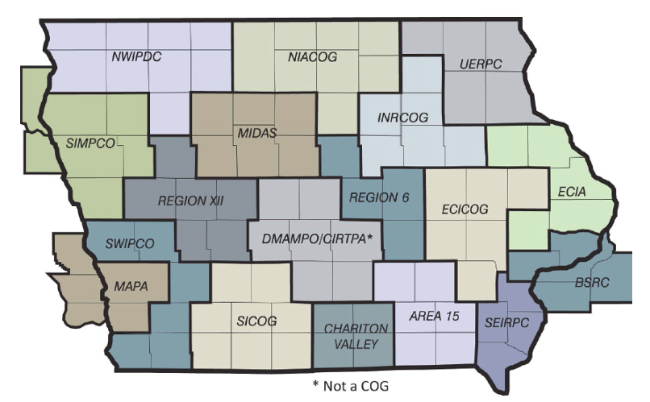
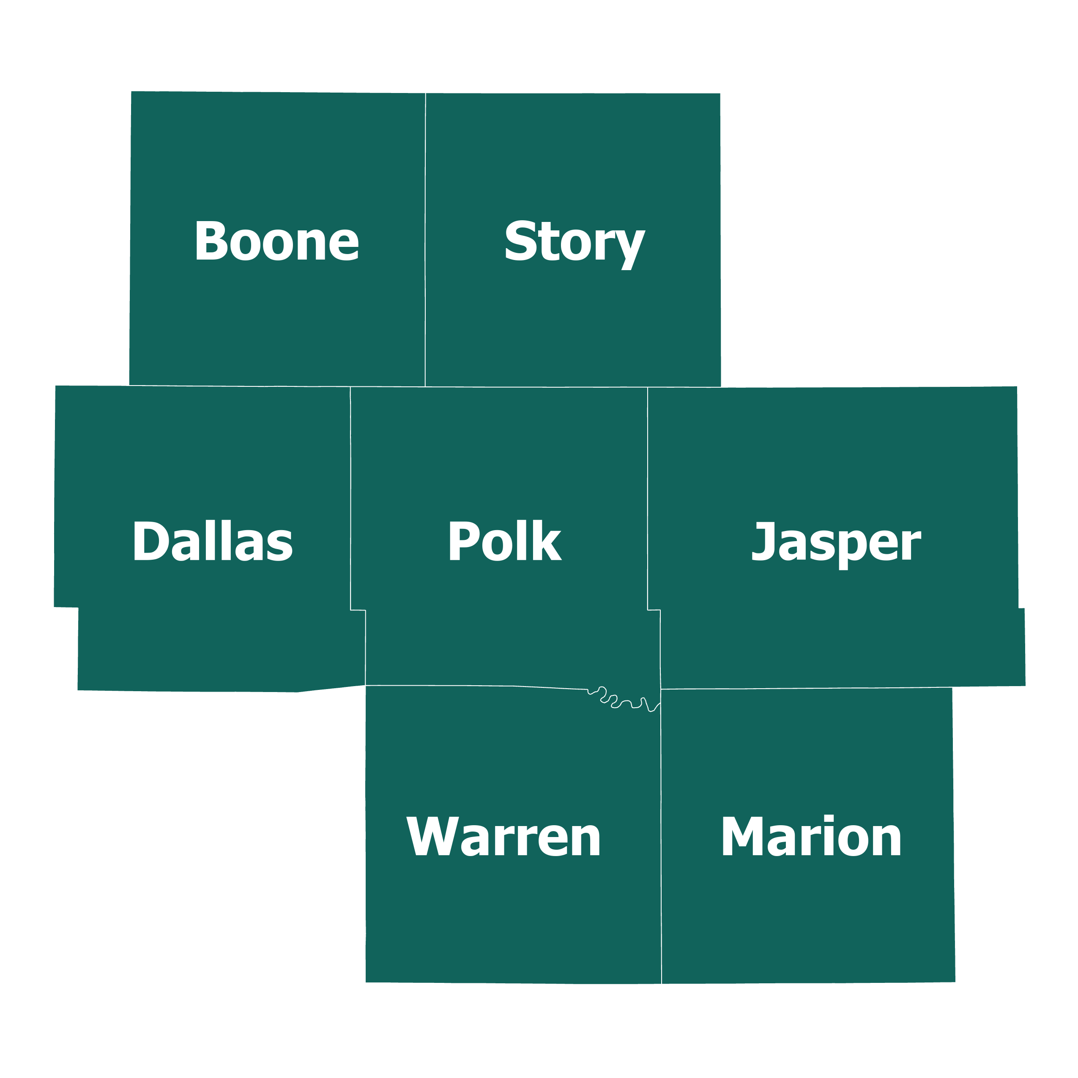
Steps to Being Designated a COG
To be designated a COG, the Iowa Legislature would need to amend Chapter 28H to add MIPA to the list of COGs. Previous efforts to add to the list of COGs necessitated the “Councils of Governments — Additional Area Act” of 2007
In November, The MIPA Executive Committee voted unanimously to recommend approval of MIPA’s COG Designation Initiative

Slide 9
COG Designation
If approved today by the MIPA Board of Directors, staff and the Executive Committee will seek an amendment to Chapter 28H
Other ways to support the initiative include:
  Writing a letter of support
  Approving a resolution in support of designation from your city council or county board of supervisors
  Contacting your local state representative and senator

Slide 10
December 11, 2025 AGENDA
Call to Order
VOTE: Approval of Agenda
VOTE: Approval of Meeting Minutes
REPORT and VOTE: MIPA Designation as a Council of Governments
Other Non-Action Items of Interest to the Committee
Next Meeting Date – TBD – June 2026
Adjournment

