Slide 1

Executive Committee Meeting
February 25, 2026

Slide 2

February 25, 2026 AGENDA
Call to Order
VOTE: Approval of Agenda
VOTE: Approval of Meeting Minutes
PRESENTATION and VOTE: MIPA FY 2025 Audit
REPORT and VOTE: Financial Statements
REPORT and VOTE: Invoices and Contracts
REPORT and VOTE: FY 2026 Budget Amendment #2
REPORT and VOTE: MIPA Organizational Chart
REPORT and VOTE: Current WIOA Title I Youth and Young Adult Contract and FY 2027 RFP
REPORT and VOTE: Lobbyist Designation
REPORT: MIPA COG Designation
REPORT: MIPA 501(c)3 Designation
REPORT: FY 2026 Audit RFP
Other Non-Action Items of Interest to the Committee
Next Meeting Date – March 16th at 2 PM
Adjournment

Slide 3
MIPA FY 2025 Audit
Denman will discuss MIPA’s FY 2025 Audit

Slide 4
Financial Statements
Information regarding MIPA’s financial accounts
  January Statement of Financial Position
  January Statement of Activity
  A/R Aging Report
  Budget vs Actual
  January Transactional Detail

Slide 5
Invoices and Contracts
Invoices
None
Contracts - Revenue
IEDA Clean Cities Grant | $142,624.20 – One Time
DOE Clean Cities Grant | $215,000 – Annual Award
Slater OOR | $9,000 (Approximant)
Slater LMI Survey | $200

Slide 6
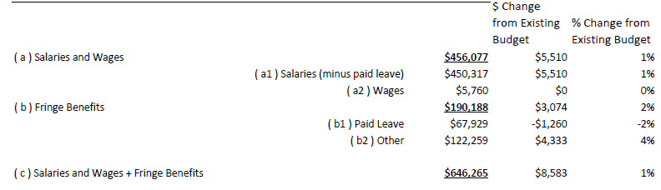
FY 2026 Budget Amendment #2
With the additional contracts that have been signed by MIPA and the need to hire an additional staff person, a budget amendment is needed to update the expected costs and revenues for FY 2026

Slide 7
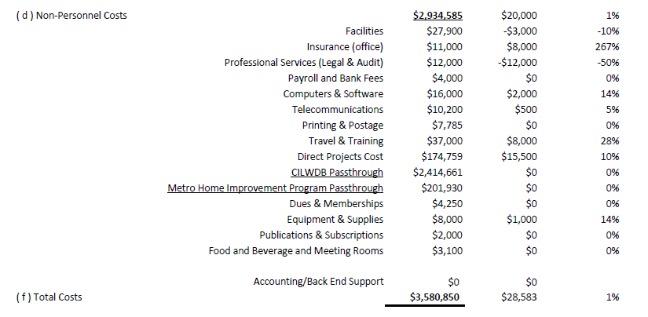
FY 2026 Budget Amendment #2

Slide 8
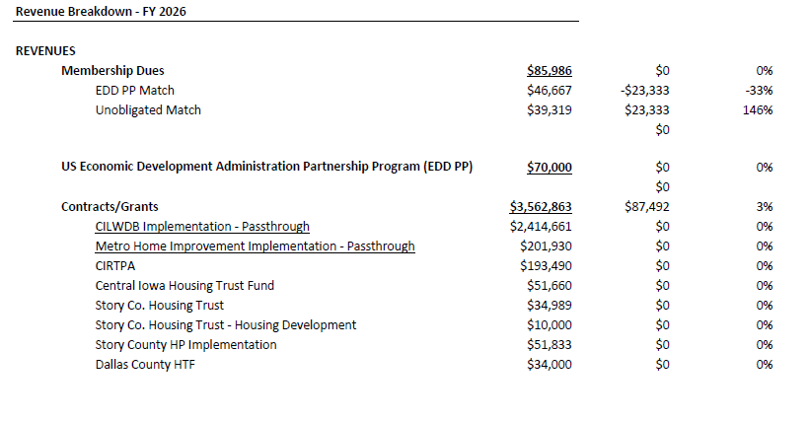
FY 2026 Budget Amendment #2

Slide 9
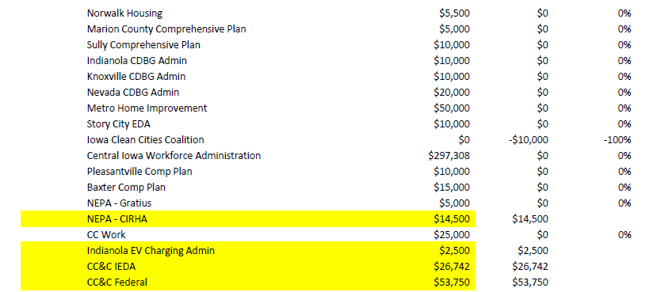
FY 2026 Budget Amendment #2

Slide 10
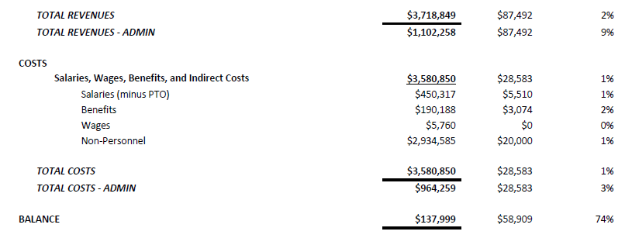
FY 2026 Budget Amendment #2
The following are proposed changes to the budget:
Salaries and wages - $8,583
Non-Personnel Costs - $20,000
Revenues - $87,492
Balance - $58,909

Slide 11
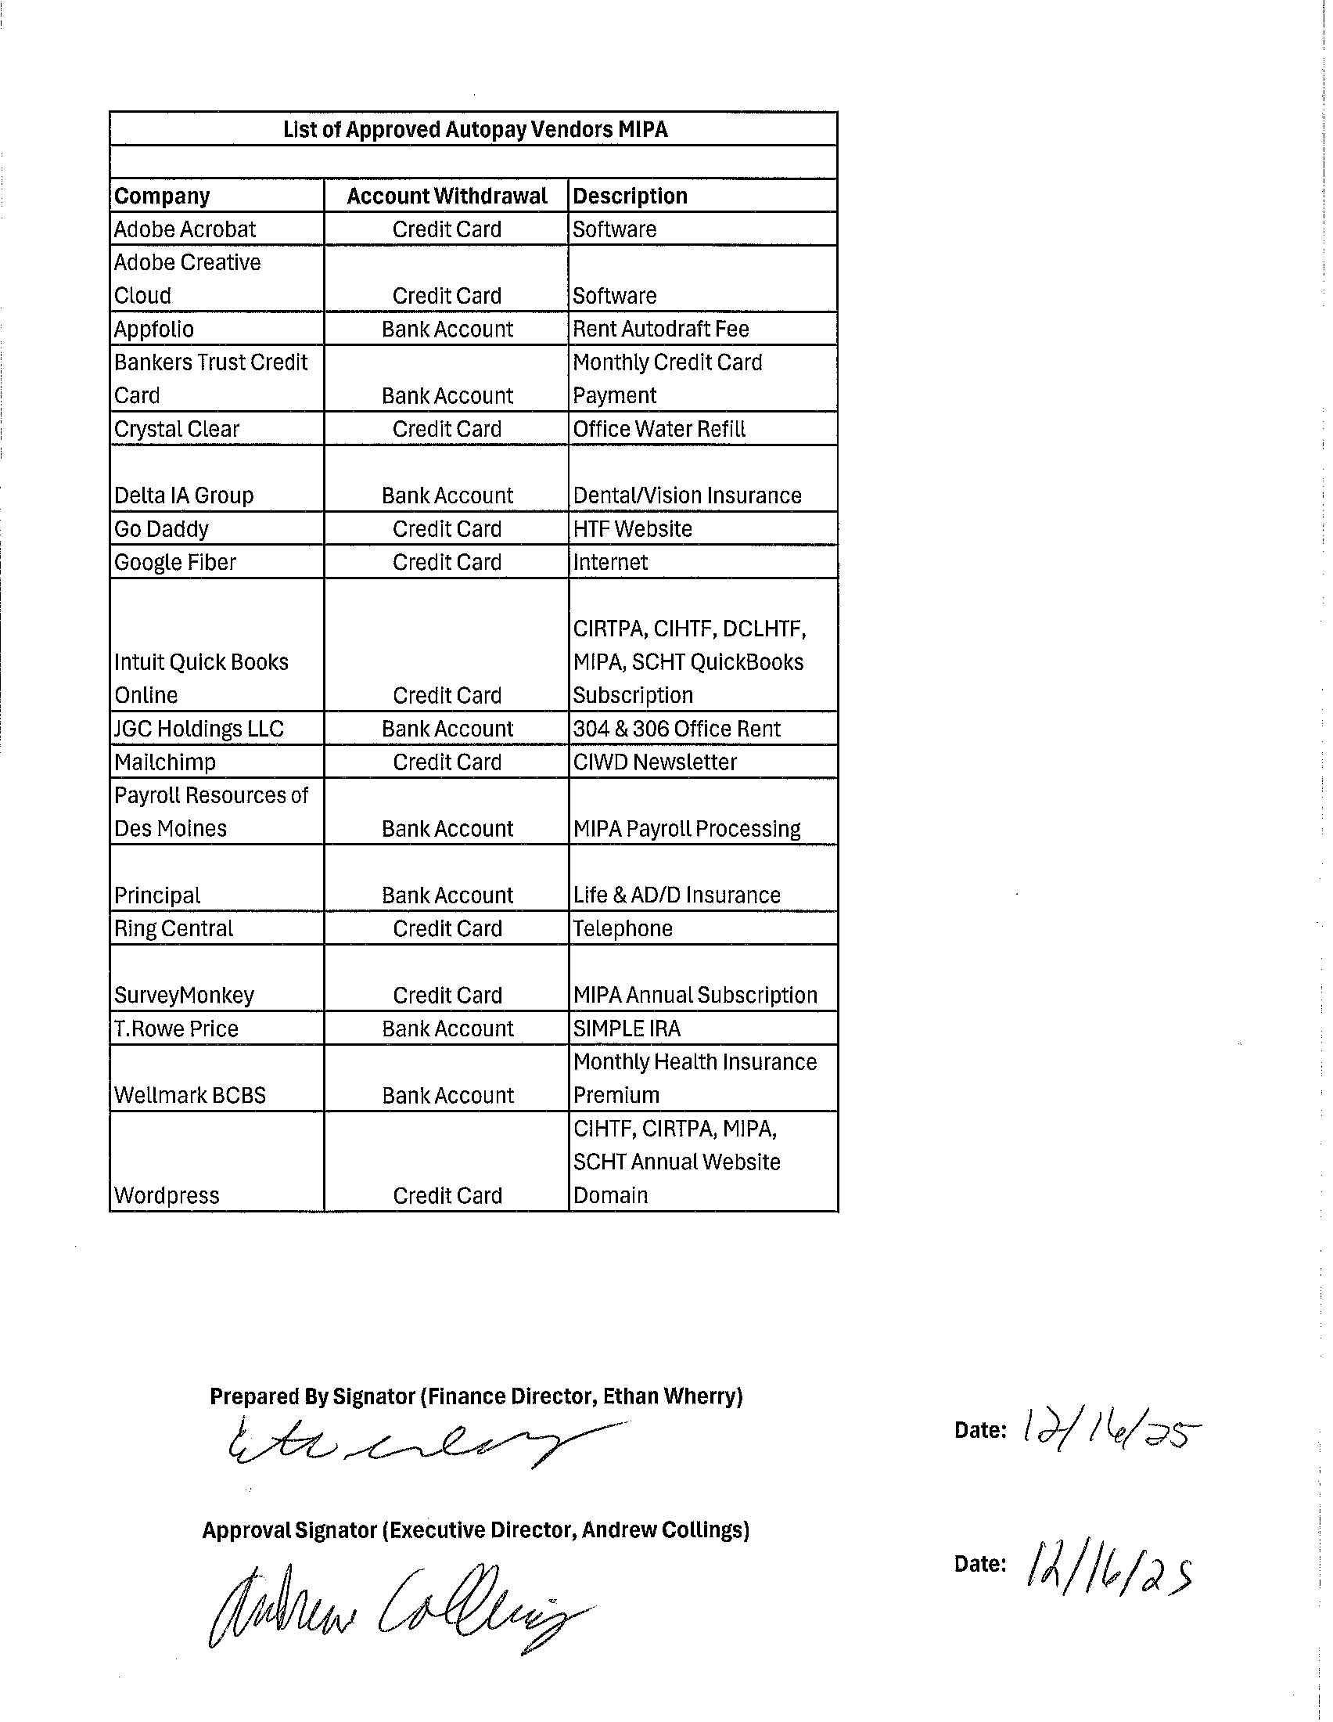
MIPA Depository List and Autopay Vendors
Various vendors that MIPA utilizes and are billing on a routine basis are set up to use Autopay. Included in the agenda was a list of vendors utilizing Autopay

Slide 12
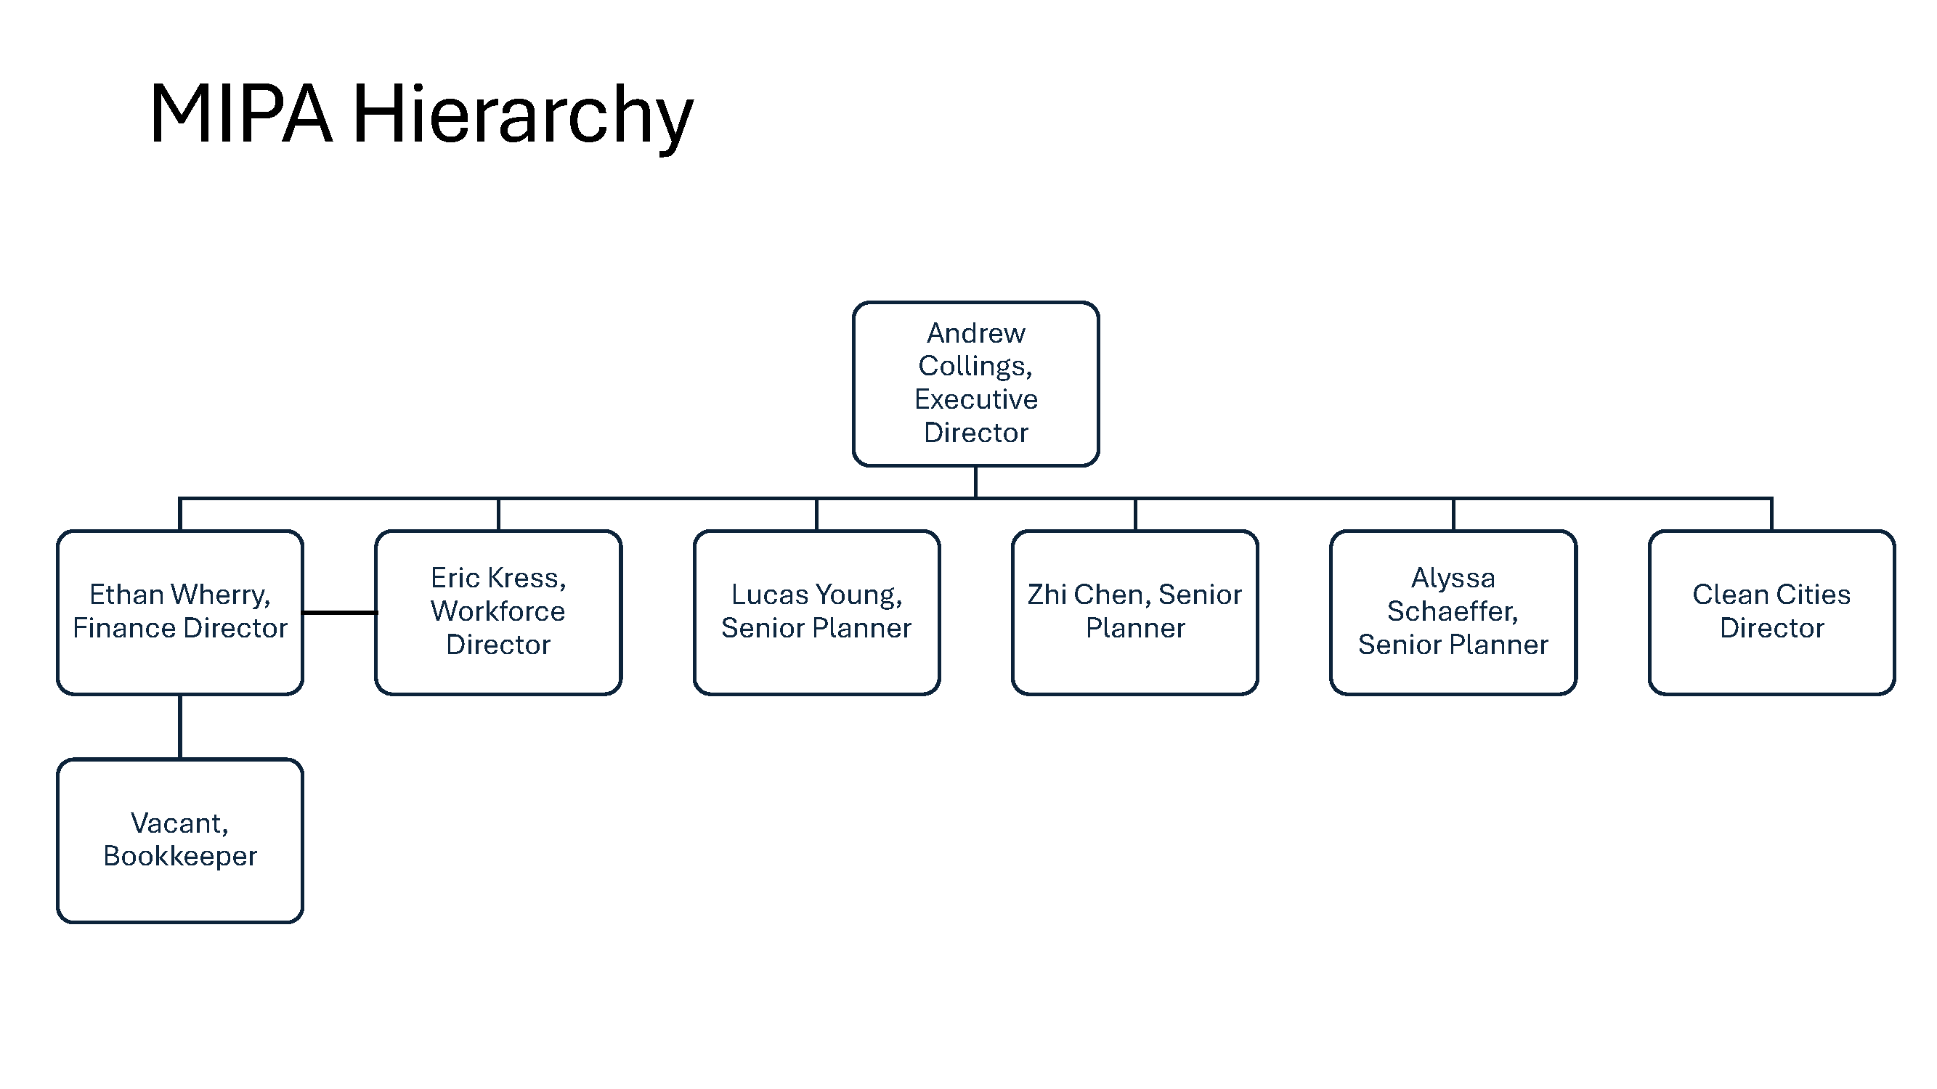
MIPA Organizational Chart
To hire additional staff, the MIPA Organizational Chart must be updated to accommodate the new staff position

Slide 13
WIOA Title I Youth and Young Adult Contract and FY 2027 RFP
Currently, YSS provides Title I Youth and Young Adult services for the Central Iowa Workforce Development Board
It is the desire of the Chief Lead Elected Official Supervisor Heddens, the County Board, and the CILWDB to issue an RFP for Title 1 services for FY 2027
As the designated grant recipient, MIPA is responsible for contracting with service providers to deliver Title 1 services and therefore is responsible for issuing RFPs for services

Slide 14
Lobbyist Designation
The State of Iowa requires individuals who will be lobbying directly to State Representatives and Senators to register as a lobbyist
Due to the initiative to designate MIPA as a COG, MIPA’s Executive Director will be engaging directly with the Legislature to change State Code
Therefore, MIPA should designate the Executive Director as its Lobbyist to ensure compliance with State Code

Slide 15
MIPA COG Designation
At the December 2025 MIPA Board Meeting, the Board voted to move forward with seeking COG designation by the State Legislature. The Board also requested a legal opinion to answer questions that were presented at the meeting
An initial legal opinion was provided that answered most of the questions that were asked. However, it did not address the major question of whether the proposed initiative would be consistent with MIPA’s Bylaws
Staff is continuing to work with Denton Davis Brown to get the updated legal opinion to the MIPA Board

Slide 16
MIPA 501(c)3 Designation
At the June 2025 MIPA Board Meeting, the Board voted to move forward with changing MIPA’s IRS designation from a 501(c)4 to a 501(c)3. Staff submitted the application in the Summer and received a response last week asking for additional information
The only potential voting item requested by the IRS would be to amend the Articles of Incorporation

Slide 17
MIPA 501(c)3 Designation
Proposed Amendment:
Upon the dissolution of the organization, assets shall be distributed for one or more exempt purposes within the meaning of Section 501 ( c )(3) of the Internal Revenue Code, or corresponding section of any future federal tax code, or shall be distributed to the federal government, or to a state or local government, for a public purpose
Current Article X – Dissolution:
Upon the dissolution of the Corporation, the Board of Directors shall, after paying or
making provision for the payment of all the liabilities of the Corporation, dispose of all of the assets of the Corporation exclusively for the purposes of the Corporation as the Board of Directors shall determine. Any of such assets not so disposed of shall be disposed of by the District Court of the County in which the principal office of the Corporation is then located, exclusively for such purposes or to such organization or organizations, as said Court shall determine, which are organized and operated exclusively for such purposes

Slide 18
FY 2026 Audit RFP
Denman currently provides auditing and 990 services for:
  MIPA
  Central Iowa Regional Transportation Planning Alliance (CIRTPA
  Central Iowa Housing Trust Fund (CIHTF)
  Dallas County Local Housing Trust Fund (DCLHTF)
Staff has been notified that costs will be increasing for FY 2026. Not including the increase in MIPA’s audit to a Single Audit, costs will be increasing from $24,400 to $43,000
To ensure competitiveness of pricing for auditing services, staff proposes to initiate an RFP for FY 2026 auding services. A draft RFP will be brought back to the Executive Committee for review

Slide 19
February 25, 2026 AGENDA
Call to Order
VOTE: Approval of Agenda
VOTE: Approval of Meeting Minutes
PRESENTATION and VOTE: MIPA FY 2025 Audit
REPORT and VOTE: Financial Statements
REPORT and VOTE: Invoices and Contracts
REPORT and VOTE: FY 2026 Budget Amendment #2
REPORT and VOTE: MIPA Organizational Chart
REPORT and VOTE: Current WIOA Title I Youth and Young Adult Contract and FY 2027 RFP
REPORT and VOTE: Lobbyist Designation
REPORT: MIPA COG Designation
REPORT: MIPA 501(c)3 Designation
REPORT: FY 2026 Audit RFP
Other Non-Action Items of Interest to the Committee
Next Meeting Date – March 16th at 2 PM
Adjournment

