Slide 1

Executive Committee Meeting
March 12, 2026

Slide 2

March 12, 2026 AGENDA
Call to Order
VOTE: Approval of Agenda
VOTE: Approval of Meeting Minutes
REPORT and VOTE: Financial Statements
REPORT and VOTE: Invoices and Contracts
REPORT and VOTE: FY 2026 Audit and 990 RFP
REPORT: FY 2027 Budget Draft
REPORT: MIPA COG Designation
Other Non-Action Items of Interest to the Committee
Next Meeting Date – April 20th at 2 PM
Adjournment

Slide 3
Financial Statements
Information regarding MIPA’s financial accounts
  February Statement of Financial Position
  February Statement of Activity
  (A/R) Aging Report
  Budget vs Actual
  February Transactional Detail

Slide 4
Invoices and Contracts
Invoices
DCLHTF FY 2025 Audit and 990 | $6,500
Contracts - Revenue
PCHTF | $60,000 – For Metro Home Improvement
Norwalk OOR | ~$5,500

Slide 5
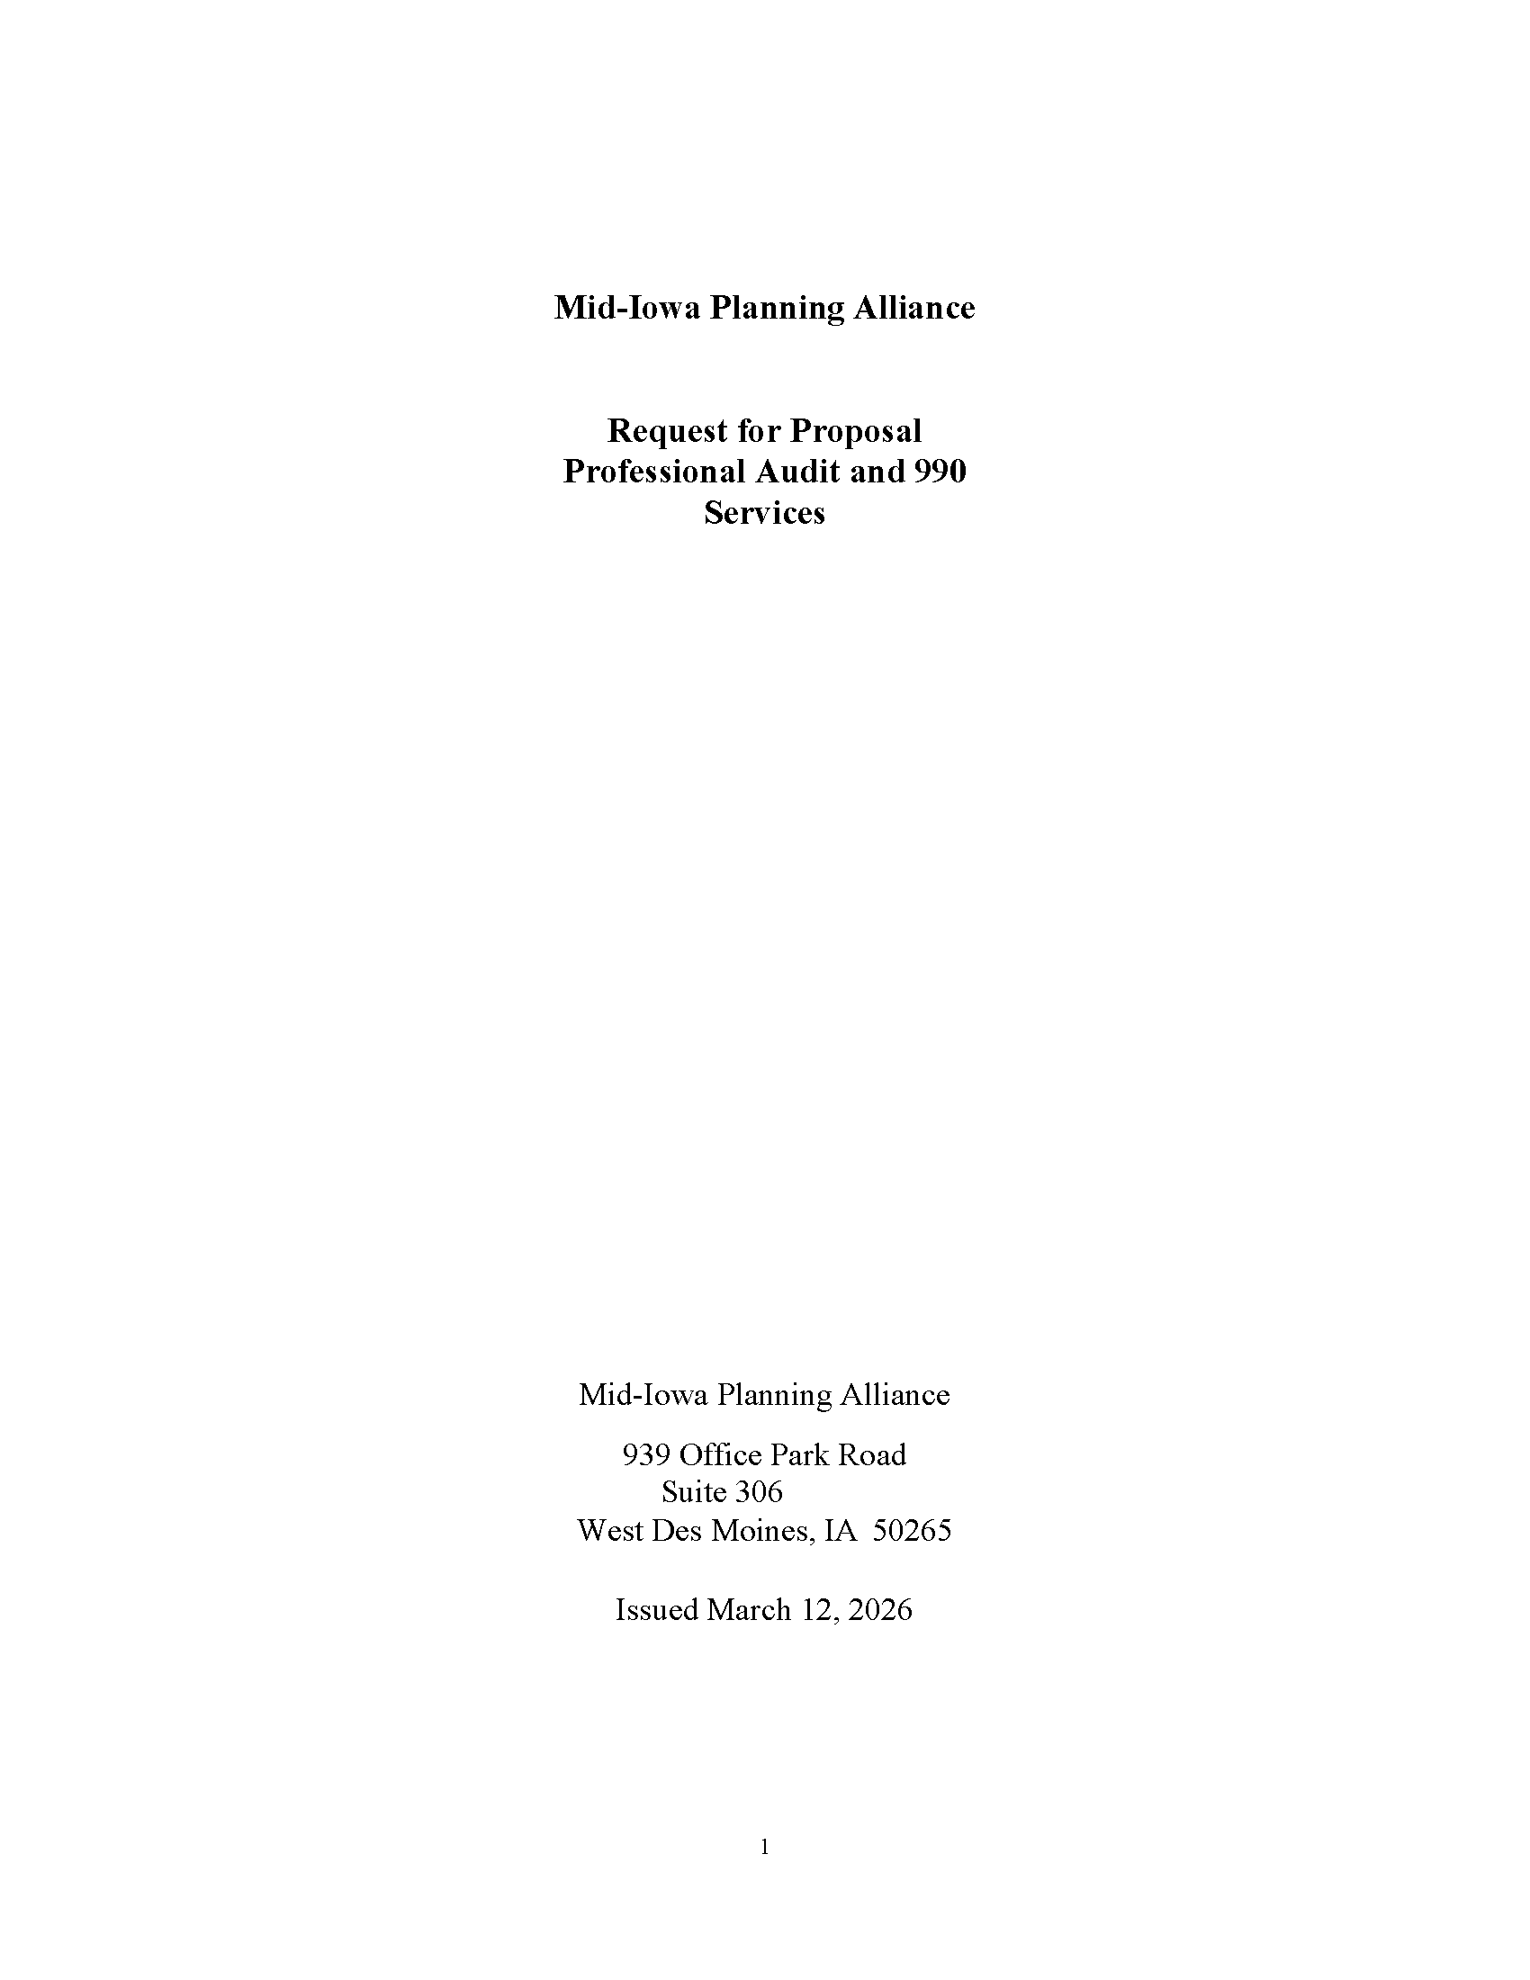
FY 2026 Audit and 990 RFP
Denman currently provides auditing and 990 services for:
  MIPA
  CIRTPA
  CIHTF
  DCLHTF
Staff has been notified that costs will be increasing for FY 2026. To ensure competitive pricing for auditing services, staff proposes to initiate an RFP for FY 2026 auding and 990 services

Slide 6
FY 2026 Audit and 990 RFP
Tentative Schedule for Selection Process
Tentative Schedule for Annual Audit
Written questions due | March 25, 2026, noon
Response to written questions e-mailed to firms | March 27, 2026, noon
Proposals due | April 16, 2026, 4:30 p.m.
Evaluate proposals | April 23-24, 2026
Interviews with selected proposers (if necessary) | May 4 - 6, 2026
MIPA board approval of selected auditor | May 18, 2026
Planning meeting | Late May
Preliminary fieldwork | Late June
Final PBC list due from auditors | End of June
Trial balance available | Early September
Draft financial statements available | Mid-October
Draft Audits | End of December
Audit Presentation to various boards | January - March
990s complete and submitted to IRS | April - May

Slide 7
FY 2027 Budget Draft
Describes the scope of work and budget for the period of July 1, 2026, through June 30, 2027
  Identifies the different contracts and scope of work for MIPA staff
  Communicates to member communities and the public MIPA’s intended work
  Development of the budget is tied to Iowa DOT deadlines of April 1 for a draft and June 1 for a final (through the administration of CIRTPA)

Slide 8
FY 2027 Budget Draft

Slide 9
FY 2027 Budget Draft

Slide 10
FY 2027 Budget Draft – Committed
The Committed Budget only includes contracts that are currently committed:
  7.25 FTEs
  Staff includes new Iowa Clean Cities Coalition Director and a summer intern
  Costs include:
    $25,000 for updates to MIPA and affiliate organization websites
    $37,000 for conference travel

Slide 11
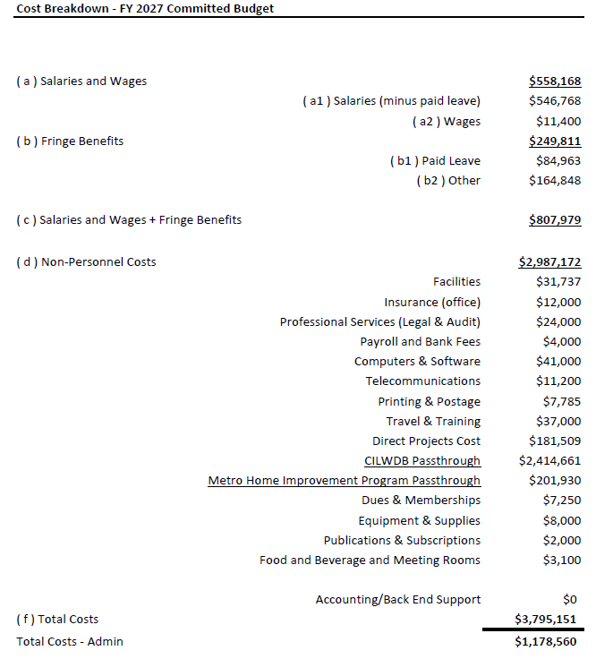

Slide 12
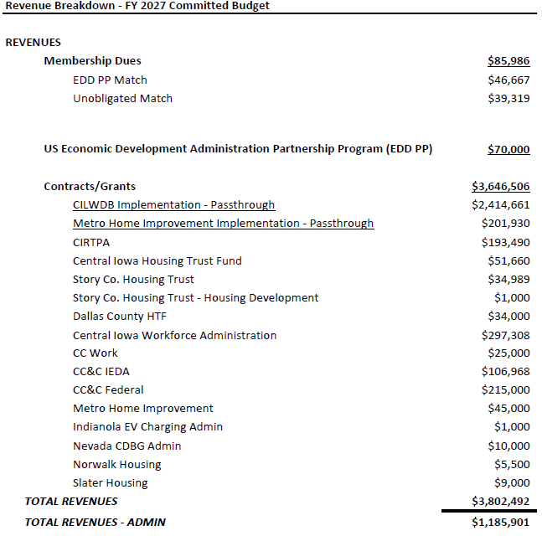

Slide 13
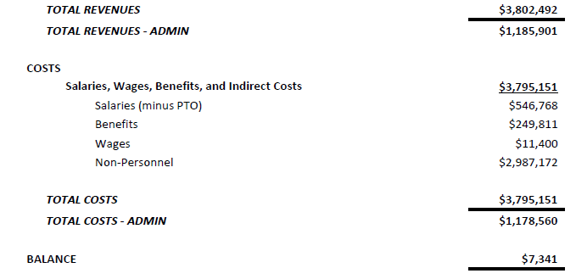

Slide 14
FY 2027 Budget Draft – Expected
The Expected Budget includes contracts that MIPA staff expects to receive:
  8.0 FTEs
  Staff includes new Iowa Clean Cities Coalition Director, 0.75 FTE Bookkeeper, and a summer intern
  Costs include:
    $25,000 for updates to MIPA and affiliate organization websites
    $37,000 for conference travel

Slide 15
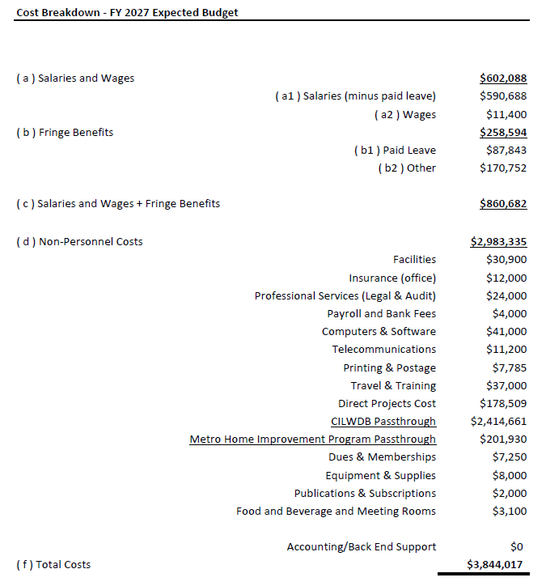

Slide 16
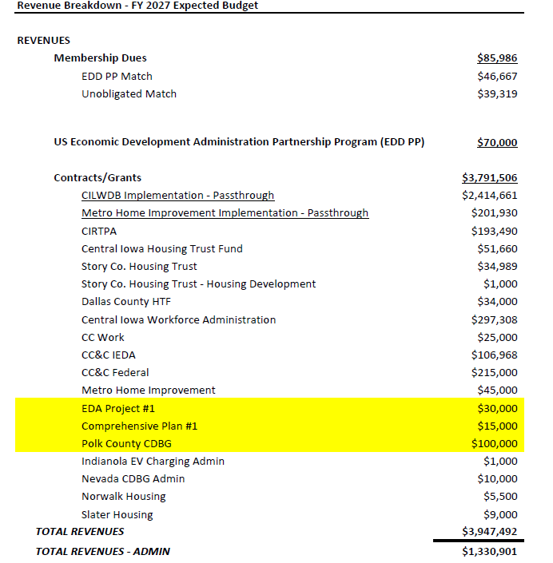

Slide 17
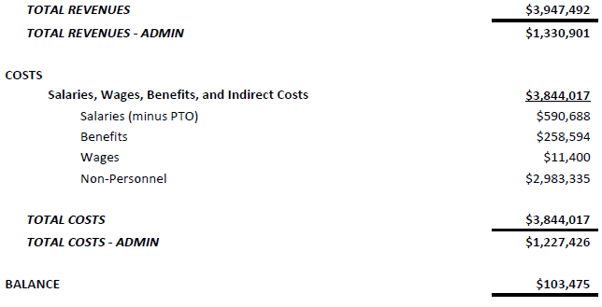

Slide 18
MIPA COG Designation
At the December 2025 MIPA Board Meeting, the Board voted to move forward with seeking COG designation by the State Legislature. The Board also requested a legal opinion to answer questions that were presented at the meeting
An initial legal opinion was provided that answered most of the questions that were asked. However, it did not address the major question of whether the proposed initiative would be consistent with MIPA’s Bylaws

Slide 19
MIPA COG Designation
Staff has received additional information on the COG Designation process for Chariton Valley. While Chariton Valley was a non-profit when it sought COG designation, a 28E Agreement was filed shortly after the legislation was approved. Therefore, it is the opinion of Scott Brennan from Denton Davis Brown, that under the current law, MIPA would need to be a 28E organization to be listed in State Code as a COG
There are several options available in moving forward with COG Designation, including modifying state code. Staff will bring back those options at a future meeting
Nothing will be done this legislative session on this initiative. Once the session ends, Staff will reach out to legislators to prepare for the 2027 session

Slide 20
March 12, 2026 AGENDA
Call to Order
VOTE: Approval of Agenda
VOTE: Approval of Meeting Minutes
REPORT and VOTE: Financial Statements
REPORT and VOTE: Invoices and Contracts
REPORT and VOTE: FY 2026 Audit and 990 RFP
REPORT: FY 2027 Budget Draft
REPORT: MIPA COG Designation
Other Non-Action Items of Interest to the Committee
Next Meeting Date – April 20th at 2 PM
Adjournment

