Slide 1

Executive Committee Meeting
April 20, 2026

Slide 2

April 20, 2026 AGENDA
Call to Order
VOTE: Approval of Agenda
VOTE: Approval of Meeting Minutes
REPORT and VOTE: Financial Statements
REPORT and VOTE: Invoices and Contracts
REPORT and VOTE: MIPA Officers Election
REPORT and VOTE: GreenState Insured Sweep Account
REPORT: 2027 Budget Draft
REPORT: 501(c)3 Designation
Other Non-Action Items of Interest to the Committee
Next Meeting Date – May 18th at 2 PM
Adjournment

Slide 3
Financial Statements
Information regarding MIPA’s financial accounts
  March Bank Statements and Reconciliations
  March Financial Statements
  March General Ledger

Slide 4
Invoices and Contracts
Invoices
DCLHTF FY 2025 Audit and 990 | $6,500
Denton Davis Brown | $5,246
Contracts - Revenue
Story County Comprehensive Plan Economic Development | $5,000
Norwalk OOR | ~$5,500

Slide 5
MIPA Officers Election
Every year, MIPA elects officers from the Executive Committee to serve for the upcoming year
Current officers are:
    Chair – Brenda Dryer (Story County)
    Vice-Chair – Linda Murken (Story County)
    Secretary/Treasurer - Vacant

Slide 6
GreenState Insured Sweep Account
MIPA currently maintains funds in excess of $250,000 at GreenState Credit Union. In order to ensure that funds are covered by the National Credit Union Administration (NCUA), staff has identified the Insured Sweep Account program as a potential option
GreenState, in partnership with other credit unions and through a management company, would deposit funds in accounts up to $250,000 in other credit unions to maintain NCUA coverage. MIPA would still work directly with GreenState, but funds over $250,000 would be deposited elsewhere
Without access to banking coverage provided to public entities, staff believes this would protect the public funds that MIPA holds at GreenState
There is no cost for this program

Slide 7
FY 2027 Budget Draft
Describes the scope of work and budget for the period of July 1, 2026, through June 30, 2027
  Identifies the different contracts and scope of work for MIPA staff
  Communicates to member communities and the public MIPA’s intended work
  Development of the budget is tied to Iowa DOT deadlines of April 1 for a draft and June 1 for a final (through the administration of CIRTPA)

Slide 8
FY 2027 Budget Draft

Slide 9
FY 2027 Budget Draft

Slide 10
FY 2027 Budget Draft – Committed
The Committed Budget only includes contracts that are currently committed:
  7.25 FTEs
  Staff includes new Iowa Clean Cities Coalition Director and a summer intern
  Costs include:
    $45,000 (previously $25,000) for updates to MIPA and affiliate organization websites
    $37,000 for conference travel

Slide 11
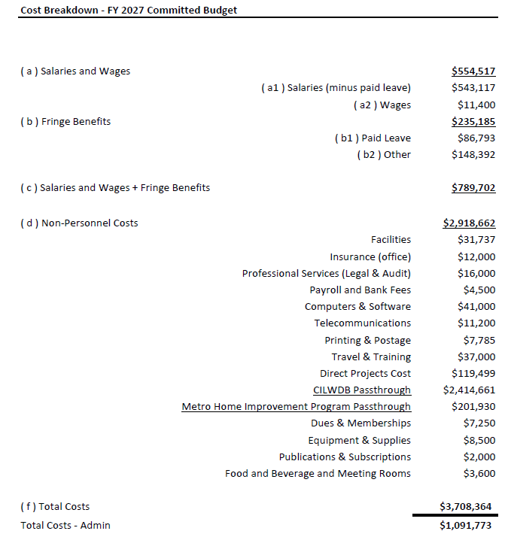

Slide 12
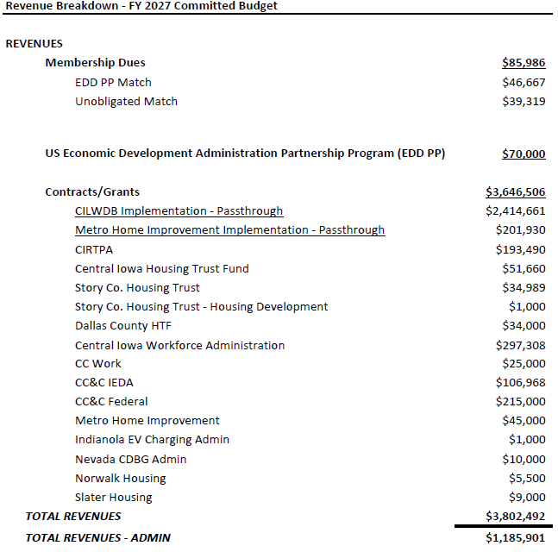

Slide 13
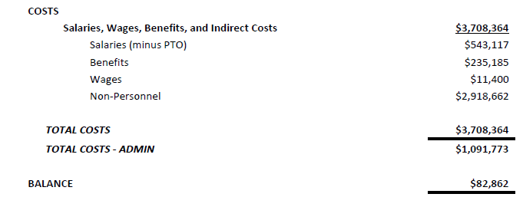

Slide 14
FY 2027 Budget Draft – Expected
The Expected Budget includes contracts that MIPA staff expects to receive:
  8.25 FTEs
  Staff includes new Iowa Clean Cities Coalition Director, a Bookkeeper/Admin position, and a summer intern
  Costs include:
    $45,000 (previously $25,000) for updates to MIPA and affiliate organization websites
    $37,000 for conference travel

Slide 15
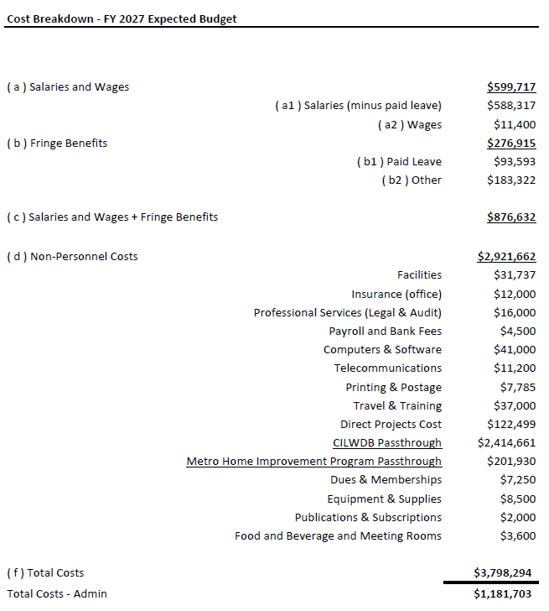

Slide 16
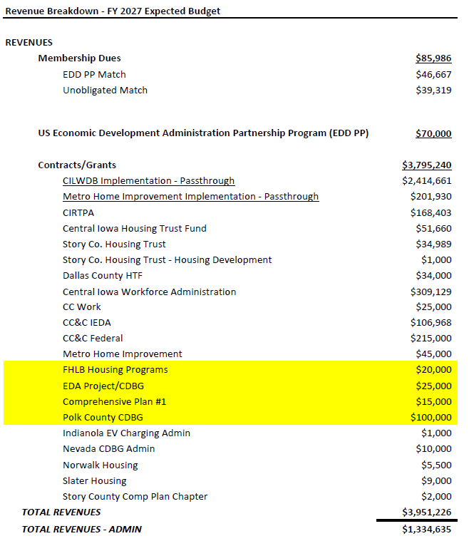

Slide 17
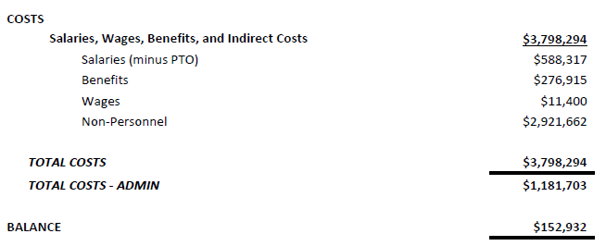

Slide 18
FY 2027 Budget Draft – Expected
Federal Home Loan Bank Housing Programs - $20,000 Revenue
  MIPA is applying for $300,000 in funding from the FHLB of Des Moines to provide supplemental funding for MIPA administered owner-occupied repair programs. Approximately $40,000 in admin funding would be available, $20,000 of which would be in FY 2027. MIPA has a reasonable expectation of receiving the funding
EDA Project/CDBG - $25,000 Revenue
  At some point in FY 2027, MIPA will most likely receive an EDA or CDBG grant to administer. MIPA could receive more but this is a reasonable expectation
Comprehensive Plan - $15,000 Revenue
  MIPA has a reasonable expectation of working on a comprehensive plan in FY 2027. Not all of the work may be done in FY 2027 so the amount is less than what MIPA would typically charge to reflect that fact

Slide 19
FY 2027 Budget Draft – Expected
Polk County CDBG Administration - $100,000 Revenue
  Polk County has now received their 3rd year of allocation of funding and now needs to begin spending the funds. The County may begin allocating funding in communities and may need a 3rd party administrator to assist. MIPA has a good chance of being the administrator for this program
Administrative Position - $99,682 Expense
  Should MIPA receive the CDBG contract from Polk County, MIPA would hire an administrative position to assist with bookkeeping and other administrative duties which would free up other personnel to complete CDBG services

Slide 20
501(c)3 Designation
Last year, the MIPA Board authorized staff to begin the process of redesignating from a 501(c)4 to a 501(c)3. The biggest difference between the two designations is that as a 501(c)3, money given to MIPA would be considered tax free
Staff was successful in its efforts and as of October 2, 2025 MIPA has been designated a 501(c)3

Slide 21
April 20, 2026 AGENDA
Call to Order
VOTE: Approval of Agenda
VOTE: Approval of Meeting Minutes
REPORT and VOTE: Financial Statements
REPORT and VOTE: Invoices and Contracts
REPORT and VOTE: MIPA Officers Election
REPORT and VOTE: GreenState Insured Sweep Account
REPORT: 2027 Budget Draft
REPORT: 501(c)3 Designation
Other Non-Action Items of Interest to the Committee
Next Meeting Date – May 18th at 2 PM
Adjournment

