Slide 1

Executive Committee Meeting
May 18, 2026

Slide 2

May 18, 2026 AGENDA
Call to Order
VOTE: Approval of Agenda
REPROT and VOTE: Approval of Meeting Minutes
REPORT and VOTE: Financial Statements
REPORT and VOTE: Invoices and Contracts
REPORT and VOTE: FY 2026 Budget Amendment #3
REPORT and VOTE: FY 2027 Budget
REPORT and VOTE: Executive Director Review
REPORT and VOTE: FY 2026 – FY 2028 Audit RFP
REPORT and VOTE: CIWDB Title I Youth Provider Procurement
REPORT and VOTE: CIWDB FY 2027 Budget
REPORT and VOTE: CIWDB FY 2027 Program Budget Transfer Request
REPORT and VOTE: Board of Directors Meeting Agenda
Other Non-Action Items of Interest to the Committee
Next Meeting Date – Last week of June
Adjournment

Slide 3
Financial Statements
Information regarding MIPA’s financial accounts
  April Bank Statements and Reconciliations
  April Financial Statements
  April General Ledger

Slide 4
Invoices and Contracts
Invoices
City Model Code of Ordinances | $1,758.71
Contracts - Expenses
CIWDB Small Grant Award - CFI | $5,000
CIWDB Small Grant Award - Easter Seals Iowa | $4,350
Contracts - Revenue
City of Carlisle CIP | $5,000
Perry Chamber Bike Maps | $2,000

Slide 5
FY 2026 Budget Amendment #3
With the additional work that MIPA has, particularly with the Iowa Clean Cities Coalition, staff is requesting the flexibility to hire up to 3 summer interns. Funding for the Model Code is included as well.
The following are proposed changes to the budget:
  Salaries and wages - $5,892
  Non-Personnel Costs - $1,759
  Revenues - $0
  Balance – (-$7,651)

Slide 6
FY 2027 Budget Draft
Describes the scope of work and budget for the period of July 1, 2026, through June 30, 2027
  Identifies the different contracts and scope of work for MIPA staff
  Communicates to member communities and the public MIPA’s intended work
  Development of the budget is tied to Iowa DOT deadlines of April 1 for a draft and June 1 for a final (through the administration of CIRTPA)

Slide 7
FY 2027 Budget Draft

Slide 8
FY 2027 Budget Draft

Slide 9
FY 2027 Budget Draft – Committed
The Committed Budget only includes contracts that are currently committed:
  7 Full-time positions, 3 summer interns including 1 year-round intern
  Costs include:
    $45,000 for updates to MIPA and affiliate organization websites
    $37,000 for conference travel

Slide 10
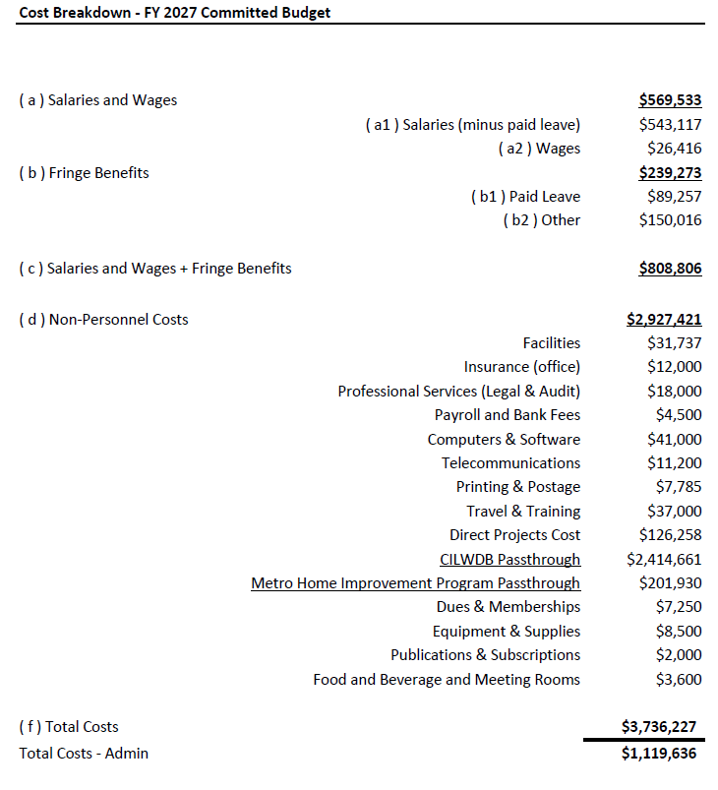

Slide 11
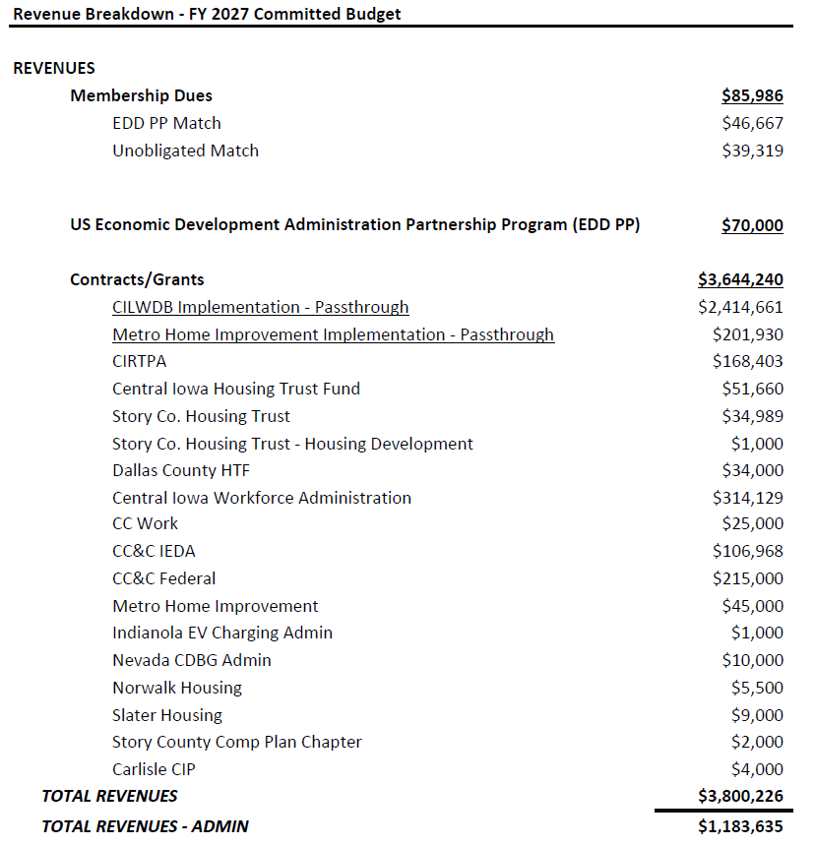

Slide 12
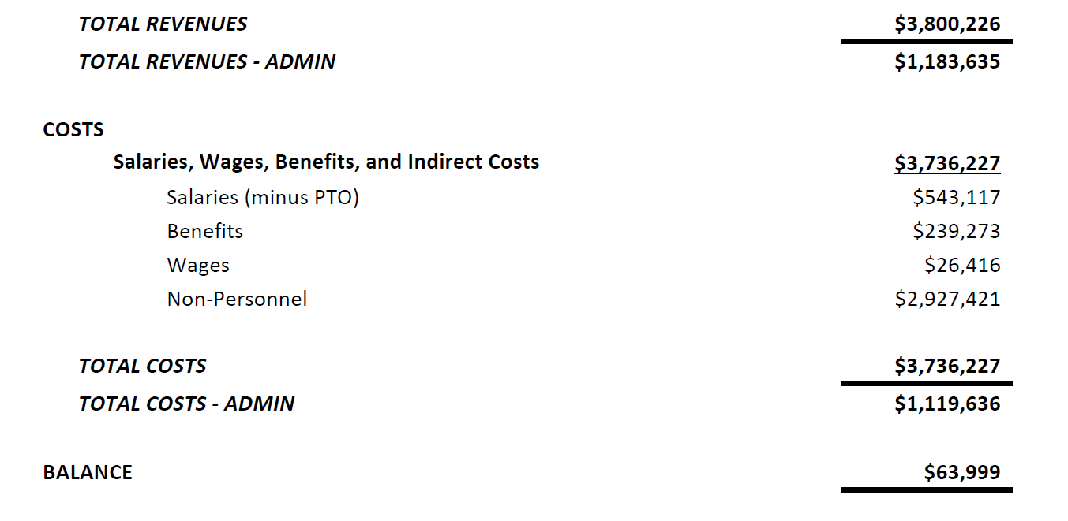

Slide 13
FY 2027 Budget Draft – Expected
The Expected Budget includes contracts that MIPA staff expects to receive:
  8 Full-time positions, 3 summer interns including 1 year-round intern
  Staff includes a Bookkeeper/Admin position
  Costs include:
    $45,000 for updates to MIPA and affiliate organization websites
    $37,000 for conference travel

Slide 14
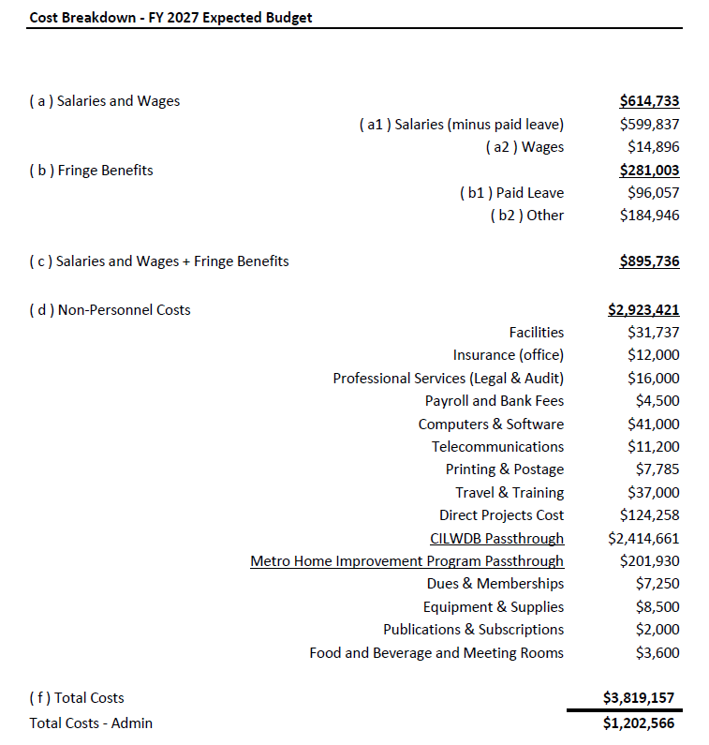

Slide 15
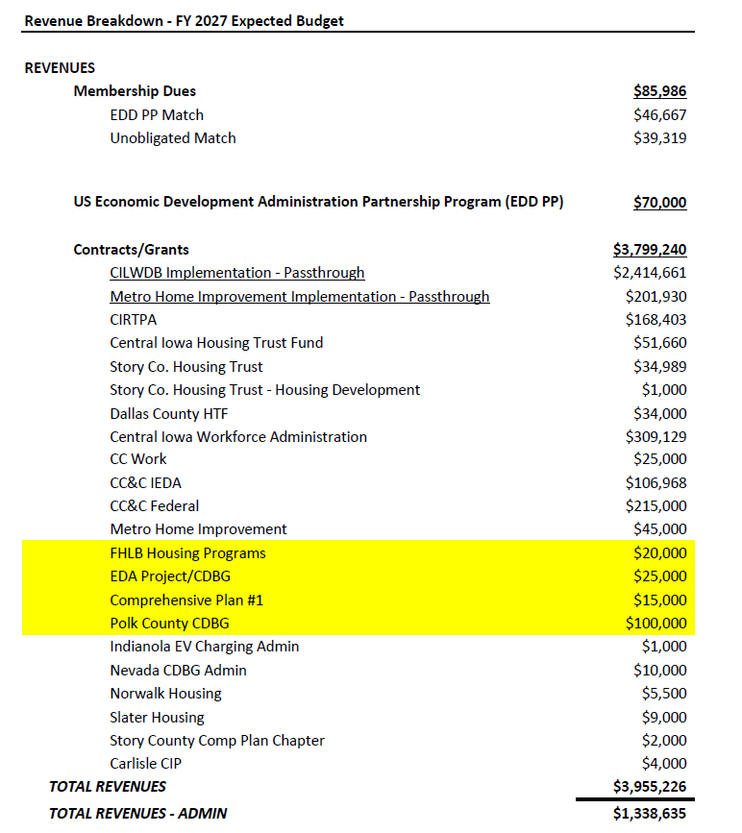

Slide 16
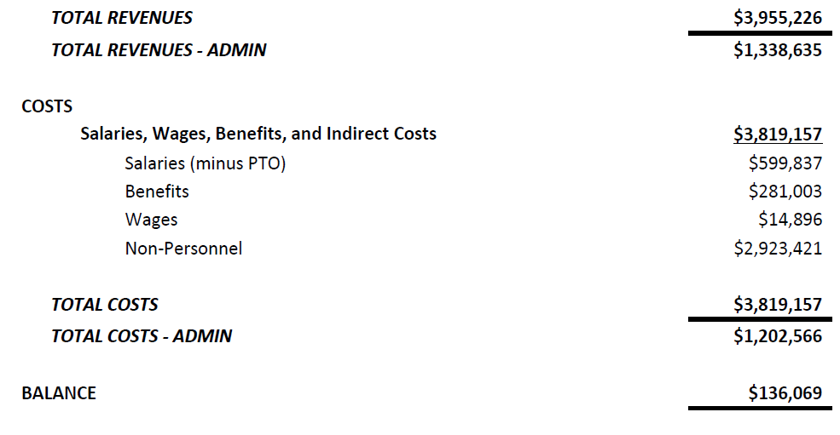

Slide 17
FY 2027 Budget Draft – Expected
Federal Home Loan Bank Housing Programs - $20,000 Revenue
  MIPA is applying for $300,000 in funding from the FHLB of Des Moines to provide supplemental funding for MIPA administered owner-occupied repair programs. Approximately $40,000 in admin funding would be available, $20,000 of which would be in FY 2027. MIPA has a reasonable expectation of receiving the funding
EDA Project/CDBG - $25,000 Revenue
  At some point in FY 2027, MIPA will most likely receive an EDA or CDBG grant to administer. MIPA could receive more but this is a reasonable expectation
Comprehensive Plan - $15,000 Revenue
  MIPA has a reasonable expectation of working on a comprehensive plan in FY 2027. Not all of the work may be done in FY 2027 so the amount is less than what MIPA would typically charge to reflect that fact

Slide 18
FY 2027 Budget Draft – Expected
Polk County CDBG Administration - $100,000 Revenue
  Polk County has now received their 3rd year of allocation of funding and now needs to begin spending the funds. The County may begin allocating funding in communities and may need a 3rd party administrator to assist. MIPA has a good chance of being the administrator for this program
Administrative Position - $99,682 Expense
  Should MIPA receive the CDBG contract from Polk County, MIPA would hire an administrative position to assist with bookkeeping and other administrative duties which would free up other personnel to complete CDBG services

Slide 19

Executive Director Review
The Review Committee will provide an overview of their recommendation
The Review Committee is comprised of the MIPA Officers:
  Chair - Brenda Dryer – Ames Regional Economic Alliance
  Vice-Chair - Linda Murken – Story County
  Secretary/Treasurer - Travis Cooke – City of Van Meter

Slide 20
Audit and 990 RFP
Earlier this year our current audit and 990 provider, Denman CPA LLP, notified staff that their pricing was increasing. Denman provides services for MIPA, CIRTPA, CIHTF, and the DCLHTF
Combined we were paying $24,400 in fees and for 2026 it was proposed to increase to $50,000. Approximately $7,000 of the increase was due to MIPA needing to have a Single Audit completed each year moving forward, but that represented an increase of $18,600 for the standard services that were being provided

Slide 21
Audit and 990 RFP
At the March meeting the Executive Committee reviewed the Audit and 990 RFP and staff subsequently distributed to local firms. 13 agencies received a copy of the RFP.
4 companies provided a response. Denman, Forvis Mazars, Mauldin & Jenkins, and Trustpoint LLP
In addition to the 4 organizations that we currently are responsible for audit and 990 services, the Story County Housing Trust (SCHT) traditionally has used a different firm for services but the SCHT was included in the RFP as a possible add-on to see what prices would be in case there could be some cost savings

Slide 22
Audit and 990 RFP
2026 prices for all 5 organizations were as follows:
  Trustpoint - $36,000 – 100 points
  Denman - $60,000 – 80 points
  Forvis Mazars - $64,500 – 75 points
  Mauldin & Jenkins - $66,000 – 65 points
Based on the scores that staff has provided, staff recommends selecting Trustpoint to provide auditing and 990 services for the next 3 years. Within the RFP there is the option to do interviews with firms however staff recommends not moving forward with those
Trustpoint currently completes the SCHT Audit and 990 and has been doing so since they were procured in 2020. MIPA staff has had a good experience working with the firm and they are local. They have three locations in Bondurant, Ames, and Fort Dodge

Slide 23
CIWDB Title I Youth Provider Procurement
The CIWDB contracts with other agencies to implement Title I Youth, Dislocated Worker, and Adult programming. The CIWDB decided to release an RFP to identify a new provider for Youth programing. The current provider is YSS
An RFP was issued March 2 with responses due April 3
Three agencies responded. They are:
  National Able Network
  LifeSkills Connection
  Luthern Services in Iowa

Slide 24
CIWDB Title I Youth Provider Procurement
The CIWDB created a review committee that recommended approving the National Able Network’s response. The CIWDB subsequently approved of selecting the National Able Network (NAN) as the Title I Youth provider with concurrence from the Chief Local Elected Official (CLEO) Supervisor Heddens (Story County)
A contract would be brought to the Executive Committee/Board of Directors for FY 2027 for all three funding programs

Slide 25
CIWDB Budget
Every year, the CIWDB must develop a budget for the activities of the Local Workforce Development Board. A budget has been created that shows how Title I revenues and costs will be allocated. This does not include the available administration funding as that has been incorporated into MIPA’s organizational FY 2027 budget

Slide 26
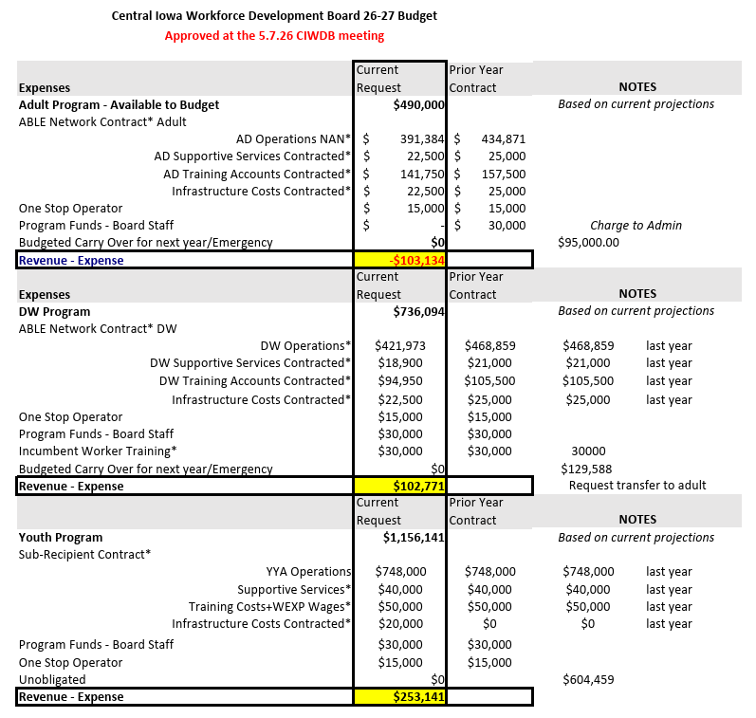

Slide 27
CIWDB FY 2027 Program Budget Transfer Request
Based on the anticipated funding availability and costs for FY 2027, the Adult program will be negative $103,134. The CIWDB is proposing to request a transfer of $102,711 from the Dislocated Worker program to cover the negative balance. If approved, the transfer request would be forwarded on IWD and the DOL

Slide 28
Board of Directors Meeting Agenda
Call to Order
VOTE: Approval of Agenda
VOTE: Approval of Meeting Minutes
REPORT and VOTE: Financial Statements
REPORT and VOTE: FY 2027 Budget
REPORT and VOTE: Executive Director Review
REPORT: COG Designation Update
REPORT: MIPA Year in Review
Other Non-Action Items of Interest to the Committee
Next Meeting Date
Adjournment

Slide 29
May 18, 2026 AGENDA
Call to Order
VOTE: Approval of Agenda
REPROT and VOTE: Approval of Meeting Minutes
REPORT and VOTE: Financial Statements
REPORT and VOTE: Invoices and Contracts
REPORT and VOTE: FY 2026 Budget Amendment #3
REPORT and VOTE: FY 2027 Budget
REPORT and VOTE: Executive Director Review
REPORT and VOTE: FY 2026 – FY 2028 Audit RFP
REPORT and VOTE: CIWDB Title I Youth Provider Procurement
REPORT and VOTE: CIWDB FY 2027 Budget
REPORT and VOTE: CIWDB FY 2027 Program Budget Transfer Request
REPORT and VOTE: Board of Directors Meeting Agenda
Other Non-Action Items of Interest to the Committee
Next Meeting Date – Last week of June
Adjournment

